Slide 1

Advances in wind wave modeling
1944 - Presidents Day Storm 1979 – now
Focus on history and technological advances.
Hendrik L. Tolman
Acting Director, Environmental Modeling Center
Chief, Marine Modeling and Analysis Branch
NOAA / NWS / NCEP / EMC
Hendrik.Tolman@NOAA.gov

Slide 2
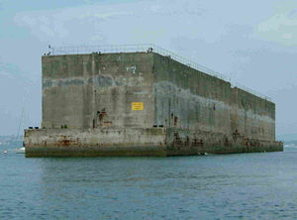
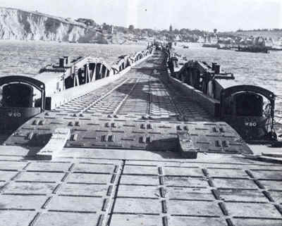
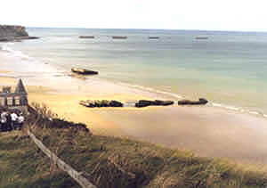
The start
Generally, predictions of wave conditions for D-Day (June 1944) are considered the first attempt at operational wave forecasting.
  Mulberry harbors of Gold Beach June 1944.

Slide 3
History
History of NCEP/EMC (and predecessors) guidance:
  1956: Single a wave height and period based on present and recent local winds.
  1968: The system was expanded to estimate a single wind seas and a single swell (H_{s}, T_{p}).
  1985: First operational spectral wave model.
  1994: First third-generation spectral model (WAM).
  1993: WAVEWATCH III model development starts.
  1999: First WAVEWATCH III implementation.
    Swell prediction.
  2007: Multi-grid modeling.
  2012: Nearshore Wave Prediction System.

Slide 4
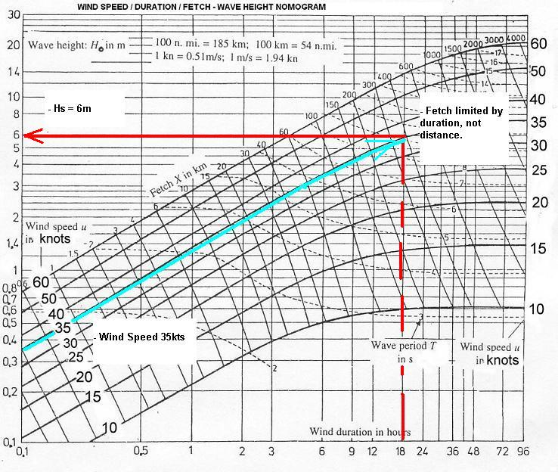
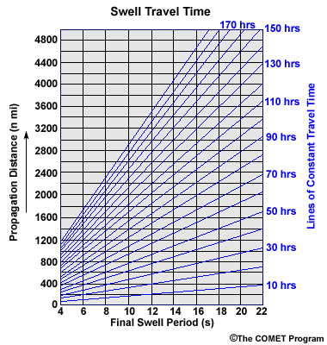
Nomogram Era, before 1985
Groen and Dorrestein (1976)

Slide 5
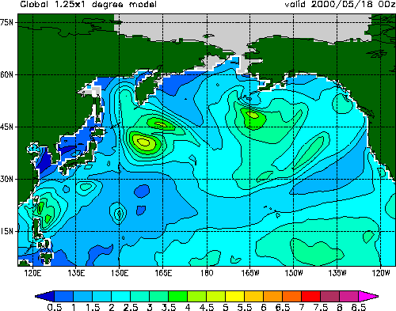
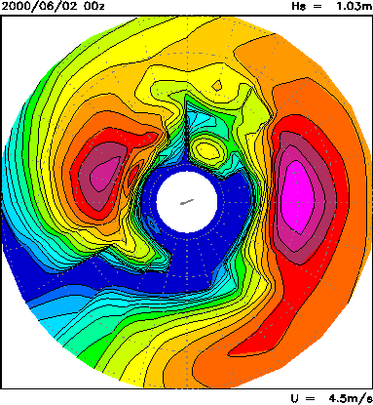
Spectral Era, 1956 literature, 1985 NCEP
significant wave height (m)
Spectral description
of wave field at
each grid point
With the introduction of the spectral models, the technology reached present day levels, but forecasters would only get mean parameters. Info in internal spectra was not available.

Slide 6
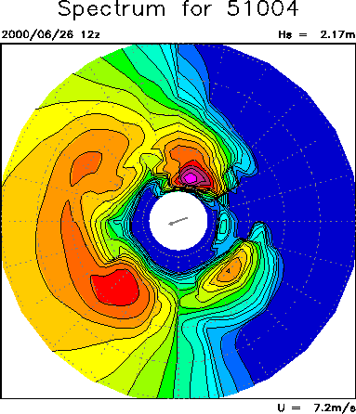
Spectral Era, WAVEWATCH III
First time we produced spectral information for forecasters:
From the original web page primer
The energy in the red box thus represents an individual wave field traveling in SE direction with a peak period of about 10s Because wave energy is concentrated in frequency and direction this corresponds to a fairly regular, well organized wave field.
The energy in the blue box travels in SW direction at lower periods, and is more chaotic as energy is distributed over a wider range in directions and frequencies.

Slide 7
Spectral Era, WAVEWATCH III
First time we produced spectral information for forecasters:
From the original web page primer
The spectral plots from the wave model mostly give qualitative information. The corresponding quantitative information can be found in the bulletins.
A piece of such a bulletin is presented below. The first column gives date and hour, the second the overall wave height and number of identified individual wave fields. The next six columns (only two shown here) identify wave fields by height, period and direction.
Location : 51004 (17.40N 152.50W)
Model : NWW3 global 1x1.25 degr.
Cycle : 20000626 t00z
+-------+-----------+-----------------+-----------------+
| day & | Hst n x | Hs Tp dir | Hs Tp dir |
| hour | (m) - - | (m) (s) (d) | (m) (s) (d) |
+-------+-----------+-----------------+-----------------+
| 25 12 | 1.9 7 | 1.0 17.5 19 | 1.0 7.0 292 |
| 25 13 | 1.9 7 | 1.0 17.6 19 | 1.0 7.0 292 |
| 25 14 | 1.9 6 | 1.1 17.6 19 | 0.9 7.1 292 |

Slide 8
Spectral Era, WAVEWATCH III
First time we produced spectral information for forecasters:
From the original web page primer
The info in the spectral plots and the bulletins can be combined as follows (H_{s} is significant wave height, T_{p} is peak or dominant period)
H_{s} = 0.7m, T_{p} = 6.6s
H_{s} = 1.4m, T_{p} = 15.9s
H_{s} = 1.4m, T_{p} = 7.0s
H_{s} = 0.3m, T_{p} = 9.9s
| 26 12 | 2.2 4 | 1.4 15.9 16 | 0.7 6.6 306 | 1.4 7.0 239 | 0.3 9.9 136 |

Slide 9
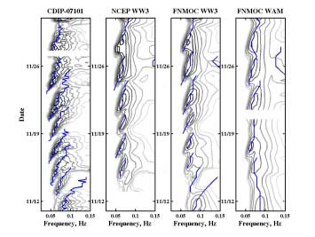
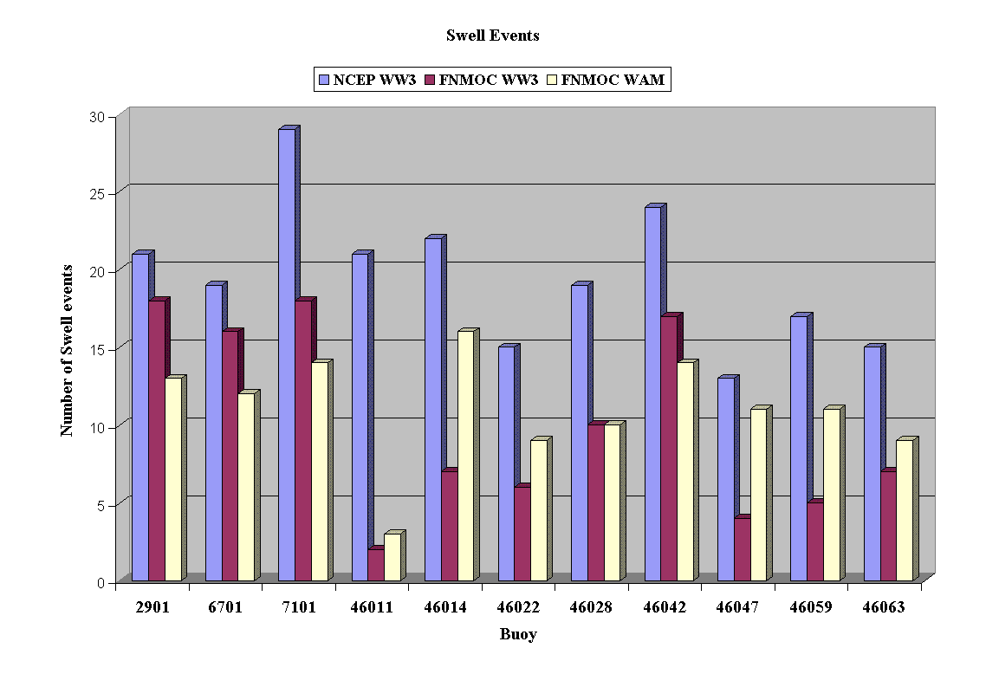
Spectral Era, WAVEWATCH III
Joe Sienkiewicz, ca 1999: “This is the first model that we can actually use for swell prediction”
Wingeart et al., 2001, swell system detection.

Slide 10
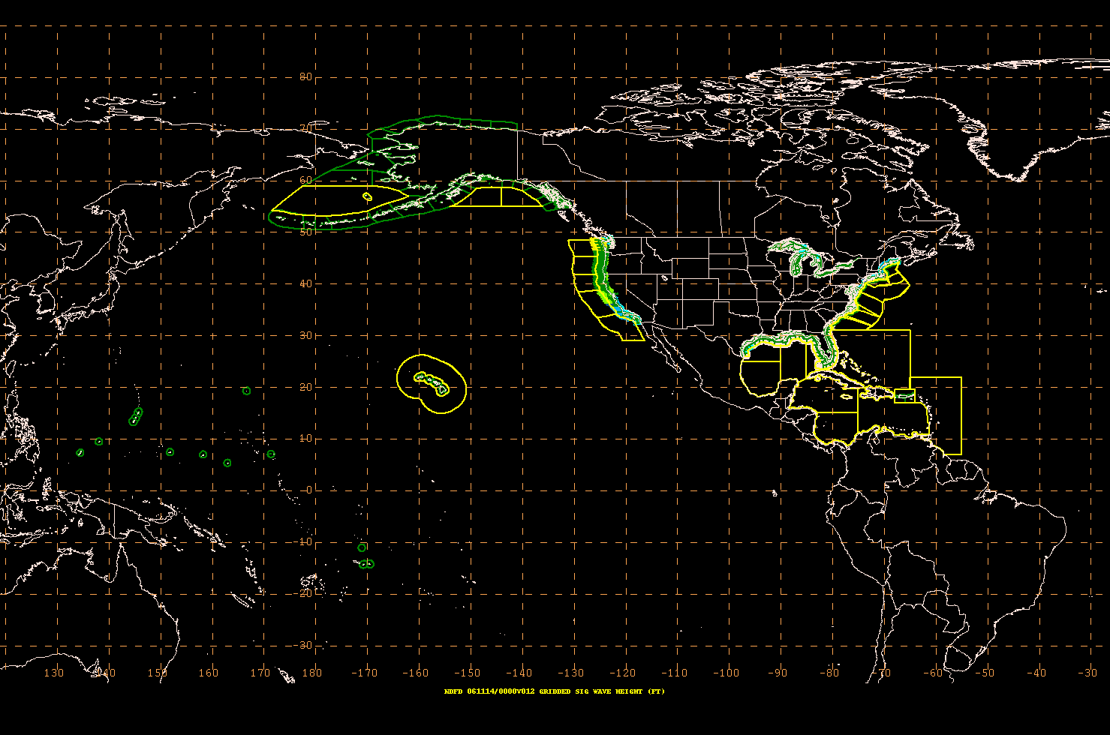
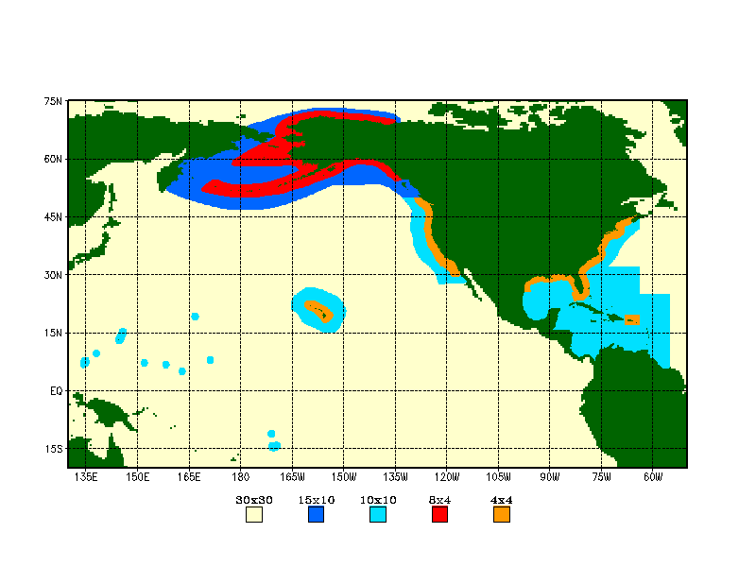
Multi-grid technology (2007)
Introducing two-way nested grid technology to better serve needs of the OPC / NHC and WFO forecasters.
OPC / NDFD areas / grids
Available resolution in NCEP multi-grid model (minutes).

Slide 11
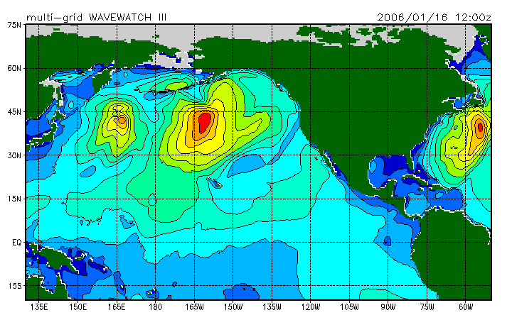
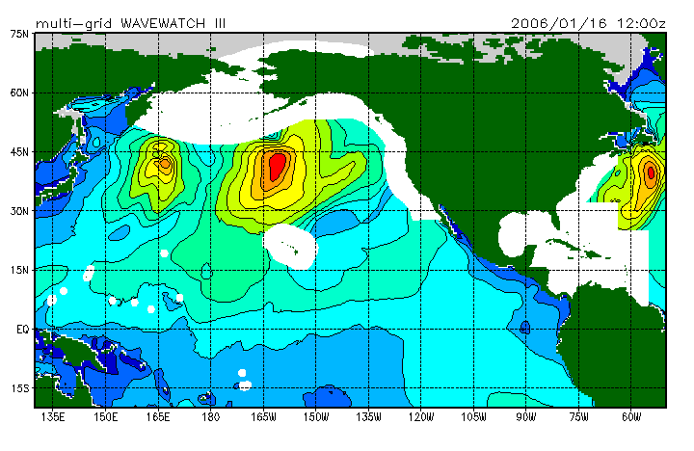

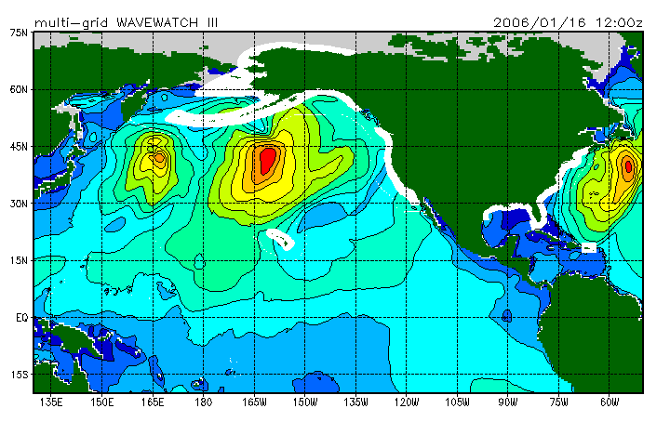
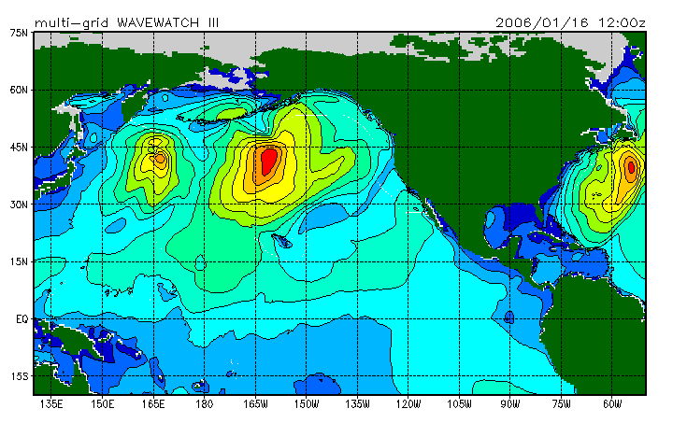
Multi-grid technology (2007)
Example of consistency between grids

Slide 12
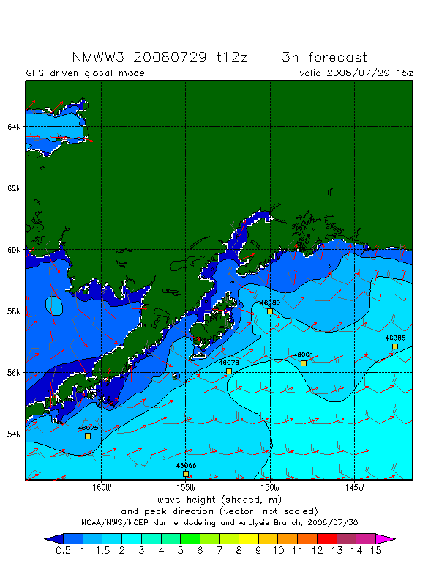
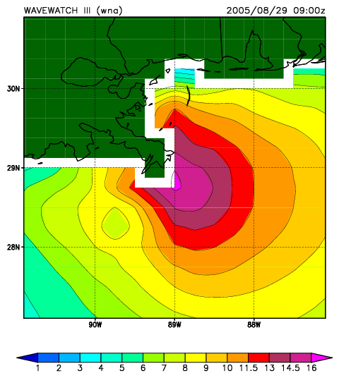
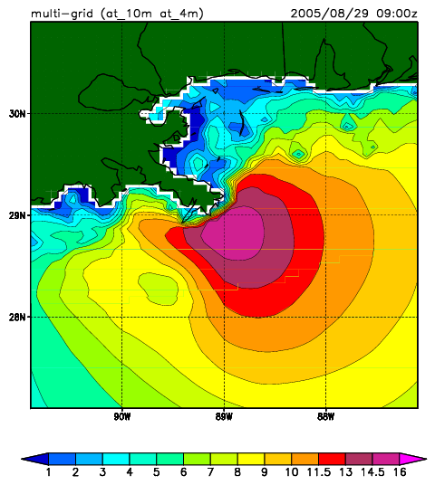
Multi-grid technology (2007)
Examples of increased resolution and shallow physics

Slide 13
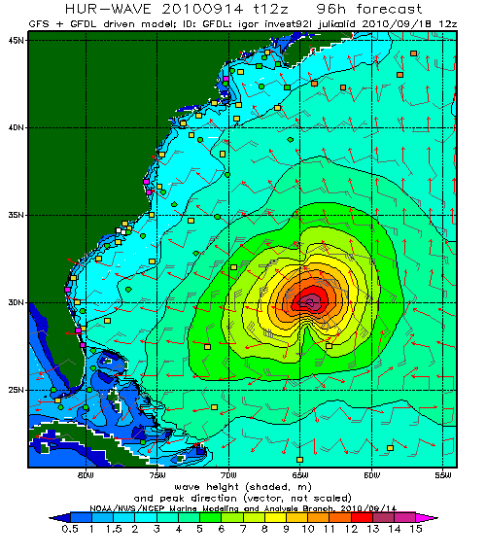
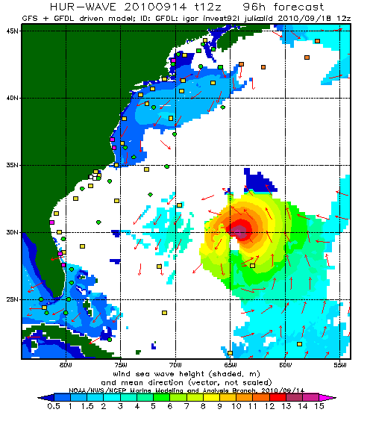
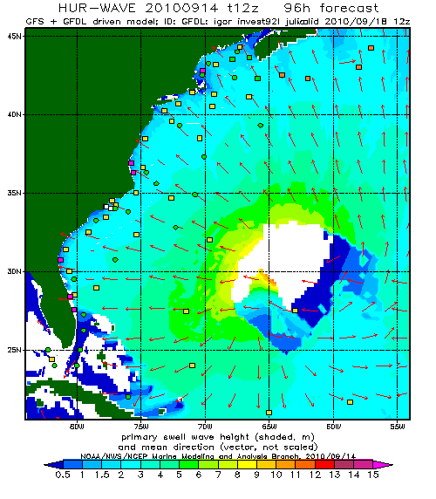
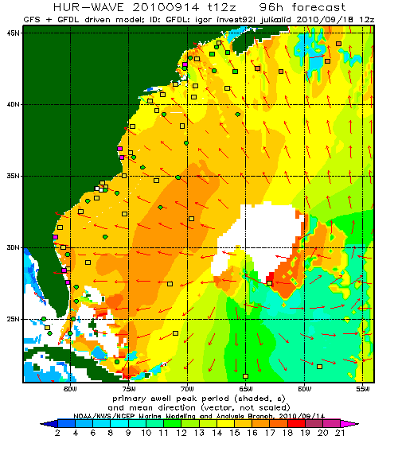
Multi-grid technology (2010)
Igor in the multi-grid hurricane wave model:
  7.5km coastal resolution.
  Shallow water physics.
  Note shadow zones behind Bahamas and Bermuda (!).
  Wave system based wind sea and swell separation (from USACE)
  Garden Sprinkler Effect will be more prevalent for hurricanes than for larger scale wave systems.
    Subject of more research to solve rather than alleviate GSE.

Slide 14
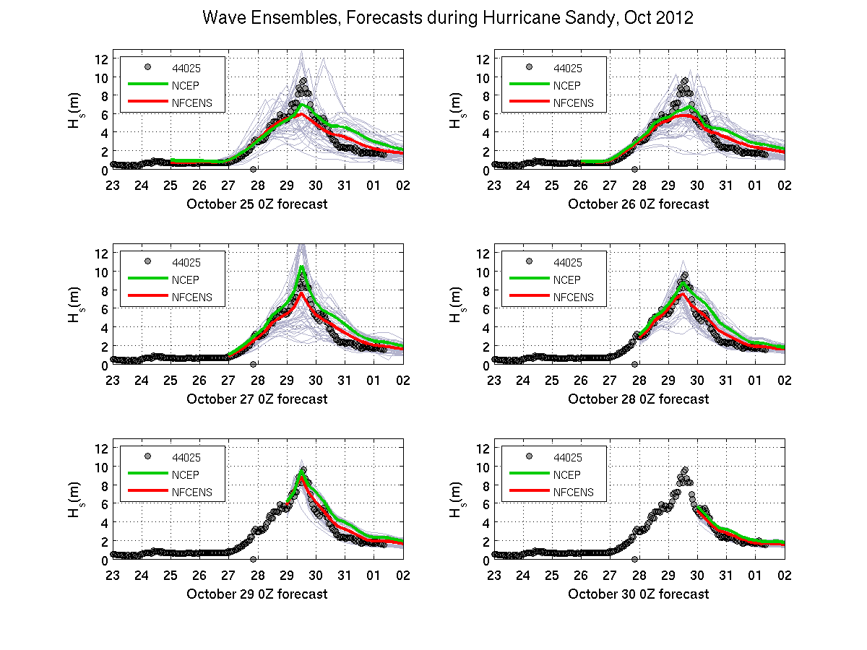
Ensembles: Sandy
120h
96h
72h
48h
24h
0h
Notes:
Time series of Significant Wave height (in m) as a function of time. The time stamp in the x-label of each sub plot shows the nowcast time for the simulation run. Data are shown as gray circles. The NCEP wave ensemble mean is in green, the combine NCEP/FNMOC ensemble mean is in red, individual ensemble members from both NCEP and FNMOC are shown in light gray.

Slide 15
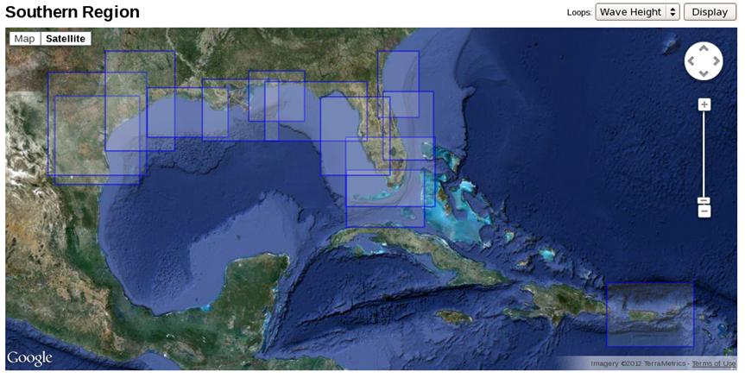
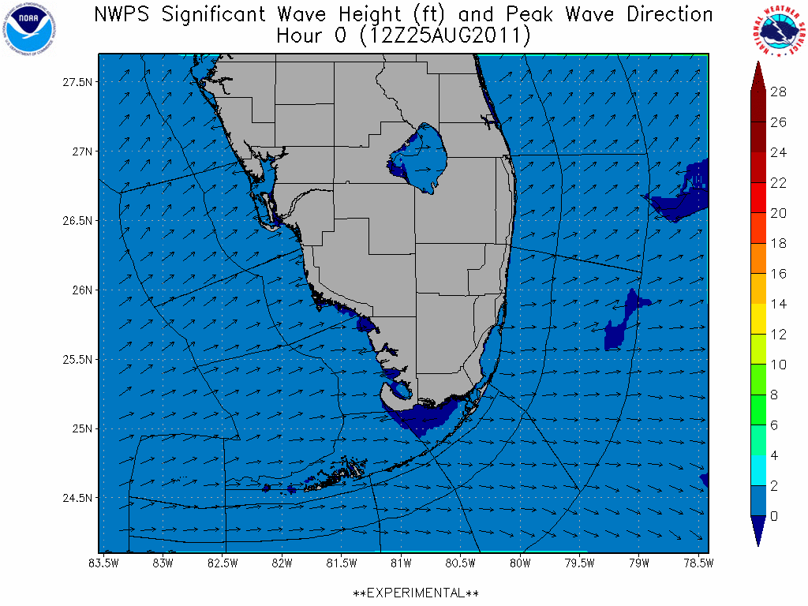
20now: Nearshore Wave Prediction System
WFO MFL
Alpha testing at all SR WFOs, NHC/TAFB, select WC and EC WFOs
1 arc-min grid, nesting down to 500 m
90 h forecast, 3 hourly

Slide 16
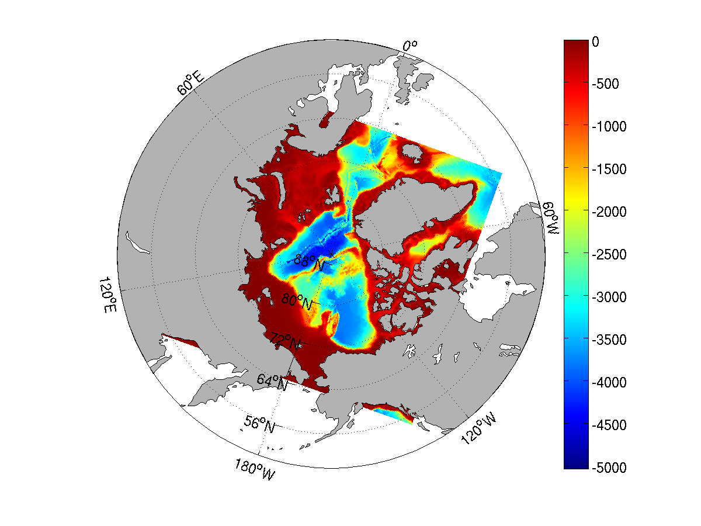
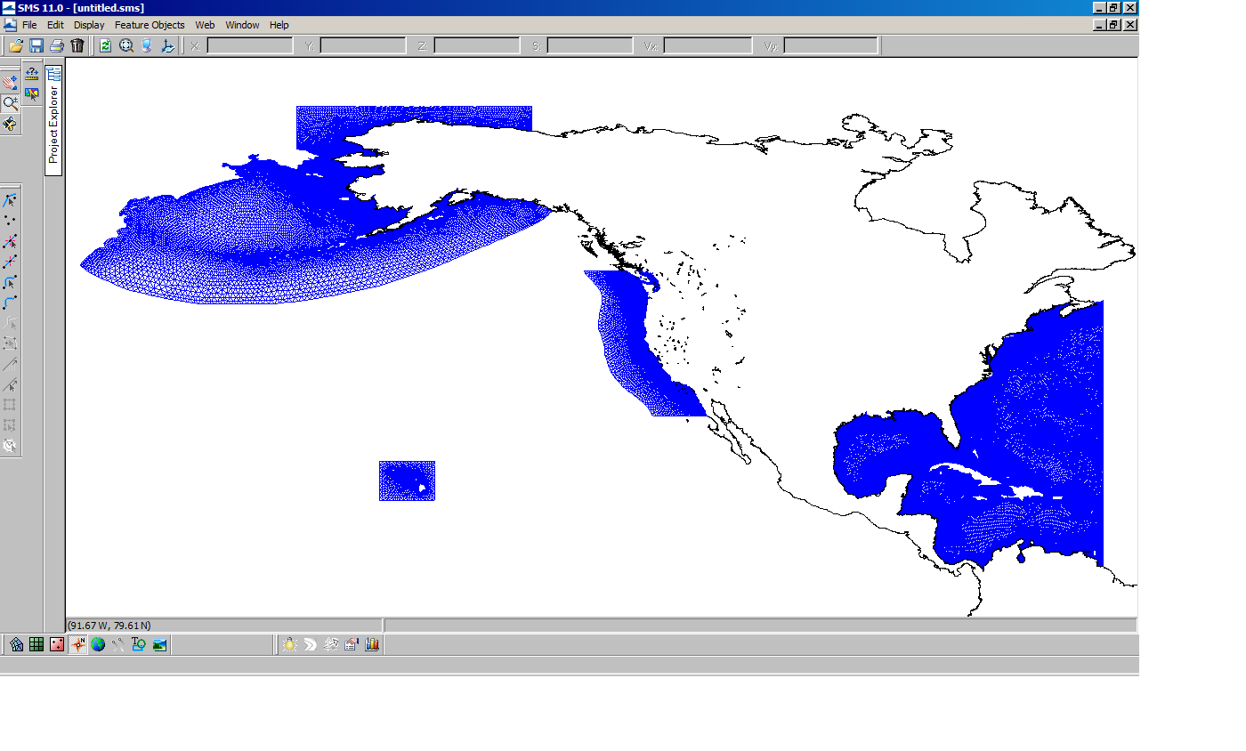
Near Future: global system
Curvilinear Arctic grid to replace regular Arctic grid
Resolution: 4 arc-min (coastal) and 10 arc-min (regional) grids
Resolution: 0.25 deg (offshore) to ~2 km (nearshore)
Replaces 4 and 10 arc-min regular grids

Slide 17
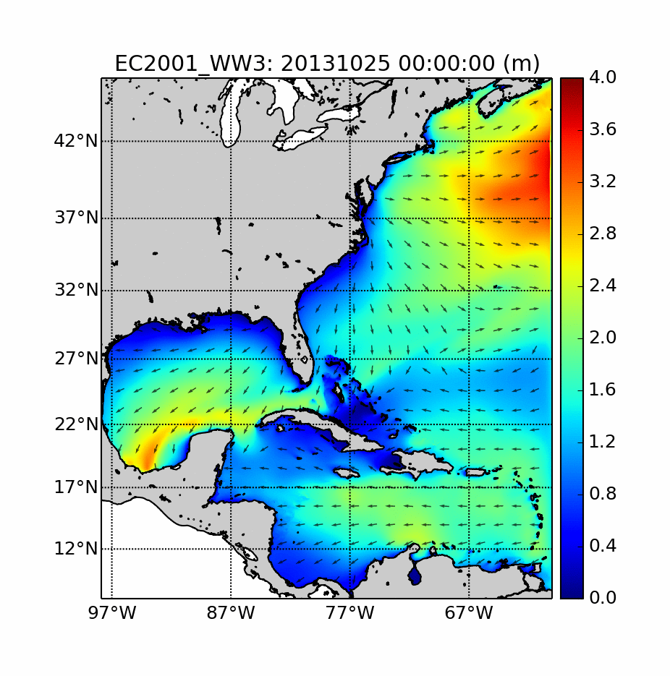
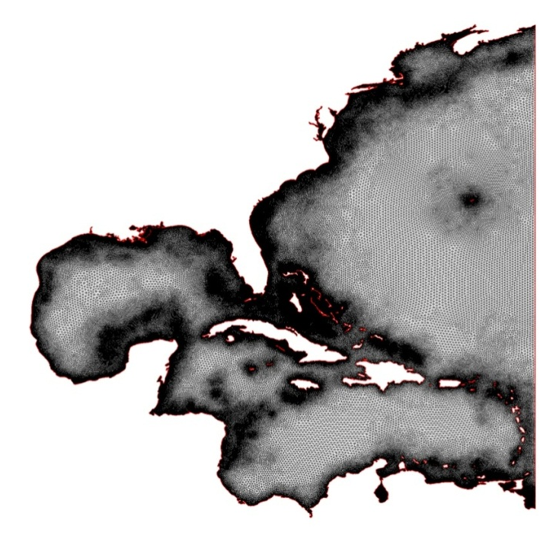
Near Future: unstructured grids
EC2001 mesh
Going to unstructured grids for the coast:
Jump from 7.5km → 2km resolution on the coast.
Coupling to “storm” surge ……

Slide 18
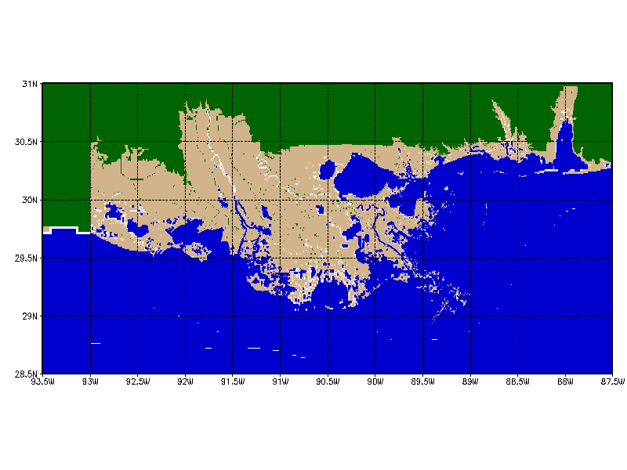
Future: coupling
Hurricane Gustav example of coupling wave and surge:
Where the water meets the people …..

Slide 19
Thank you !

