Slide 1
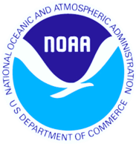
Extratropical Cyclones…
Perspective from the Ocean Prediction Center
Outline
OPC overview
Mentors
Production progression
Light tables to integrated workstations
Marine weather and global shipping
Forecast and observational capabilities
Sea Truth
Challenges
Joe Sienkiewicz, Chief, Ocean Applications Branch

Slide 2
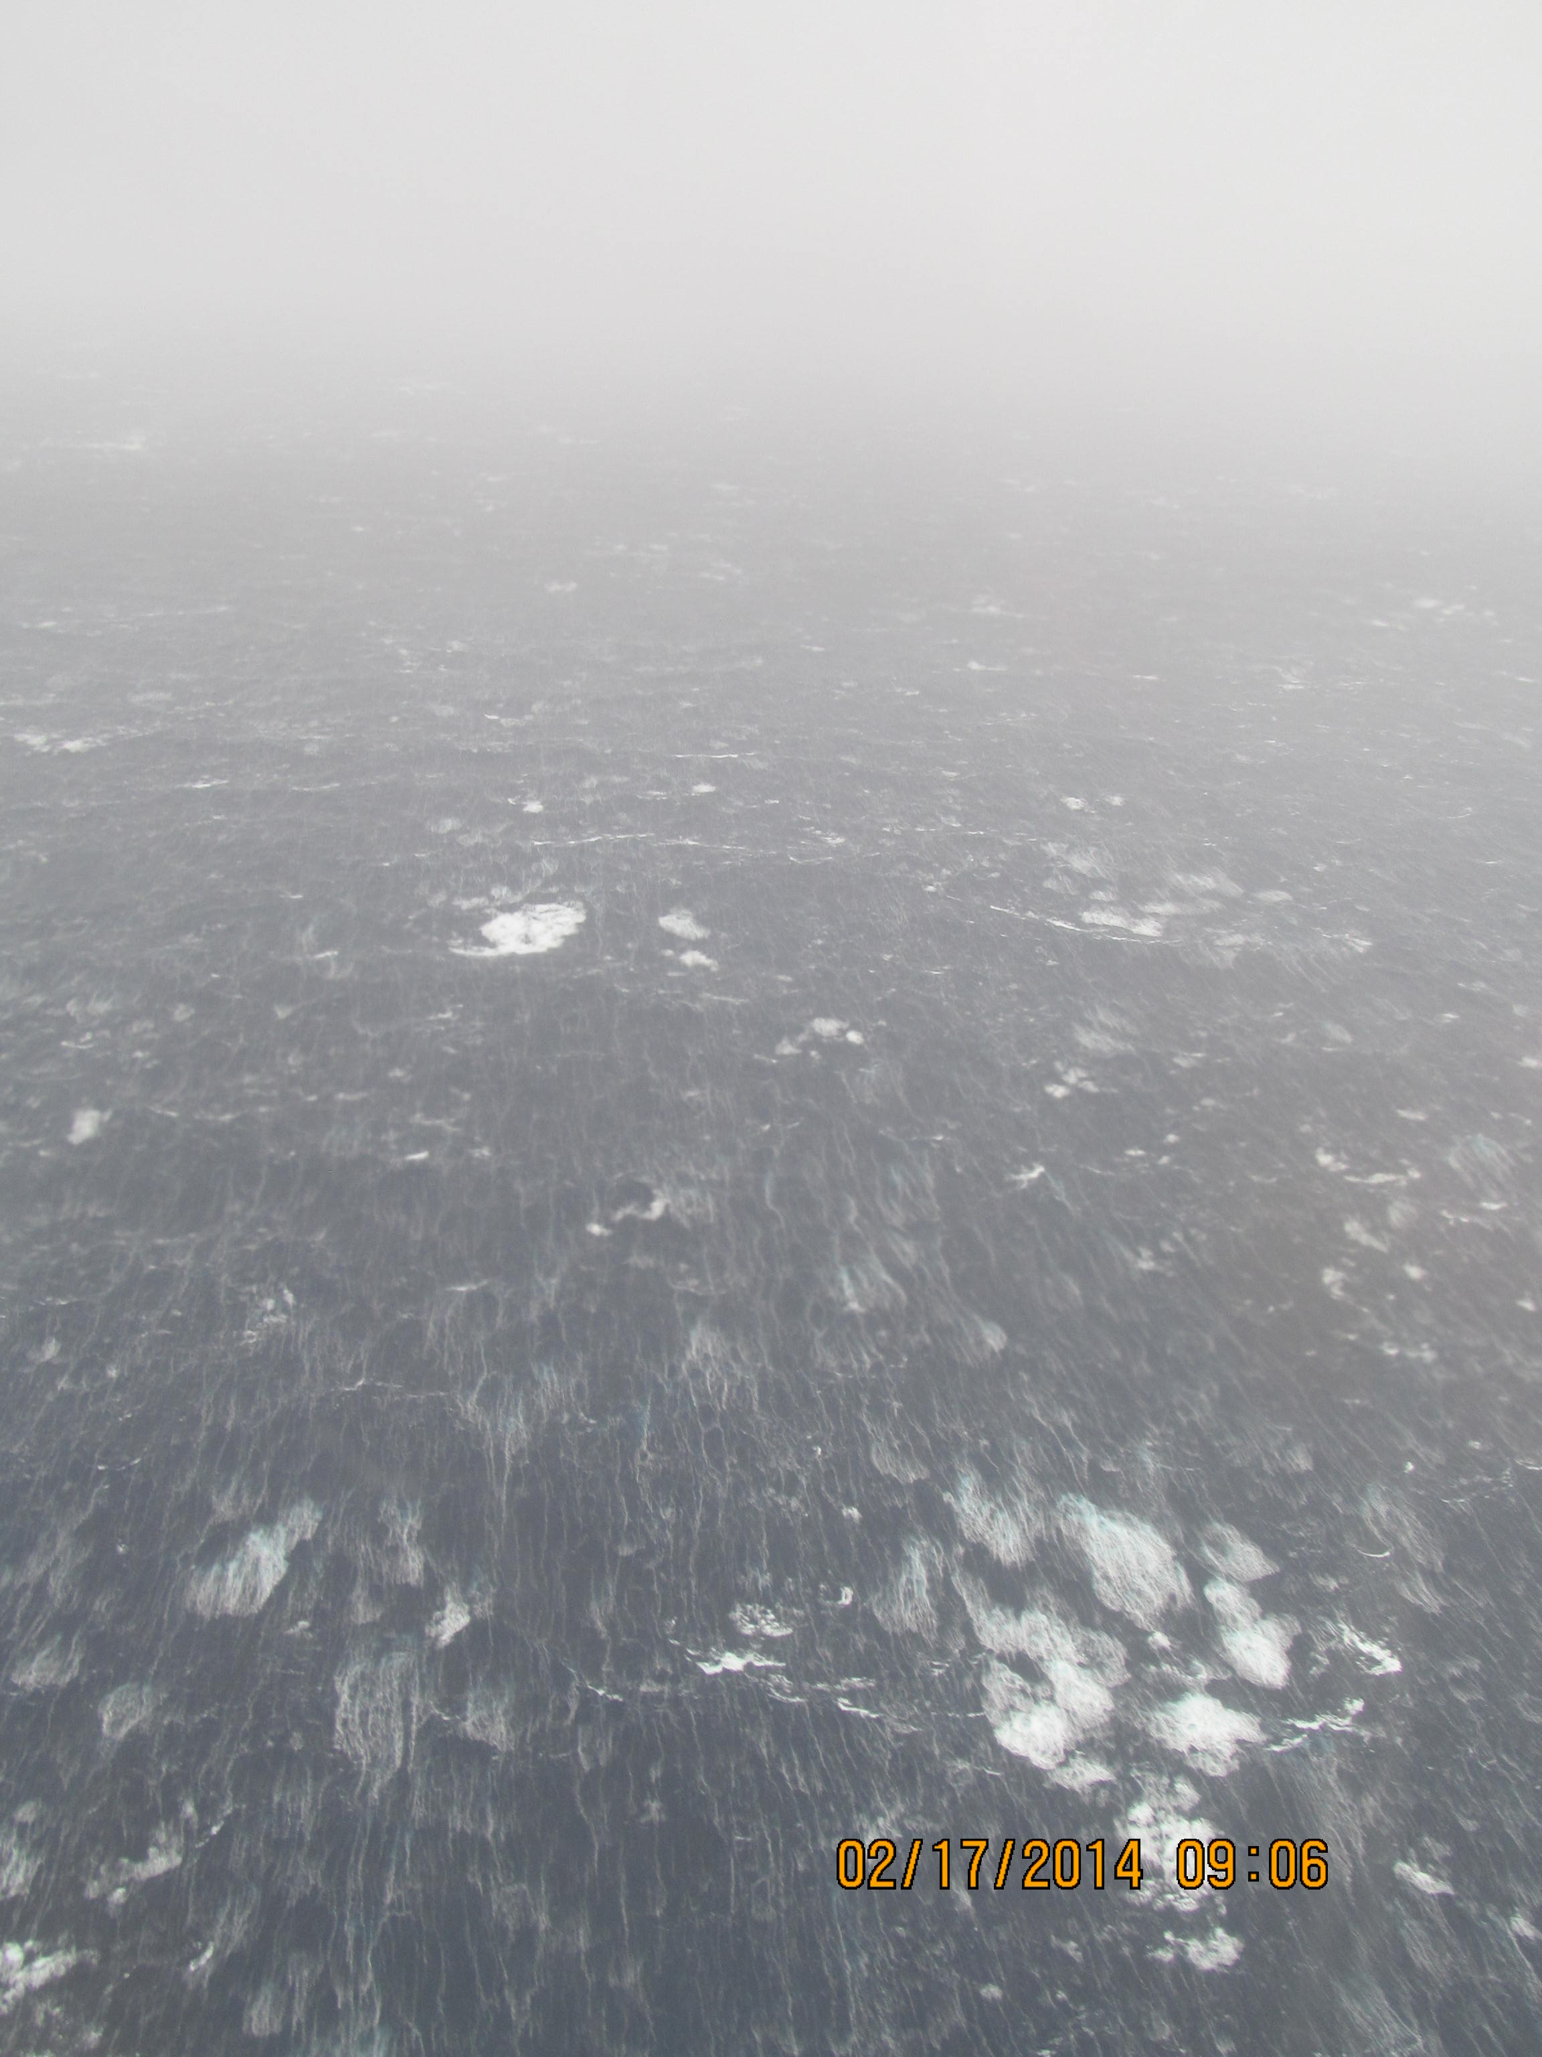
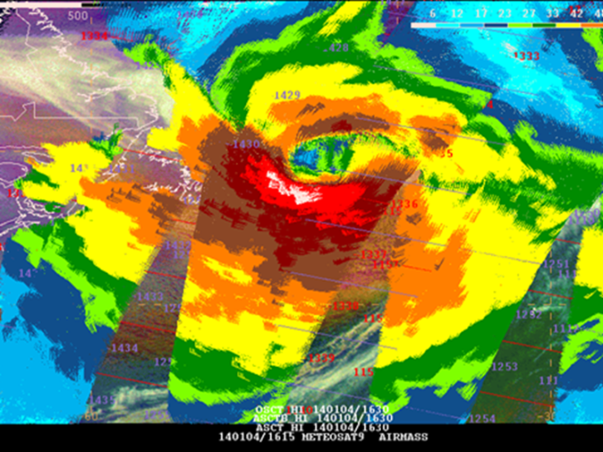
Ocean Prediction Center
Core Mission: Protection of Life and Property at Sea
Fulfills U.S. responsibility to Safety of Life At Sea Convention (SOLAS) with
NHC, WFO HFO, Alaska WFOs
Focus areas:
Marine Weather
Warning Bulletins
Graphical and Gridded Products
Operational Oceanography
Coastal Guidance
Storm Surge
Marine Weather
Enabling Ecological Prediction
75
K
N
O
T
S
An extreme ocean storm, 4 January 2014
Hurricane Force winds (red 64-75 kt, white >75 kt) as retrieved from the European ASCAT-A and B scatterometers on the MetOp satellites.
Joe Sienkiewicz
Chief, Ocean Applications Branch
Notes:
Along with NHC, Honolulu Forecast Office, and the three WFOs in Alaska, the OPC fulfills the U.S. responsibility to the International Safety At Life At Sea Convention (SOLAS). The first SOLAS was convened to improve safety after the sinking of the Titanic. Marine weather is the core focus being a 24 hour operation, 7 days a week. The OPC works within NWS and other NOAA offices and International partners to access and utilize data sets that enhance situational awareness over the oceans. Scatterometer derived ocean vector winds from satellites are a prime example… the image on the right is from the ASCAT-A and B scatterometers on the European Metop-A and B satellites over an extreme extratropical cyclone over the North Atlantic in early January 2014. The wind field is massive (winds are color coded per the scale on the left and yellow or greater requires a warning) In comparing the storm with the land mass of Newfoundland gives an idea as to how massive this cyclone was. The most severe conditions were avoided by shipping due to accurate forecasts days in advance of this storm.
The background image was from the 17th of Feb 2014 over the Labrador Sea on the cold side of the storm of 15 and 16 Feb for Nova Scotia and 15 Feb for New England. Winds were approximately 60 knots with seas in the 20 to 25 ft range.
As part of the marine weather focus the OPC is working with NWS and NOAA partners along with Environment Canada to improve prediction capabilities in the Arctic.
The OPC also has three additional focus areas:
Operational Oceanography – as an ocean focused center the OPC interacts with scientists developing and improving ocean models and analyses and provides feedback concerning performance and utility. The OPC web site hosts a variety of oceanographic as well as meteorological products.
Coastal Guidance - forecast area for the OPC covers an immense area – OPC forecasters are used to dealing with ocean storms and have a global perspective. The OPC through NWS chat and Marine Information Messages provides information to coastal WFOs concerning the possible threats and warnings for upcoming coastal weather events. During Sandy, OPC staff worked directly with NHC Storm Surge Unit and coastal WFOs to highlight the potential threats.
Enabling ecological prediction – NWS has a culture of timely service and operations – OPC is working with NOAA partners to bring ecological parameters into NOAA operations. Examples of this are sea nettle prediction for Chesapeake Bay, pathogen prediction for Chesapeake Bay, Delaware Bay, and Tampa Bay. The OPC is also working with NOS Harmful Algal Bloom staff to explore utilization of AWIPS II for use in future HAB prediction.

Slide 3
Mentors
Prof. Peter V. Hobbs
Robert W. Gove
Notes:
Prof. Hobbs invited me to join the UW Cloud and Aerosol Research Group. The invitation and the opportunities that created are a large part of who I am today. I learned from Peter the rigor to be a scientist, to carefully articulate and present my results, and to have the discipline to adhere to basic principals.
Bobby Gove roomed next to me my freshman year at NY Maritime. As future deck officers, Bobby was the kind of guy we all aspired to be. He was killed on or about the 25th of October 1980 when his ship the Poet disappeared after departing the Delaware Capes headed for Egypt. Bobby was a great guy and his death has inspired me to be the best marine meteorologist that I can be.

Slide 4
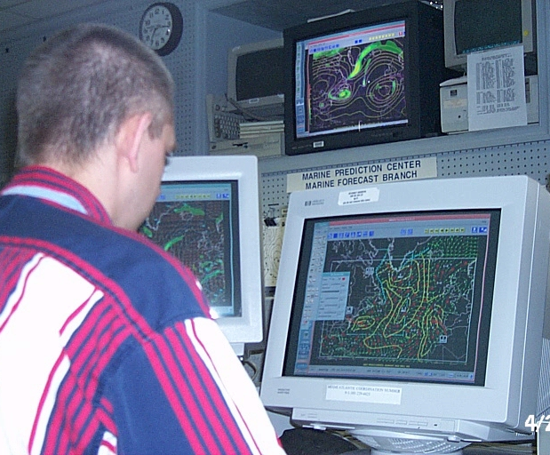
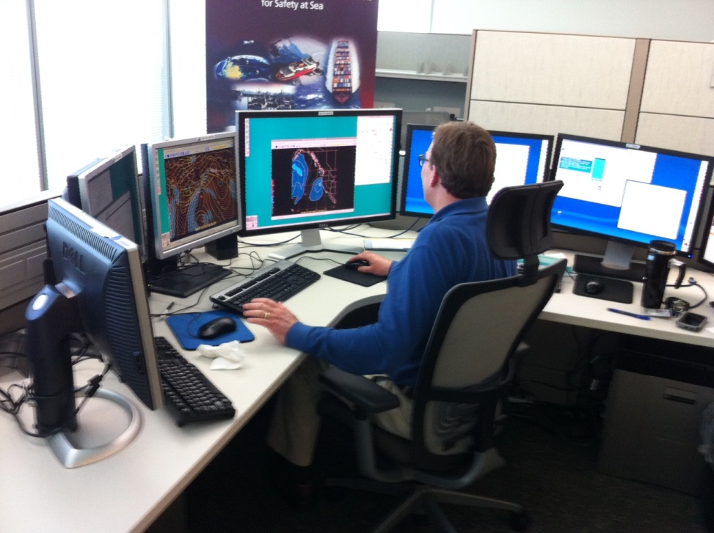
Progress
1996
2003
2014
Notes:
A look at 1993…
All graphical analyses and forecasts were produced on paper (drawn by hand), scanned on a flatbed scanner into a store and forward computer and transmitted to ships at sea via United States Coast Guard radio stations.
This method was fairly inflexible for viewing observations and numerical model output. Observation plotting format was fixed and could not be changed rapidly. Also, observations were perused on a synoptic temporal scale (6 hourly). The number of numerical model fields that a forecaster could look at to make decisions was limited due to the shear volume that would be needed. Forecasters made forecasts based on model output at 12 hour intervals.

Slide 5
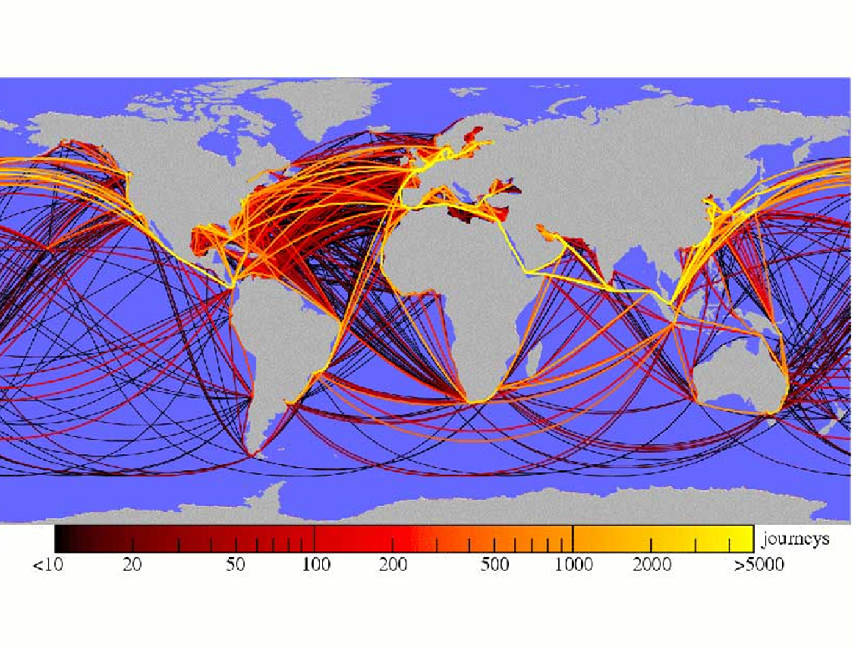
“90% of EVERYTHING”
by Rose George
“…the invisible industry…”
NWS
High Seas
OPC
OPC
NHC
TAFB
NHC
TAFB
HFO
Notes:
A recent book by Rose George describes the shipping industry as being invisible. The is 90% of everything meaning that by weight 90% of everything is moved by ships over the highways of the global ocean. This diagram shows the shipping routes and are color coded by the number of annual voyages. The trans-Atlantic and Pacific routes are very busy with frequent transits. The white lines depict the NWS High Seas areas of responsibility. Clearly, the NWS has responsibility for some of the busiest shipping routes in the world.

Slide 6
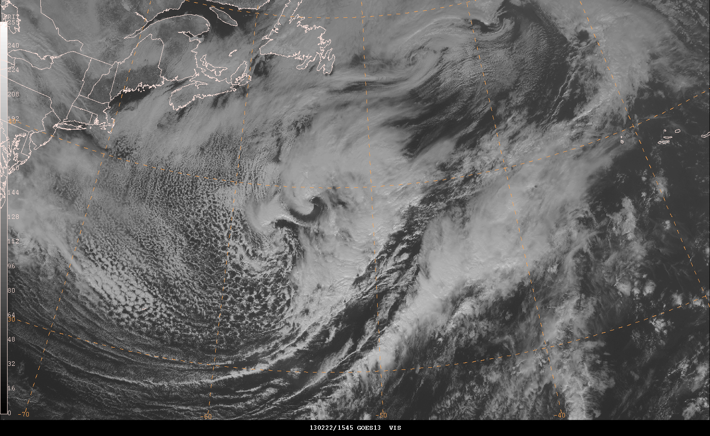
Feb 22, 2013

Slide 7
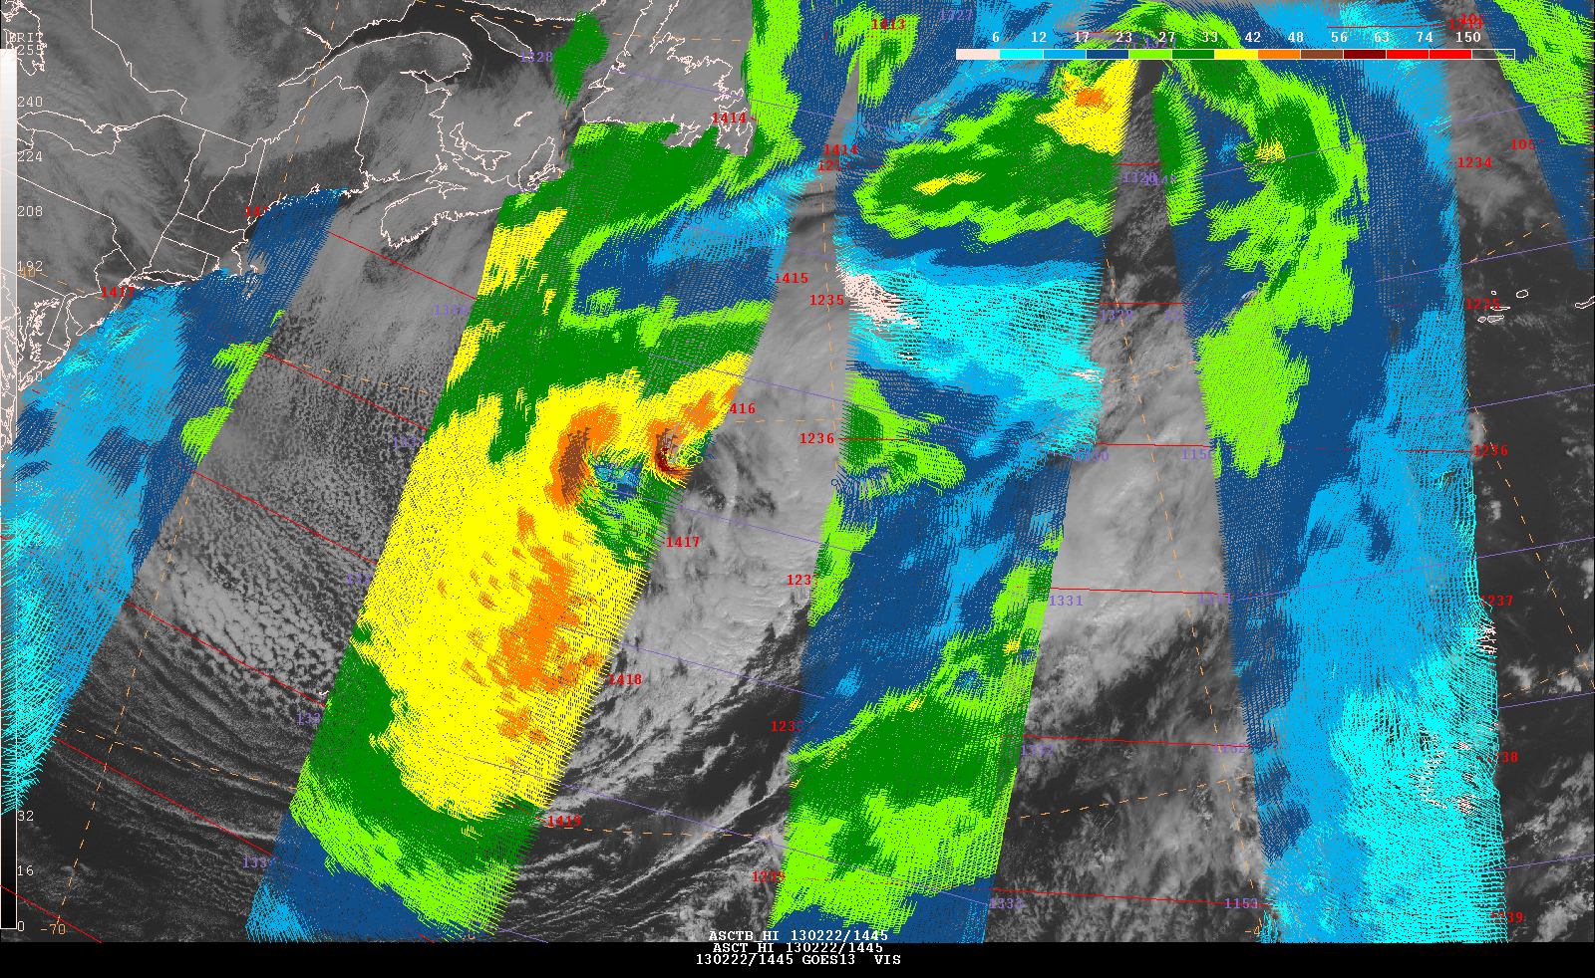
Feb 22, 2013

Slide 8
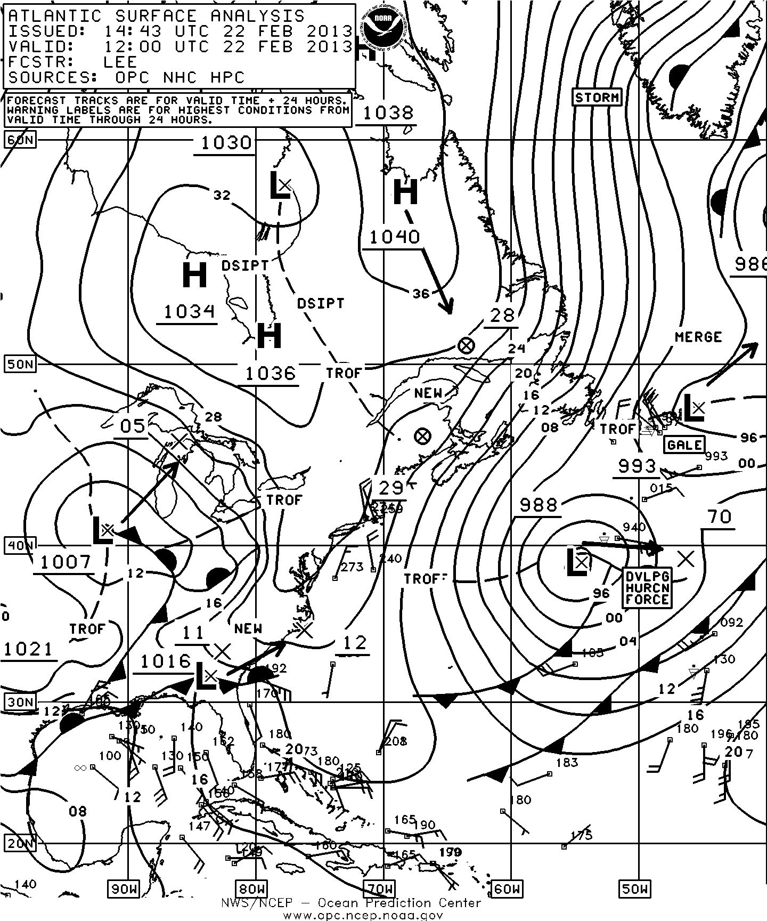
Feb 22, 2013
Analysis
96 hour Forecast

Slide 9
45 to
62 ft
>30 ft
45 to
55 ft
600 n mi
MSG RGB Airmass
CryoSat-2 and Altika Sig. Wave Heights (ft)
Jan 5, 2014

Slide 10
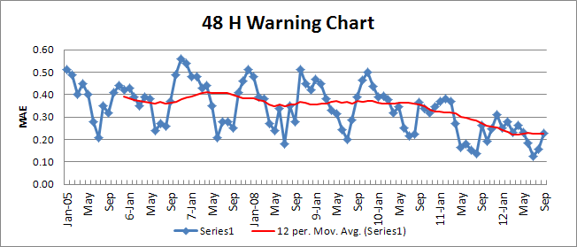
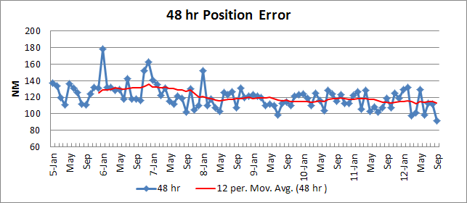
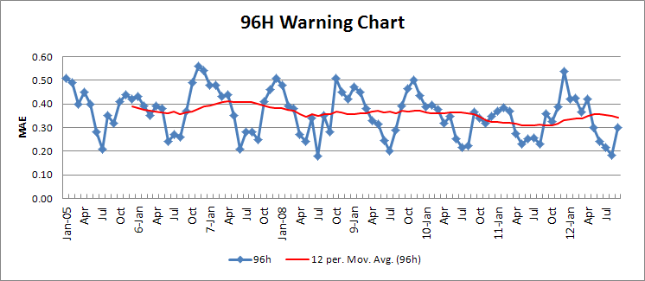
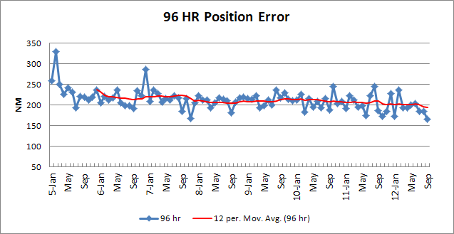
Performance (Cyclones) 2005 - 2012
Warnings – Mean Average Error (Categorical) Position Error (N MI)
48 h – trend is improving 48 h – 112 n mi (~ 28 n mi / 12 h)
96 h – slight improving trend 96 h – 215 n mi (~ 27 n mi / 12 h)

Slide 11
35 years of Improvements
Observations
Satellite ocean vector winds (scatterometers)
Focus on the extreme event
Satellite wave heights (altimeters)
NWP
Greatly improved predictive capabilities
No longer if - but when and how bad!!
Assimilation, resolution, physics
Focus on ocean waves
Availability of ensemble forecast systems

Slide 12
Challenges

Slide 13
Composites of
~ 500 wind fields Radials – 1000 km

Slide 15
Challenges
Marine weather not an area of emphasis
Maintaining and improving observations
Non-standard satellite instruments
Information = Products and Services
Training - Keeping knowledge relevant
Knowledge reflected into products and services
Consistency across areas of responsibility
Extension to probabilistic suite
Extension of forecast horizon

Slide 16
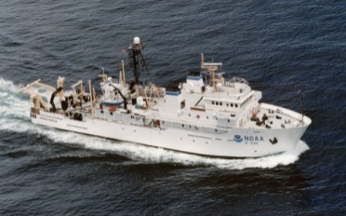
Surprise!!
NOAA Ship Gordon Gunter
SE of Nantucket
9 mb pres fall in 1 hr
Winds rapidly building to 60 kt with guists to 110 kt
Seas building to 30 ft with isolated 40 ft
Notes:
The NOAA Ship Gordon Gunter recently experienced how fast conditions can change at sea. Within less than an hour the ship recorded a 9 mb pressure decrease, drastic visibility decrease, and winds jumping from 30 to 60 knots, with gusts to 110 knots. The seas quickly responded, building from 10 feet to 25-30 feet. During the two hours the ship rode through the heaviest seas the crew noted several 40 foot waves before the sea subsided back to 15 foot seas with 30 knot winds several hours later.

