Slide 1
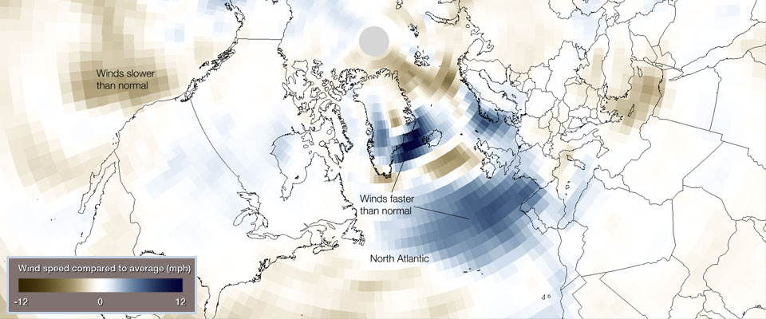
Cyclogenesis: Then (1979) and Now (2014)
http://oceanservice.noaa.gov/facts/bombogenesis.html
Sanders and Gyakum (1980)
Bosart (1981)

Slide 2
Authors
John R. Gyakum¹
Bryn Ronalds¹
Lance F. Bosart²
Shawn M. Milrad³
Eyad H. Atallah¹
Melissa Gervais¹
¹Department of Atmospheric and Oceanic Sciences, McGill University, Montreal, QC
²Department of Atmospheric and Environmental Sciences, University at Albany, NY
³Applied Aviation Sciences Department, Embry-Riddle Aeronautical University, Daytona Beach, FL

Slide 3
Pressure, potential temperature, and equivalent potential temperature time series at weather ship ‘D’ for 28-30 January 1972 (Stubbs 1975)
First cyclone’s maximum deepening of 2.6 bergerons!

Slide 4
Motivation:
The January 1972 surface cyclogenesis processes were associated with a regime change in the North Atlantic Basin
Sanders and Gyakum (1980) noted the clustering of explosive cyclogeneses during 11-17 February 1979
At the end of this clustering was the Presidents’ Day cyclone

Slide 5
Six-hourly SLP, 1000-500 hPa thickness, Dynamic Tropopause (2 PVU level) jet (>100 knots) for 28 Jan-3 Feb 1972
Dark Blue: 474-480 dam
Blue: 492-498 dam
Pink: 540-546 dam
Red: 558-564 dam

Slide 6
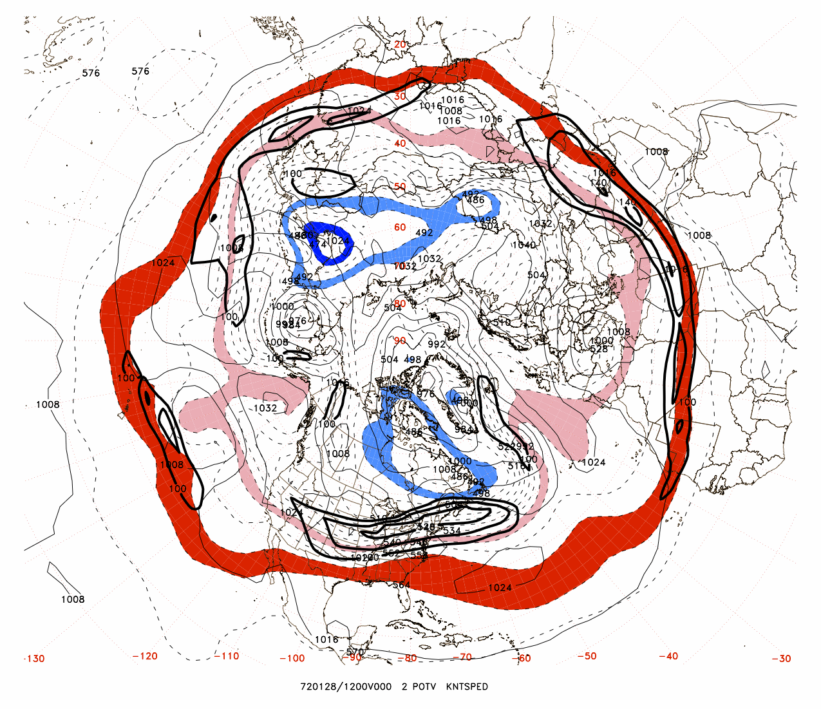

Slide 7
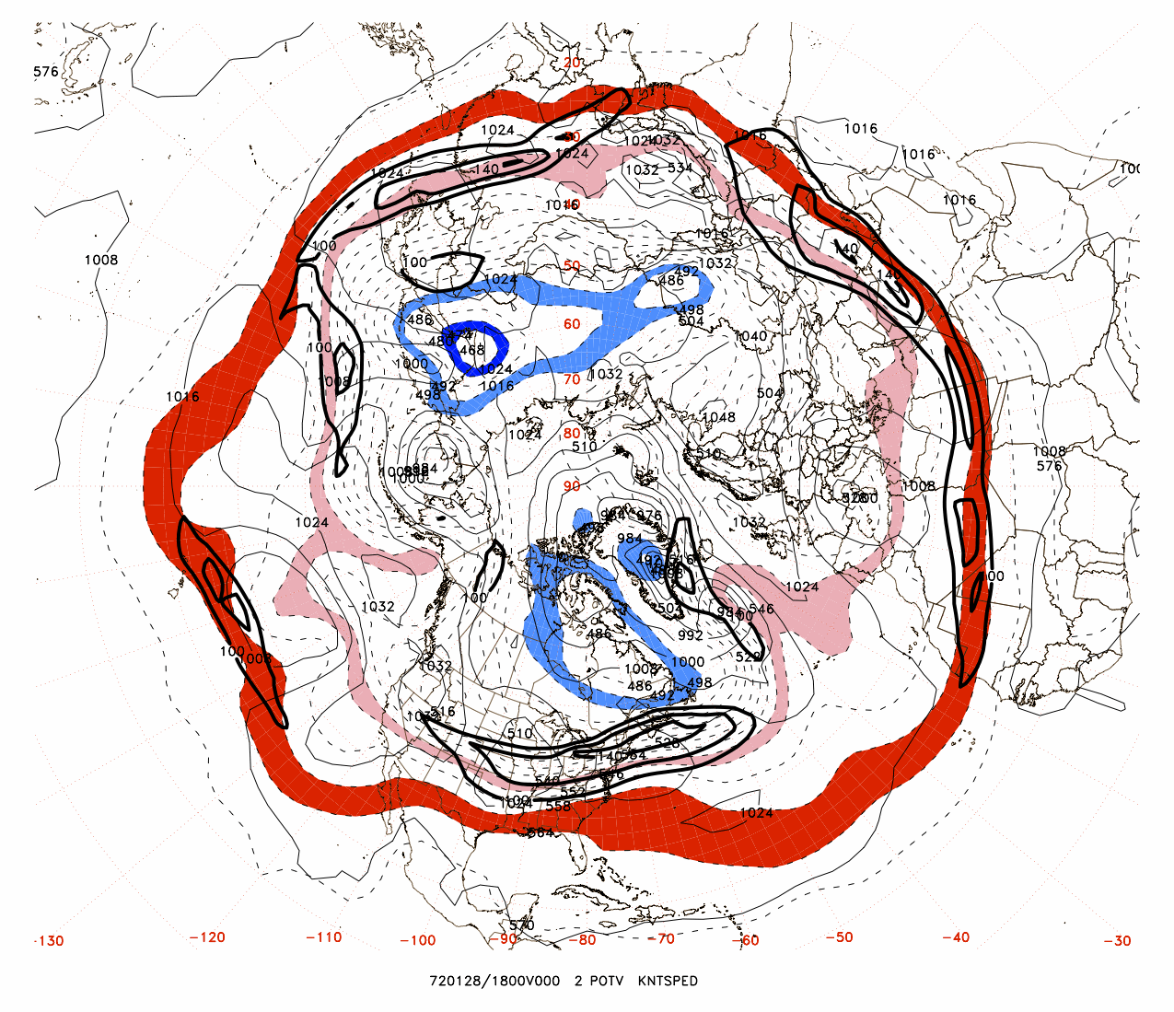

Slide 8
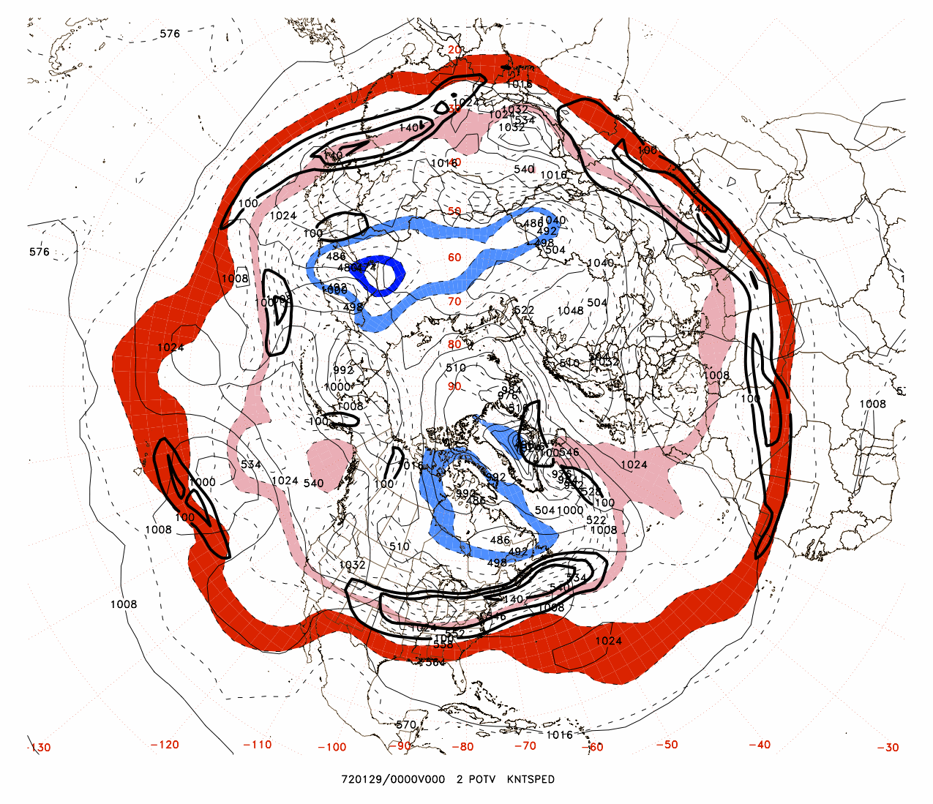

Slide 9
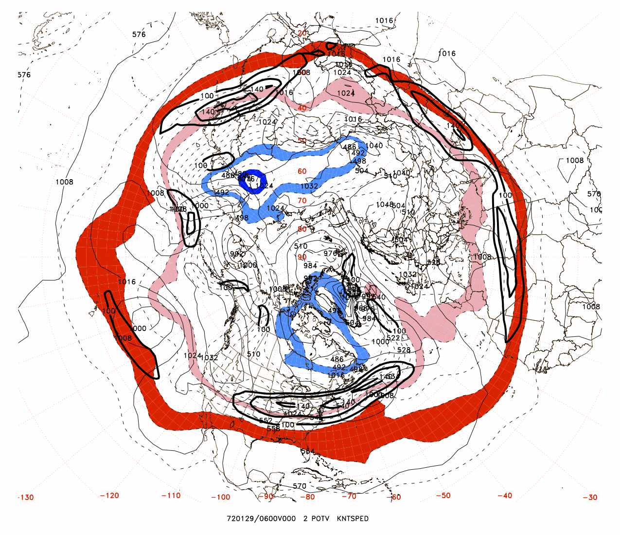

Slide 10
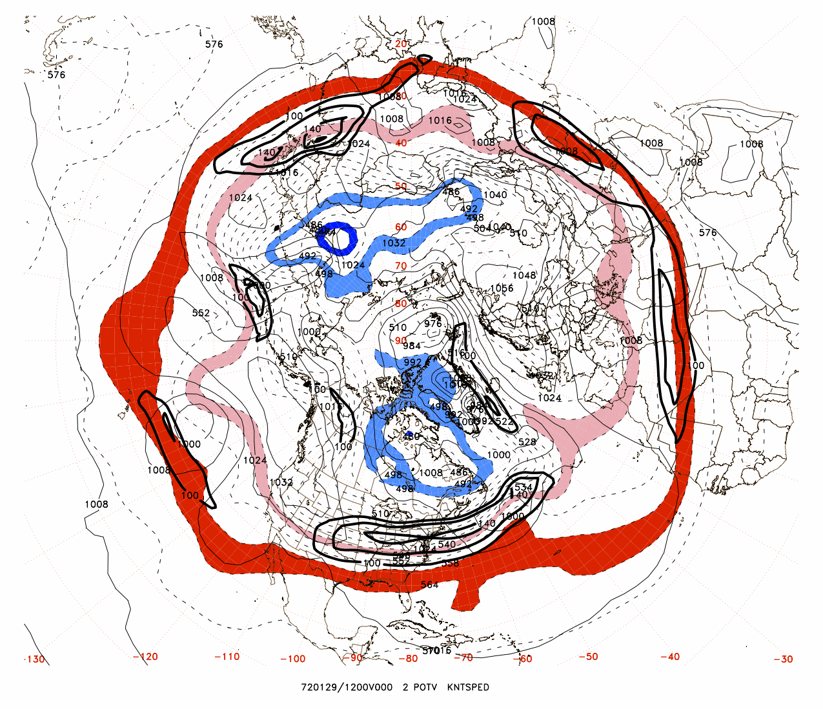

Slide 11
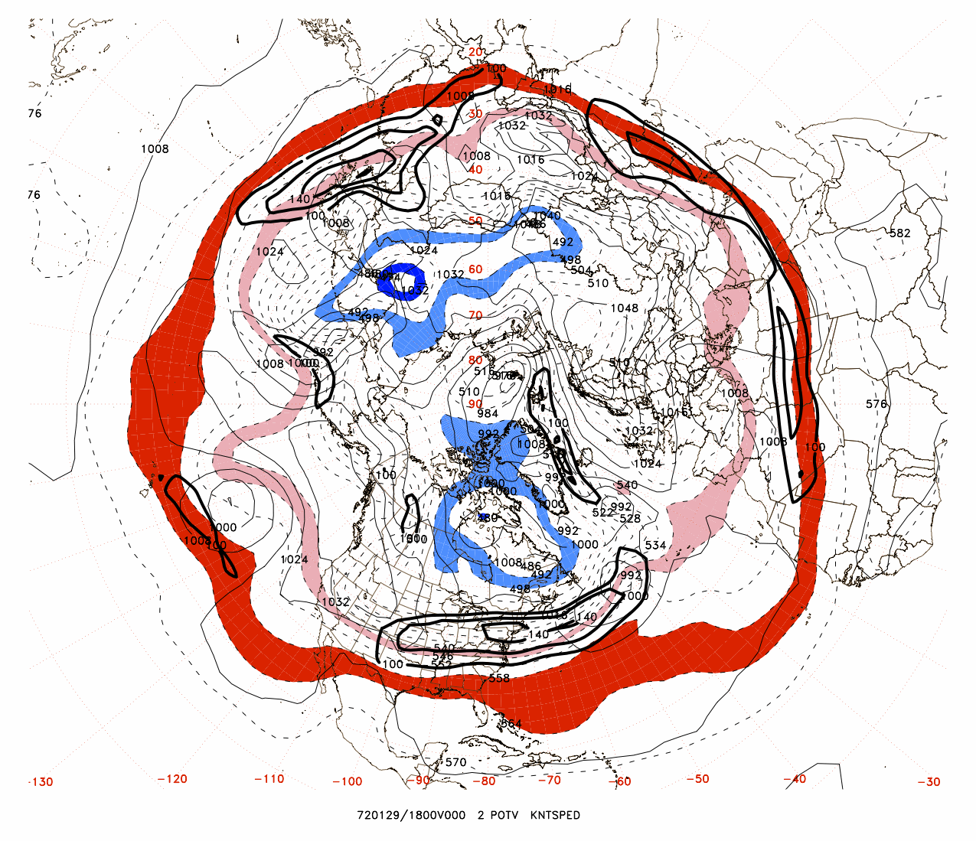

Slide 12
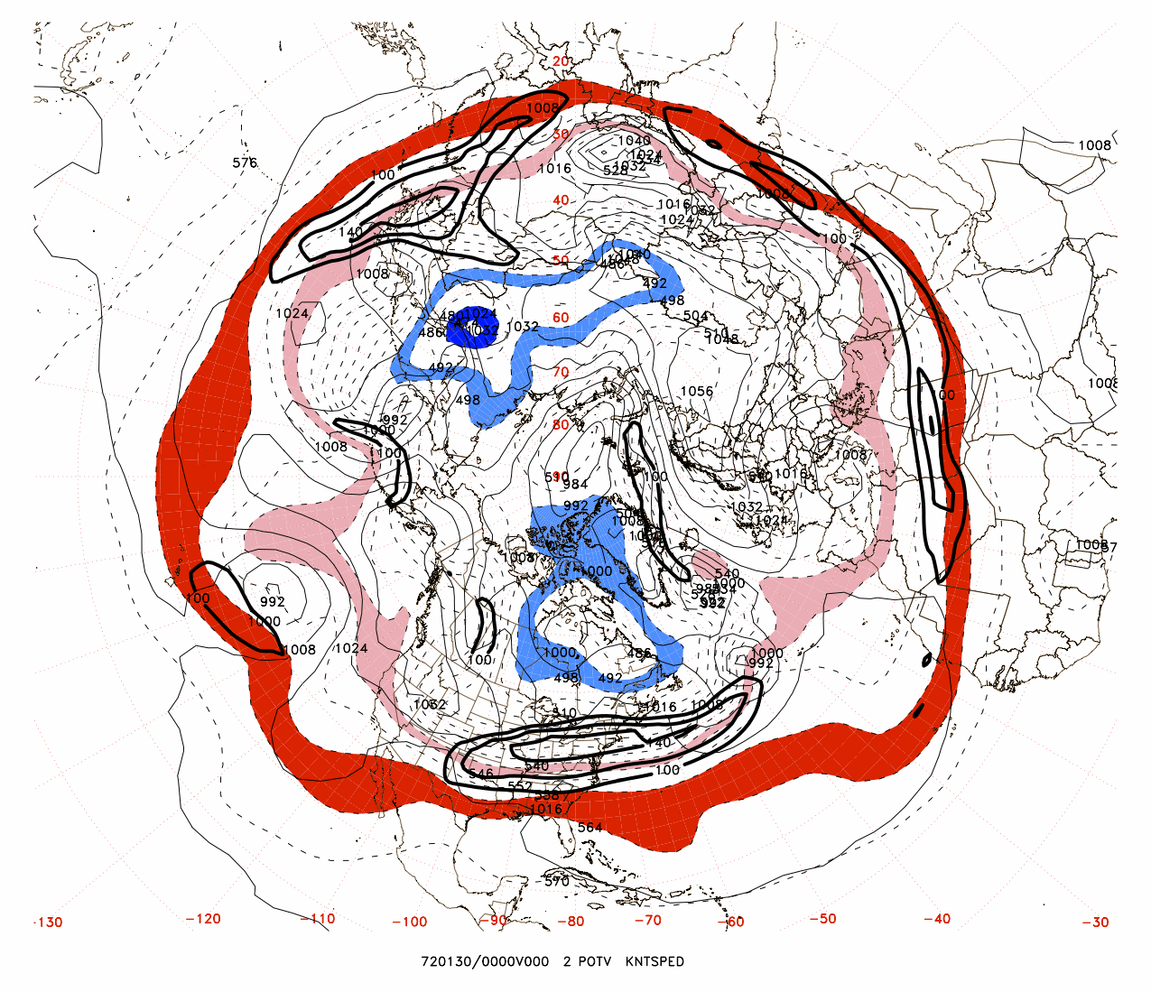

Slide 13
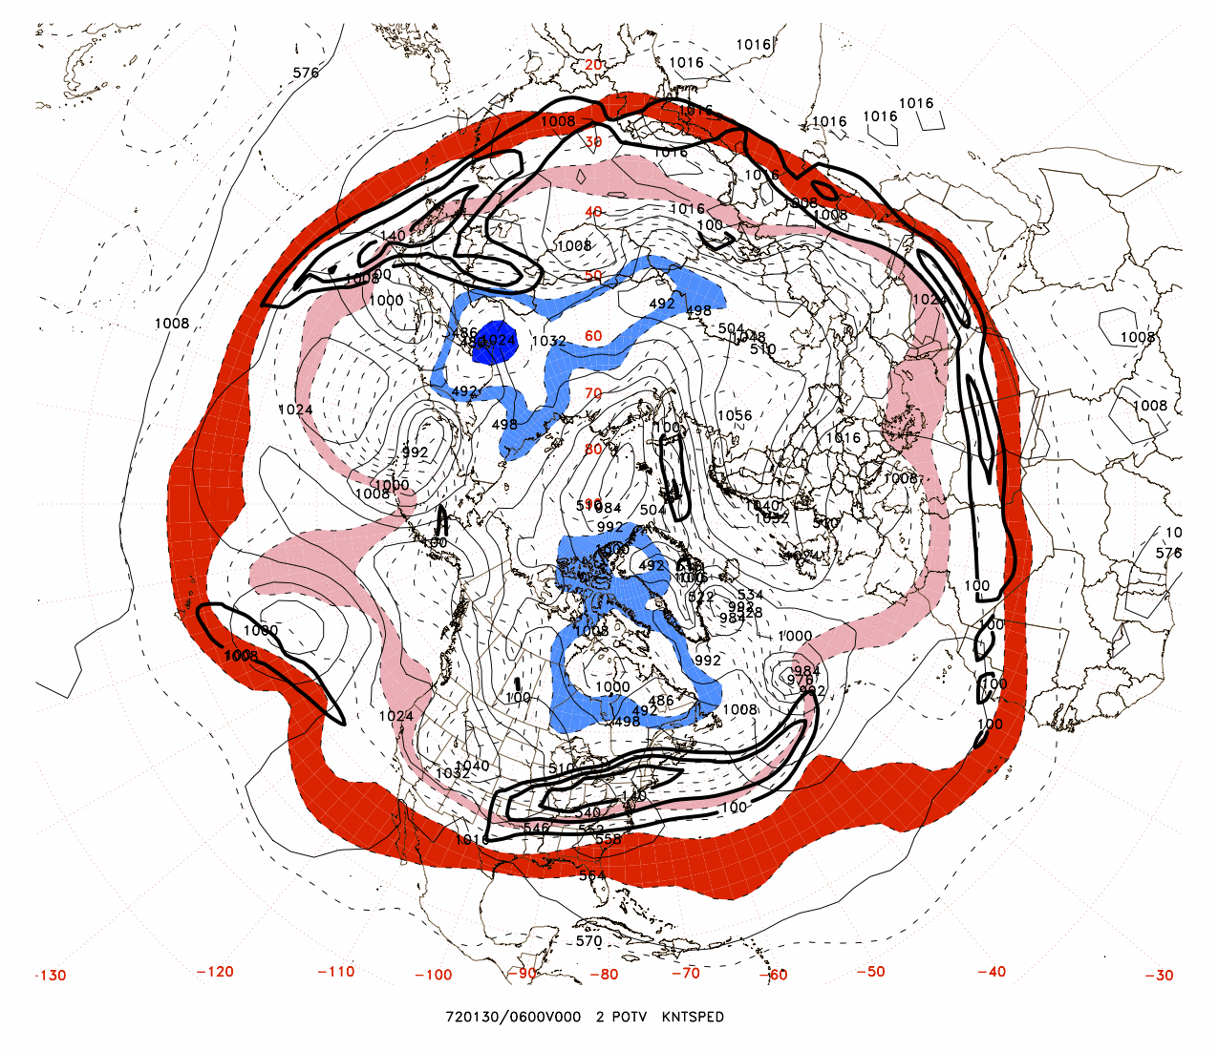

Slide 14
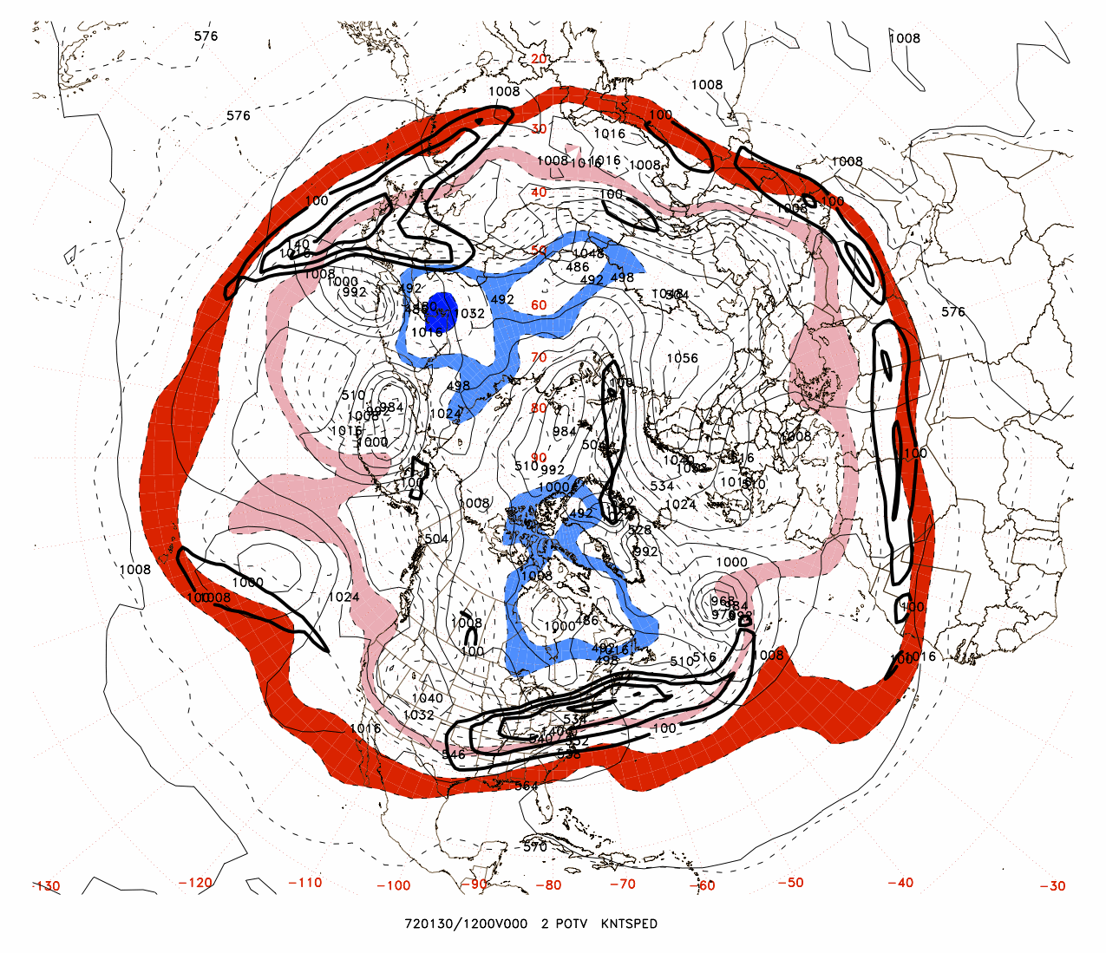

Slide 15
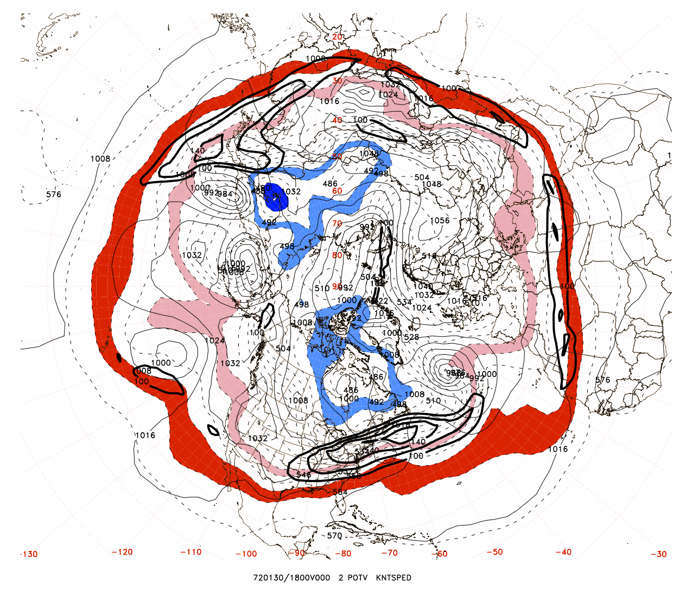

Slide 16
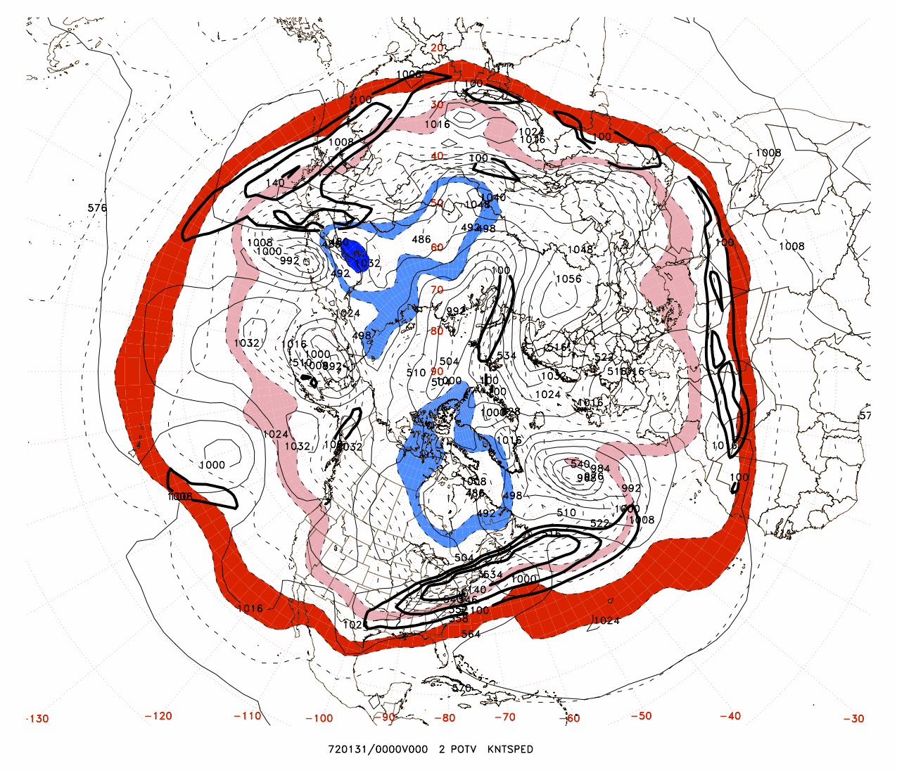

Slide 17
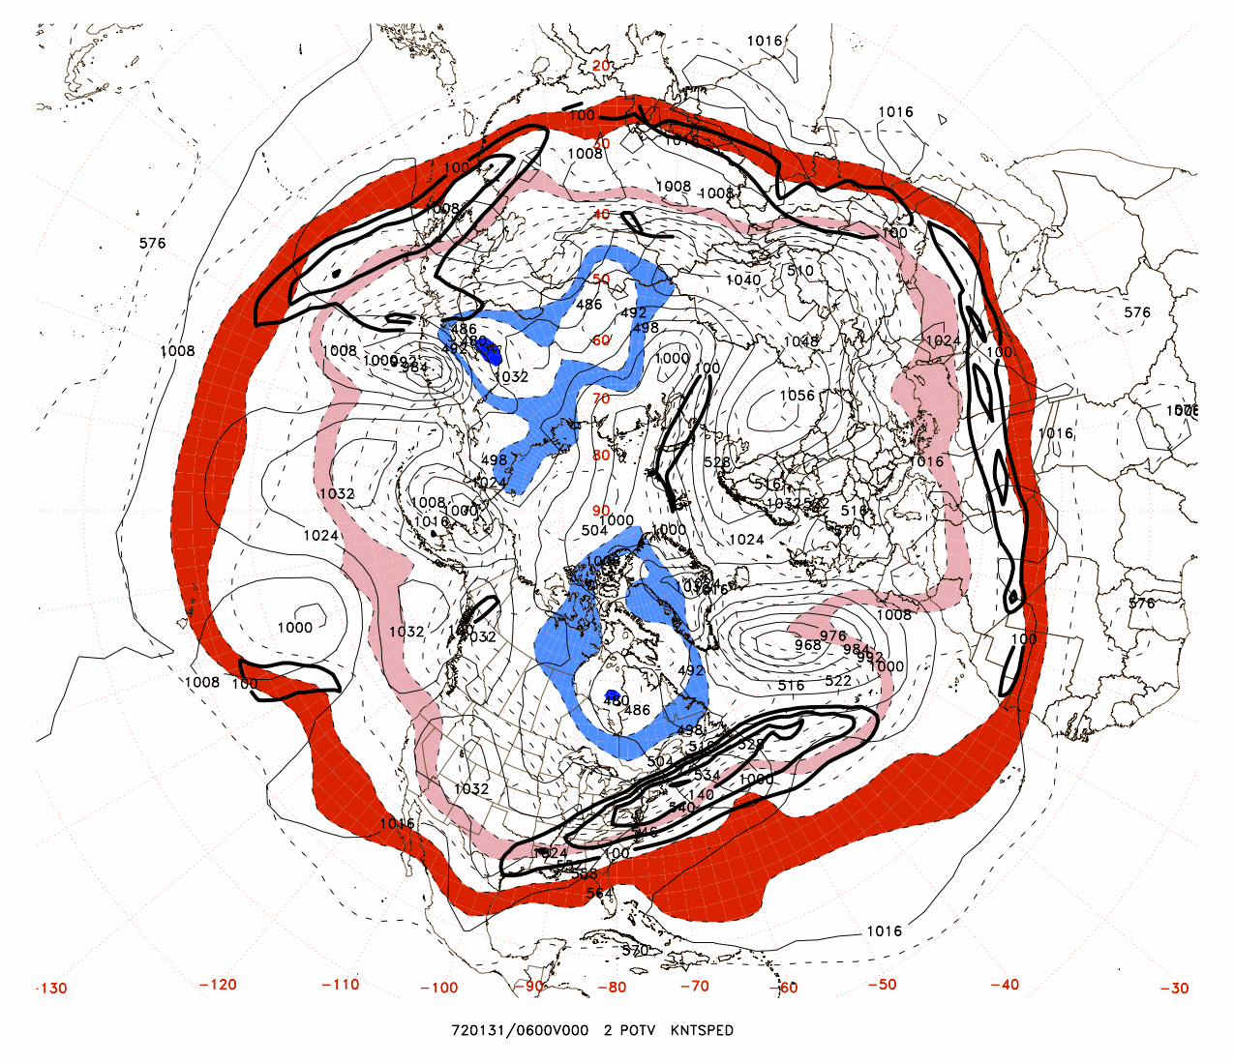

Slide 18
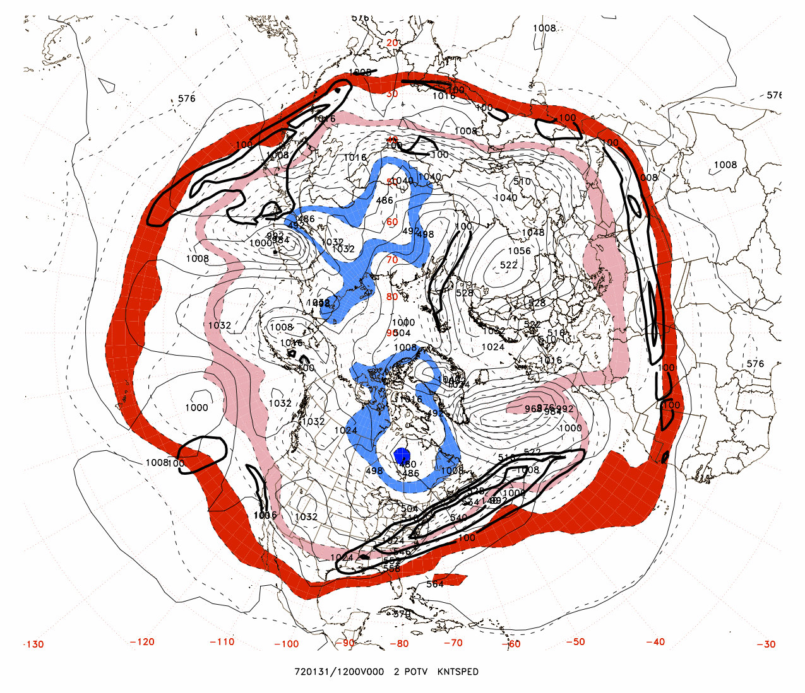

Slide 19
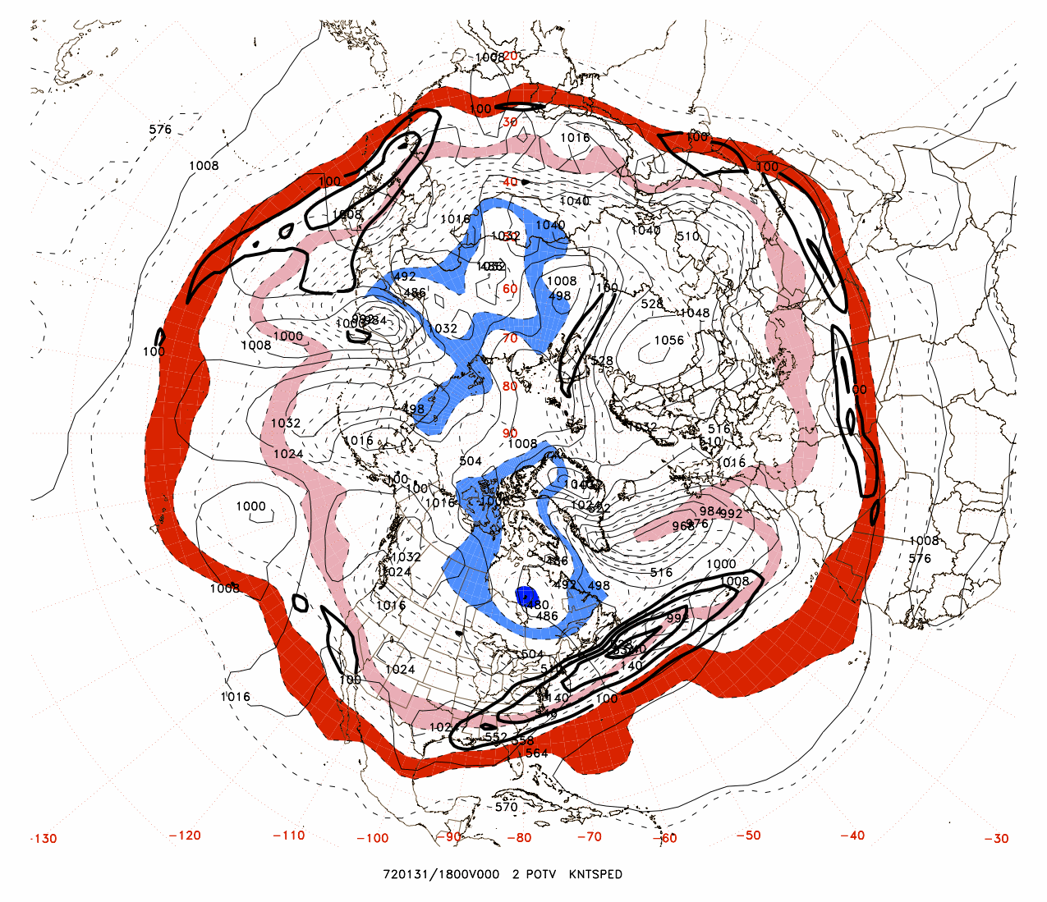

Slide 20
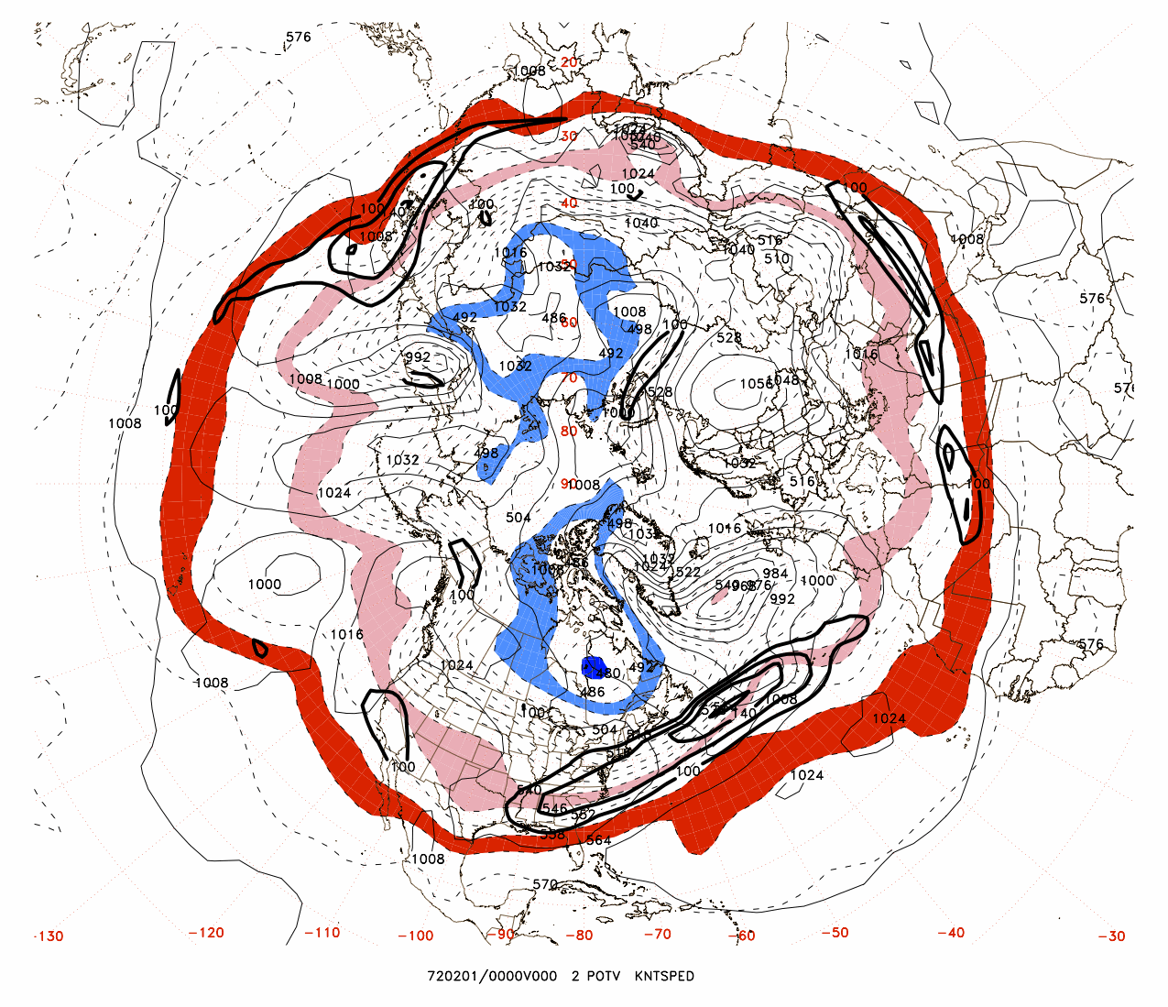

Slide 21
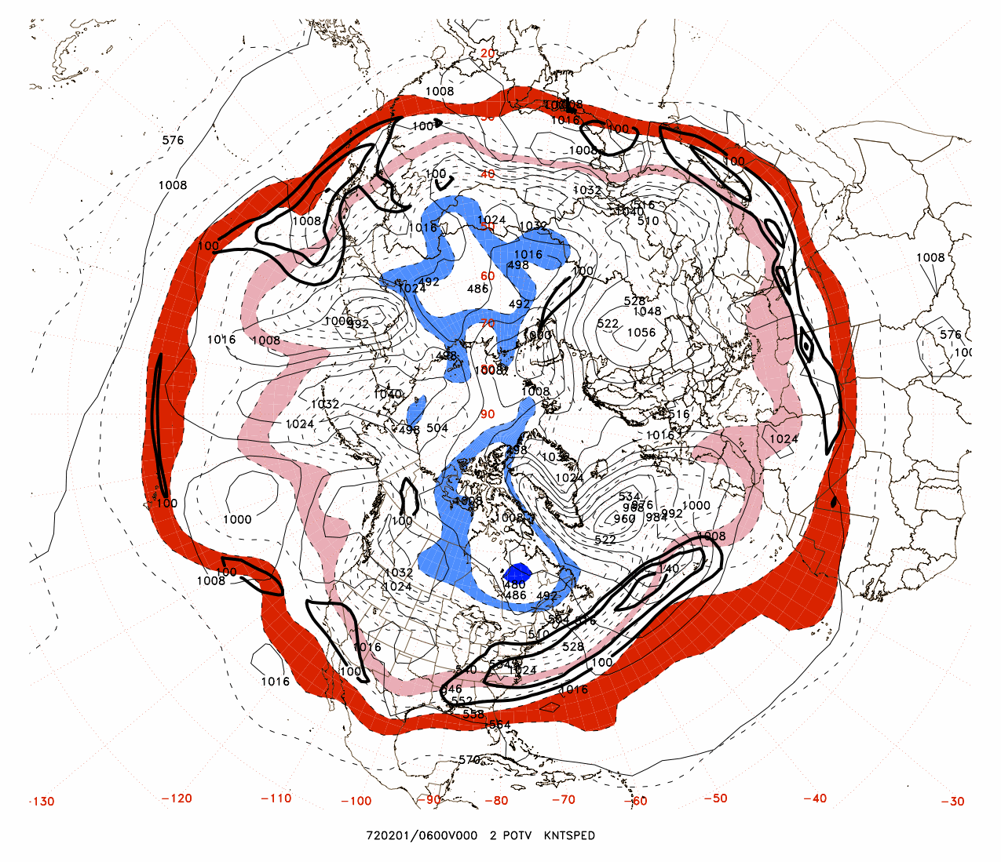

Slide 22
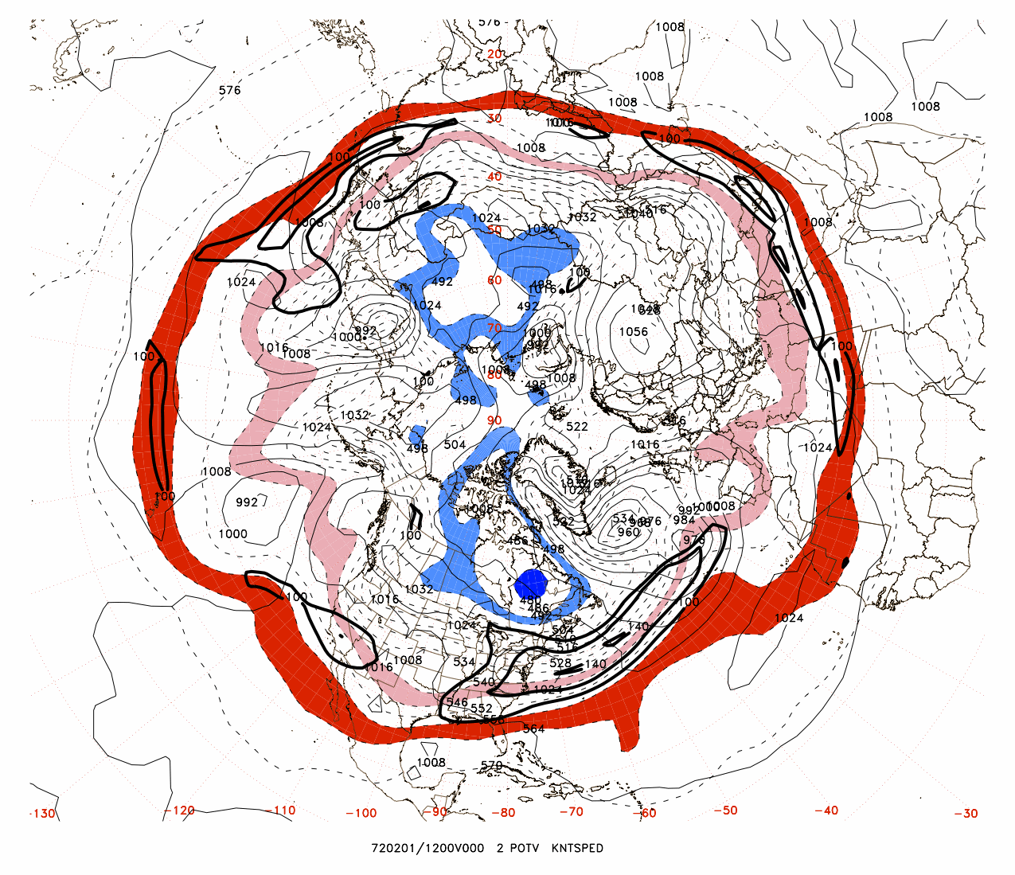

Slide 23
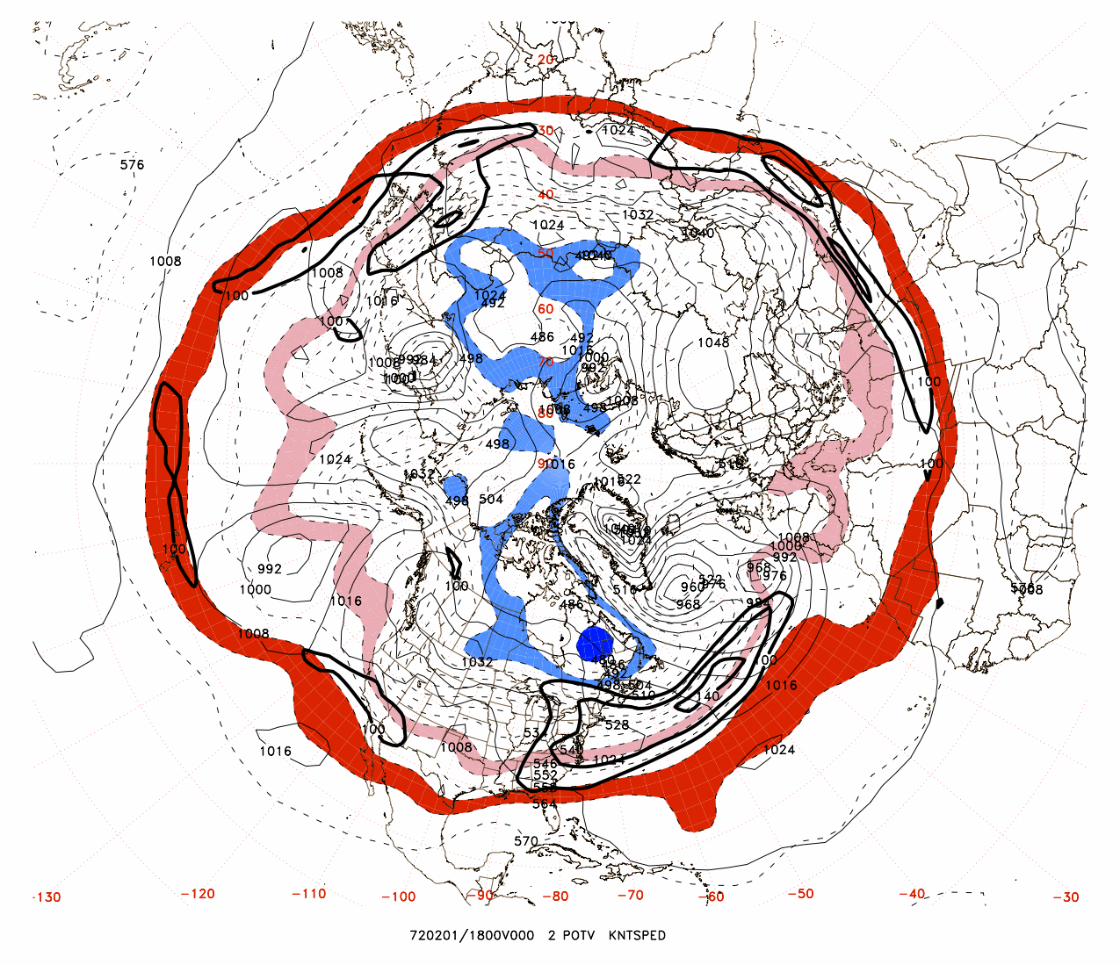

Slide 24
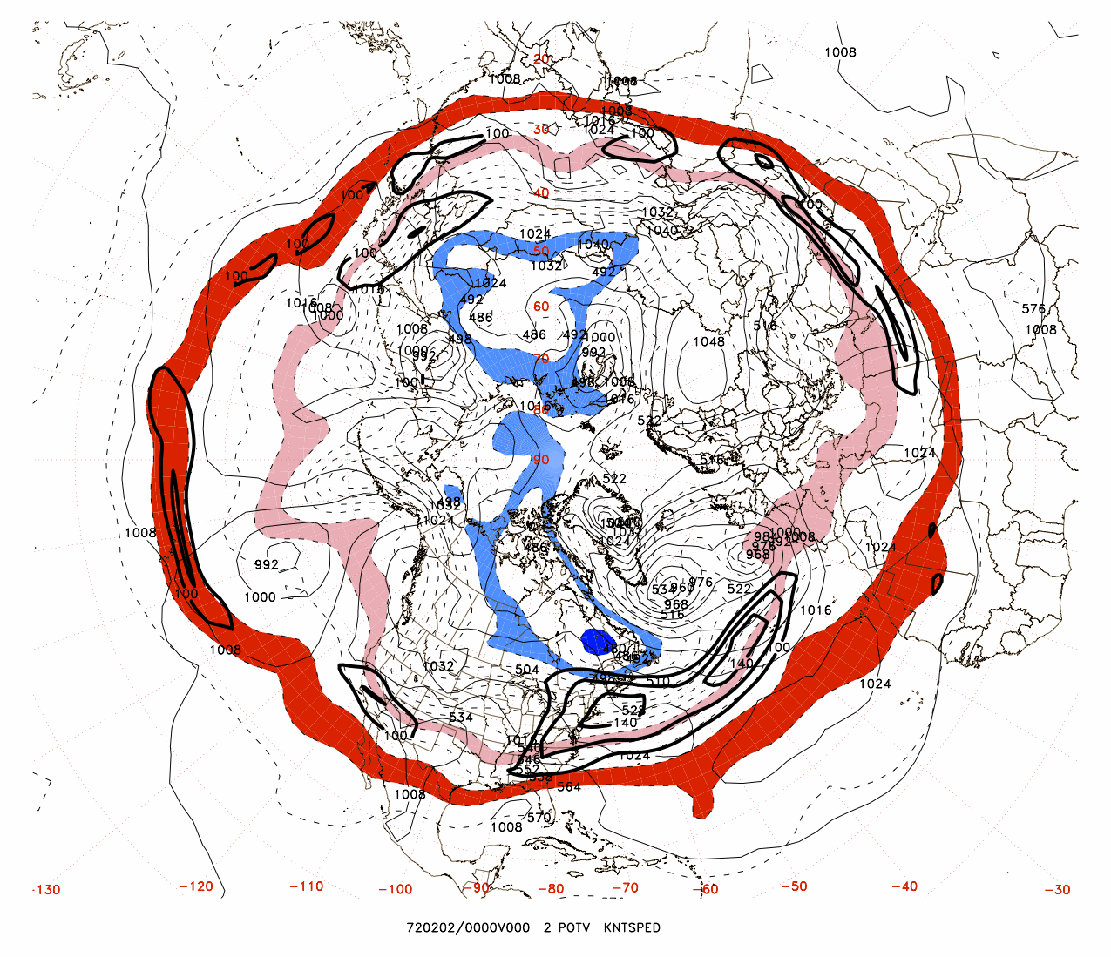

Slide 25
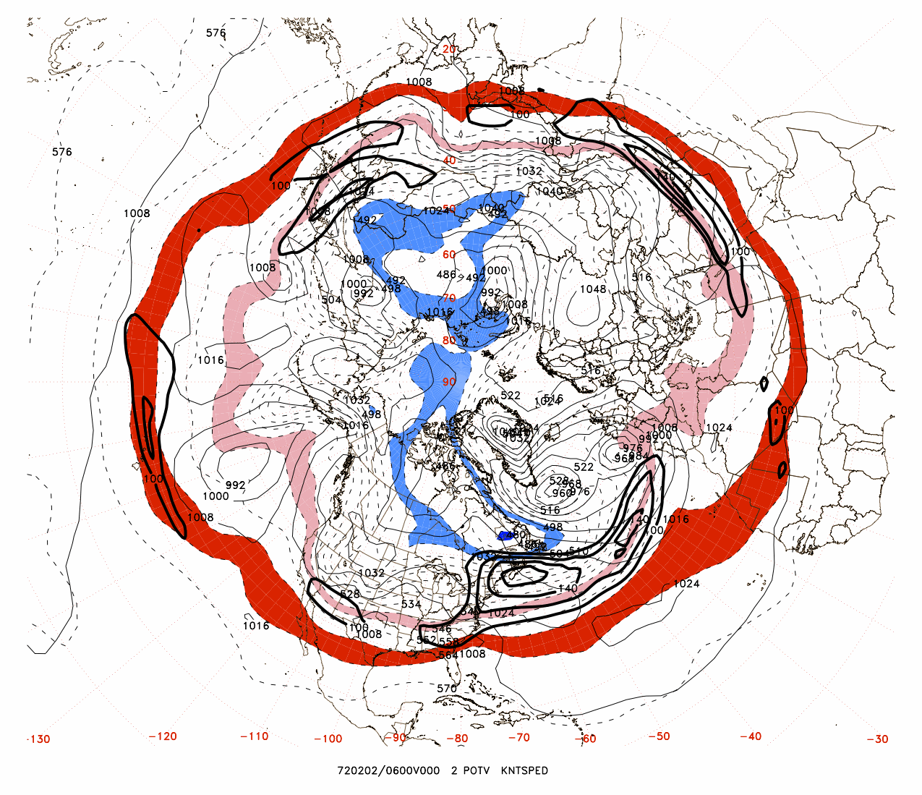

Slide 26
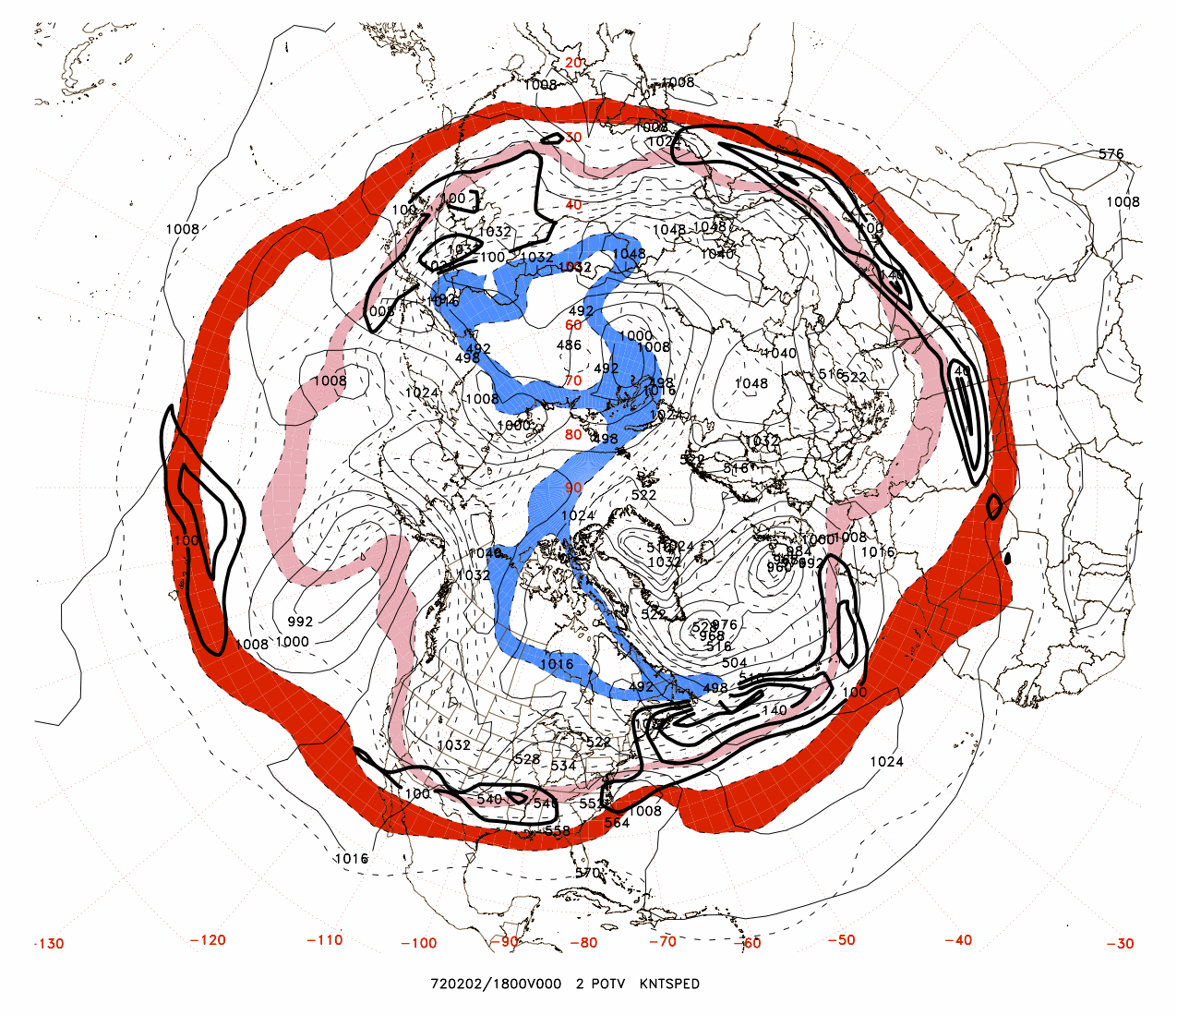

Slide 27
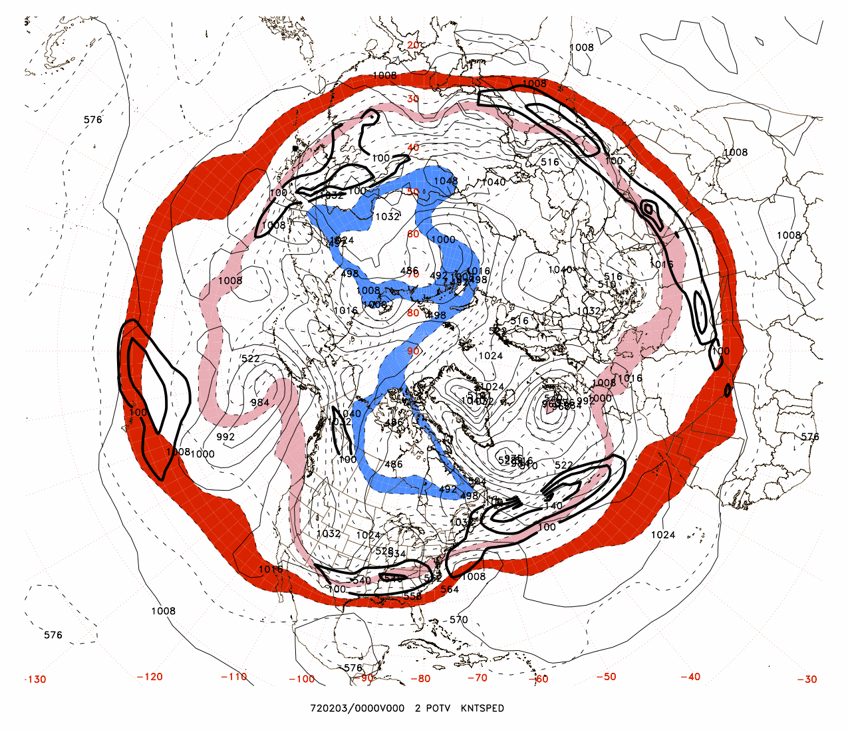

Slide 28
Previous slides illustrate the upscale growth of surface cyclonic coverage throughout the North Atlantic basin

Slide 29
The initial cyclogenesis (1200 UTC, 28 Jan) occurs on the equatorward side of the jet, where the moist Brunt-Väisälä frequency (N_{m})²= (g/T)(∂T/∂z + Γ_{m}) is near zero (units of 10⁻⁴ s⁻²)

Slide 30
At 1200 UTC, 30 January 1972, the cyclone has migrated to the left exit region of the jet, while a new surface cyclogenesis is occurring on the equatorward side of the jet in near zero effective stability:

Slide 31
Consider that the more extreme of the N. Atlantic cyclones deepened at 2.6 bergerons).
From Roebber (1984):

Slide 32
An index for North Atlantic Basin Storm Activity: Its relationship to explosive cyclogenesis
Theory
Observations
Surface cyclogenesis
Concluding discussion

Slide 33
Theory

Slide 34
Eady growth rate maximum:
σ = 0.31 f | ∂v/∂z |N⁻¹, where N is the dry Brunt-Väisälä frequency
N² = (g/T)(∂T/∂z + Γ_{d})
and the moist baroclinic growth rate:
σ_{m} = 0.31 f | ∂v/∂z |N_{m}⁻¹, where N_{m} is the moist Brunt-Väisälä frequency
(N_{m})²= (g/T)(∂T/∂z + Γ_{m})

Slide 35
The North Atlantic Storm Index (NASTI):
The count of events during which the areal coverage (%) in the North Atlantic basin (25-60 deg N; 80-0 deg W) of moist baroclinic growth exceeding 1.5/day exceeds 2 standard deviations from a 30-year running mean climatology

Slide 36
Observations

Slide 39
North Atlantic Storm Index from 1950 through February 2014 (counts of normalized standard deviations with absolute values exceeding 2.0)

Slide 40
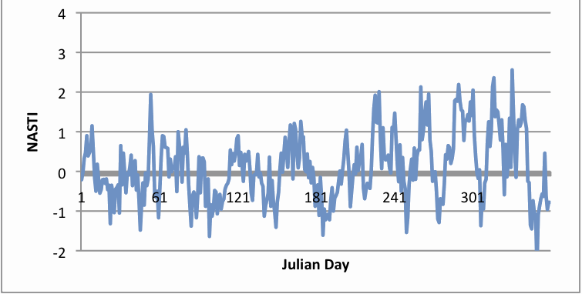
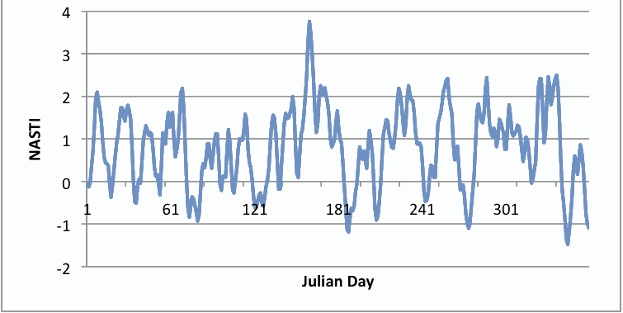
Counts of NASTI events (DJF) from Dec. 1950 through February 2014
JFM 1992:
JFM 2014:

Slide 42
Surface cyclogenesis

Slide 43
Cyclone intensifications (observed versus forecasted)

Slide 44
Deep low (<960 hPa) maximum deepenings vs forecasted (Bergerons) (of the 37 960 hPa cases during Dec. 2013-March 2014, 31 qualified as ‘bombs’)
Forecasted
Observed

Slide 46
The large decrease in NASTI in late March 2014:

Slide 47
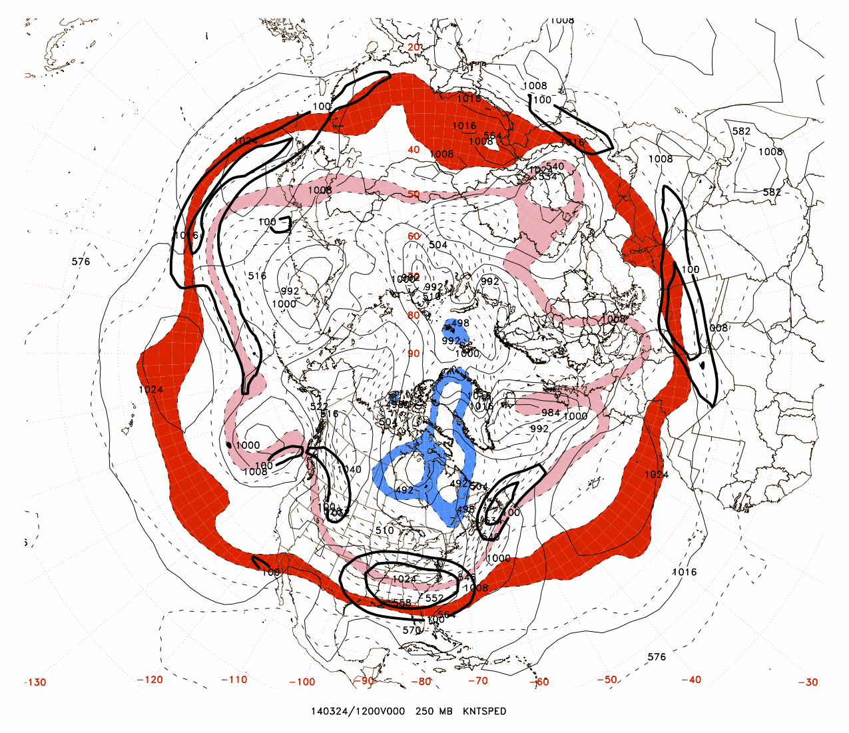
2.46

Slide 48
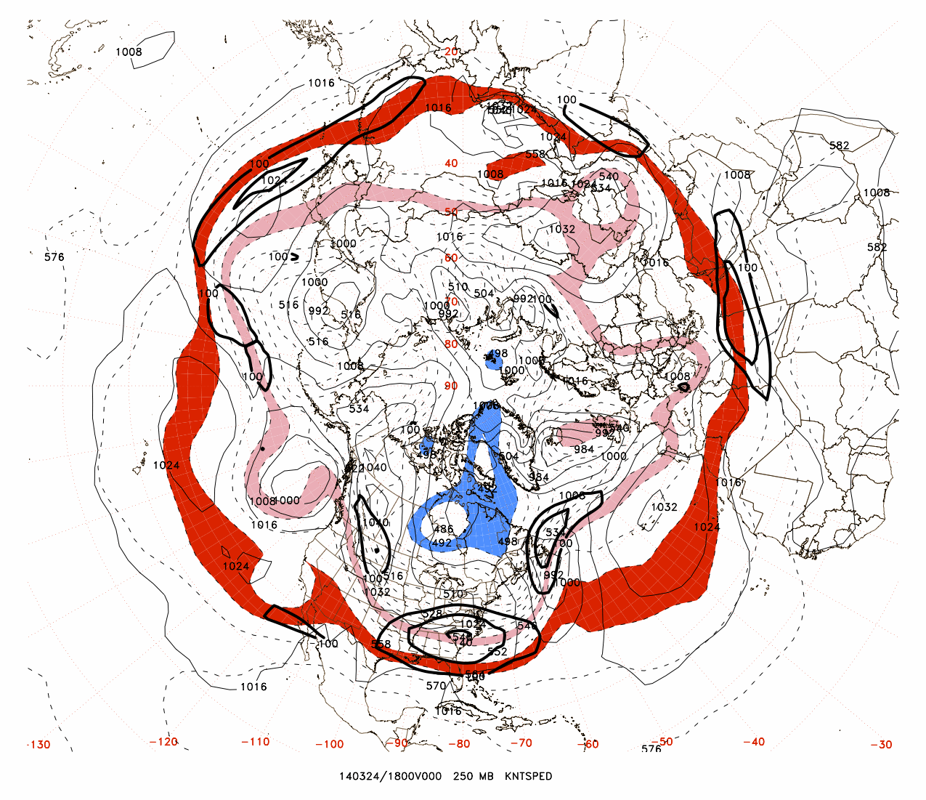
2.23

Slide 49
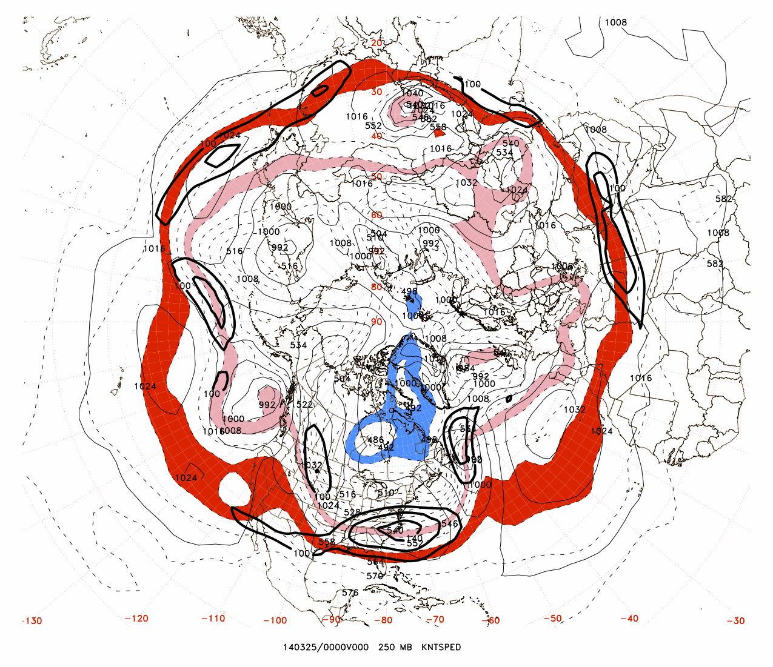
1.80

Slide 50
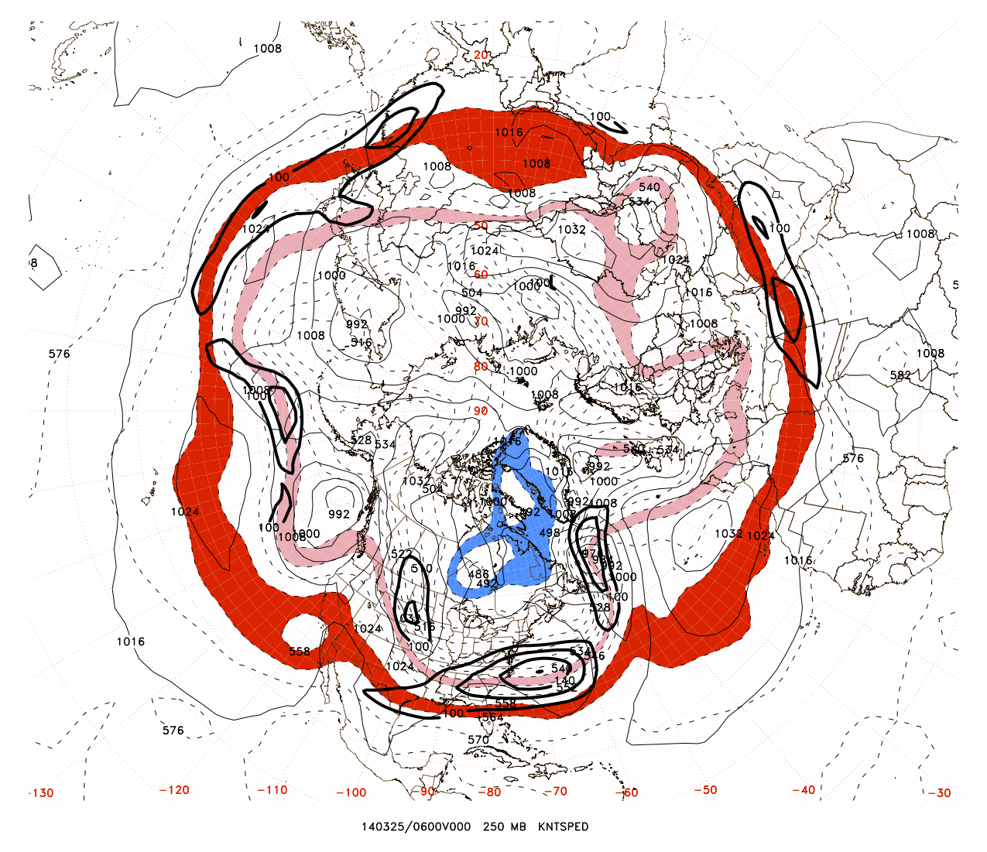
1.98

Slide 51
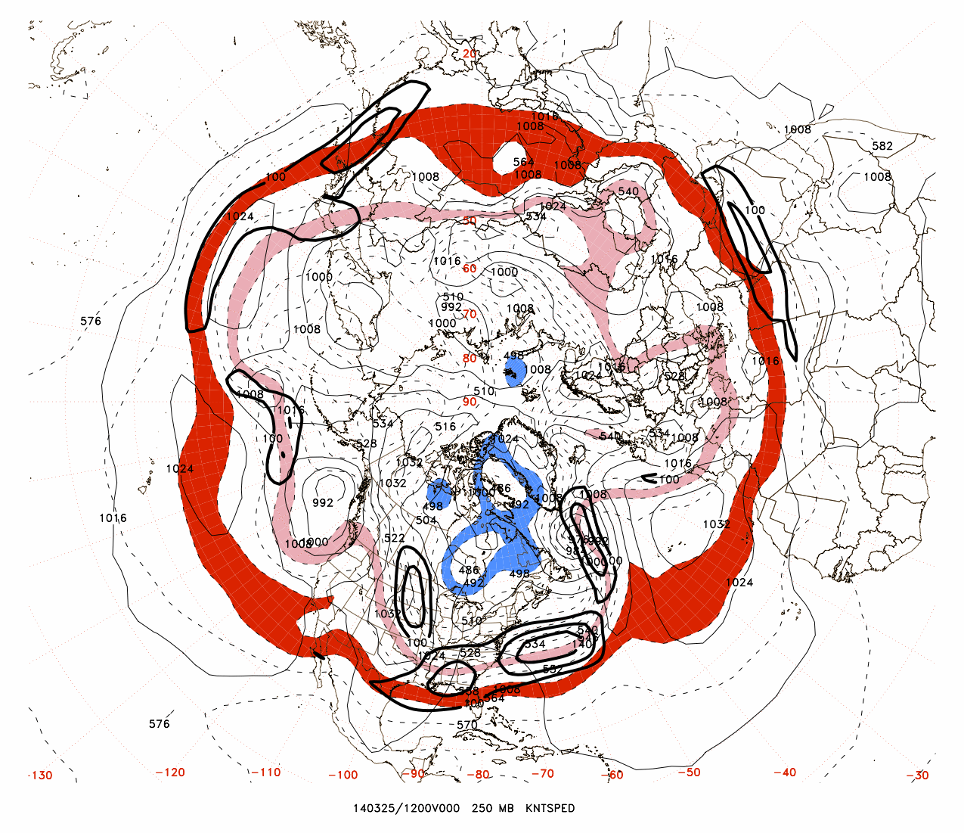
2.26

Slide 52
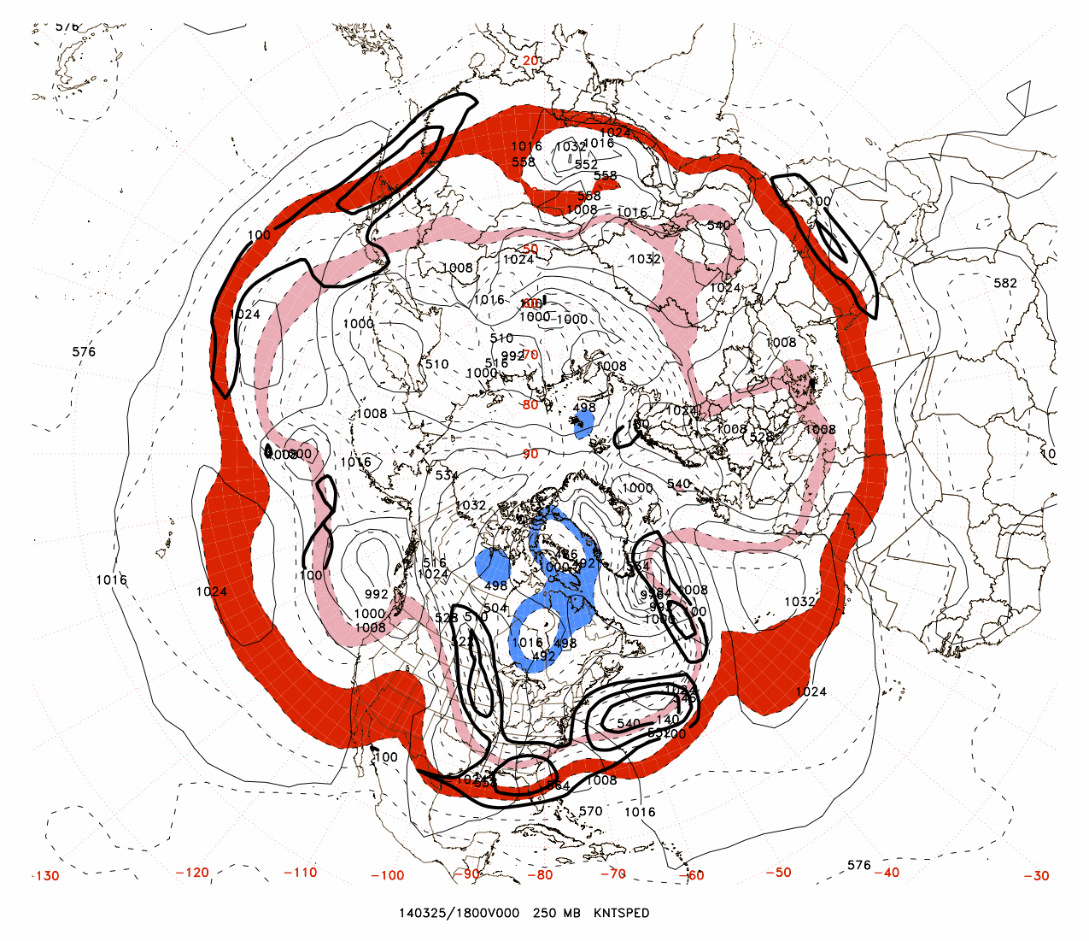
2.41

Slide 53
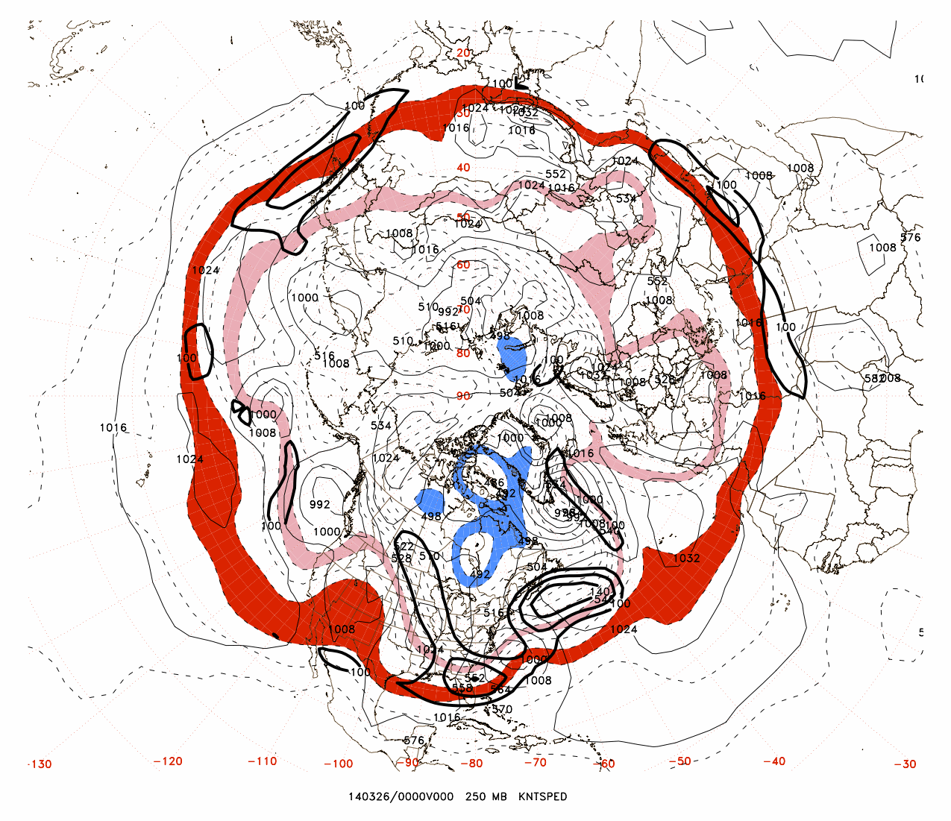
2.50
Ongoing
3.05 Bergeron
Intensification
At 33°N, 71°W

Slide 54
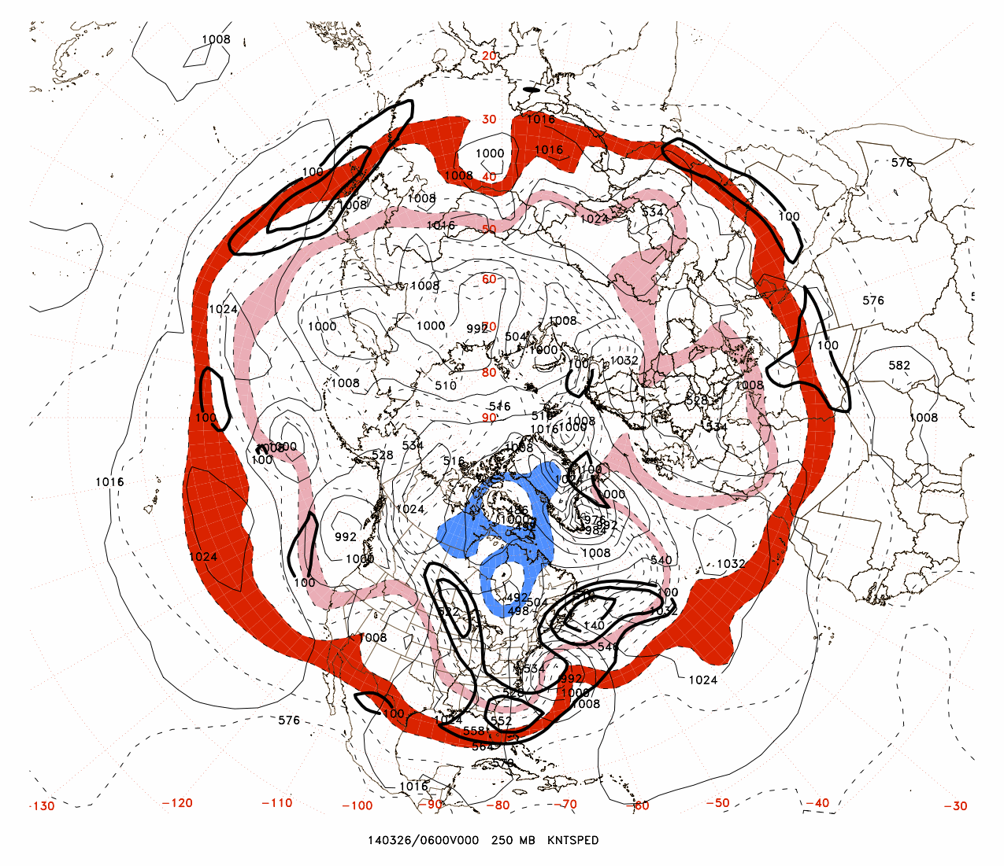
2.22

Slide 55
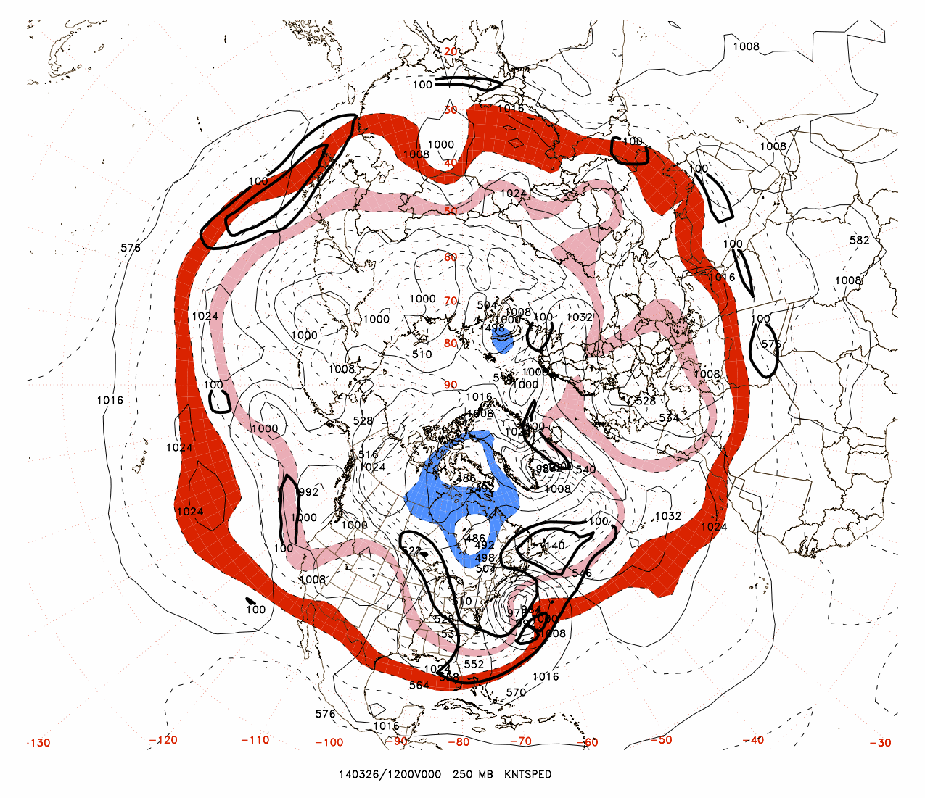
1.50

Slide 56
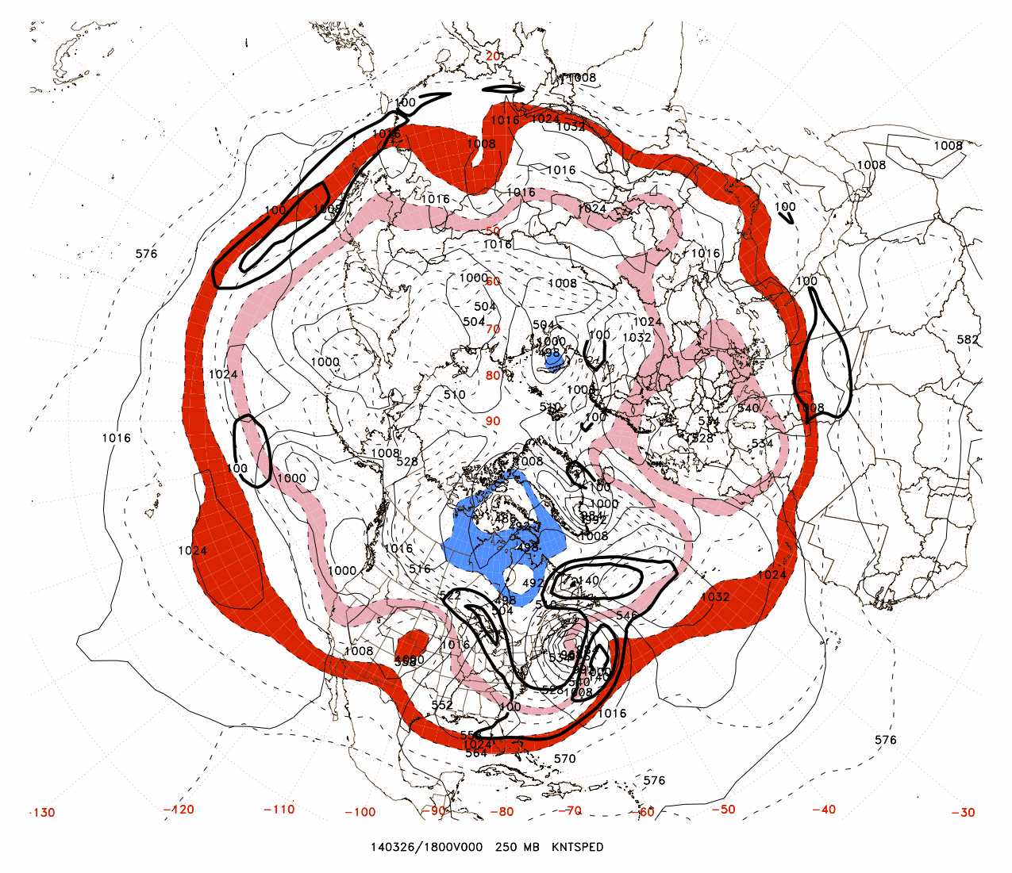
0.50

Slide 57
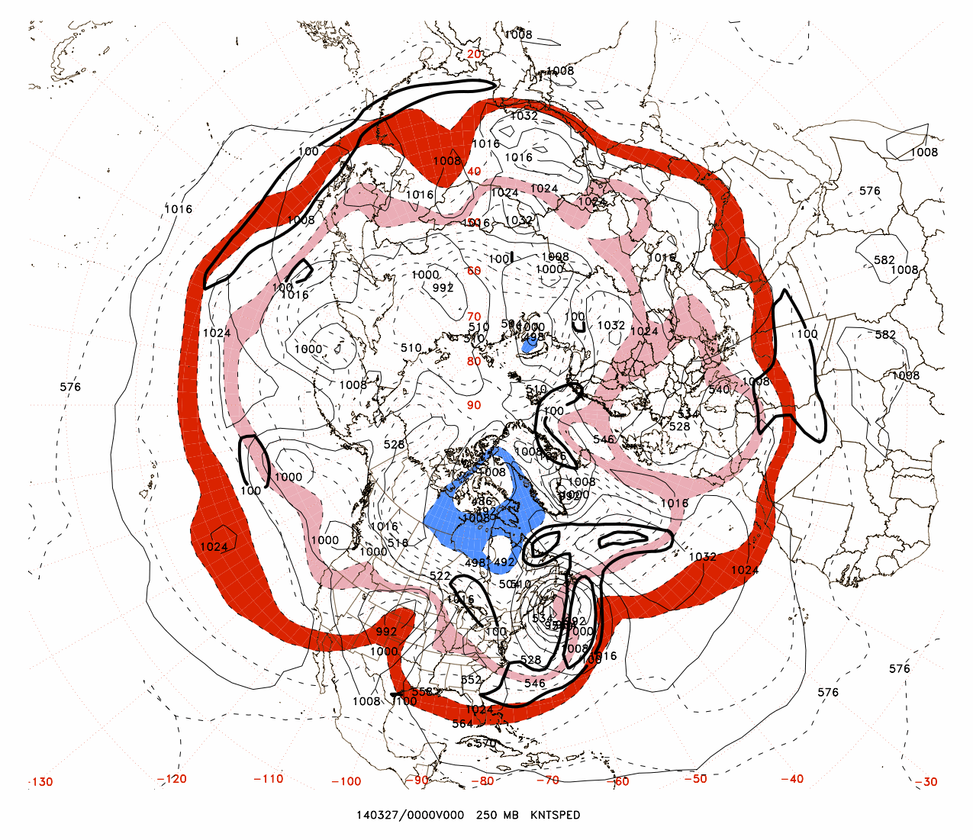
-0.20

Slide 58
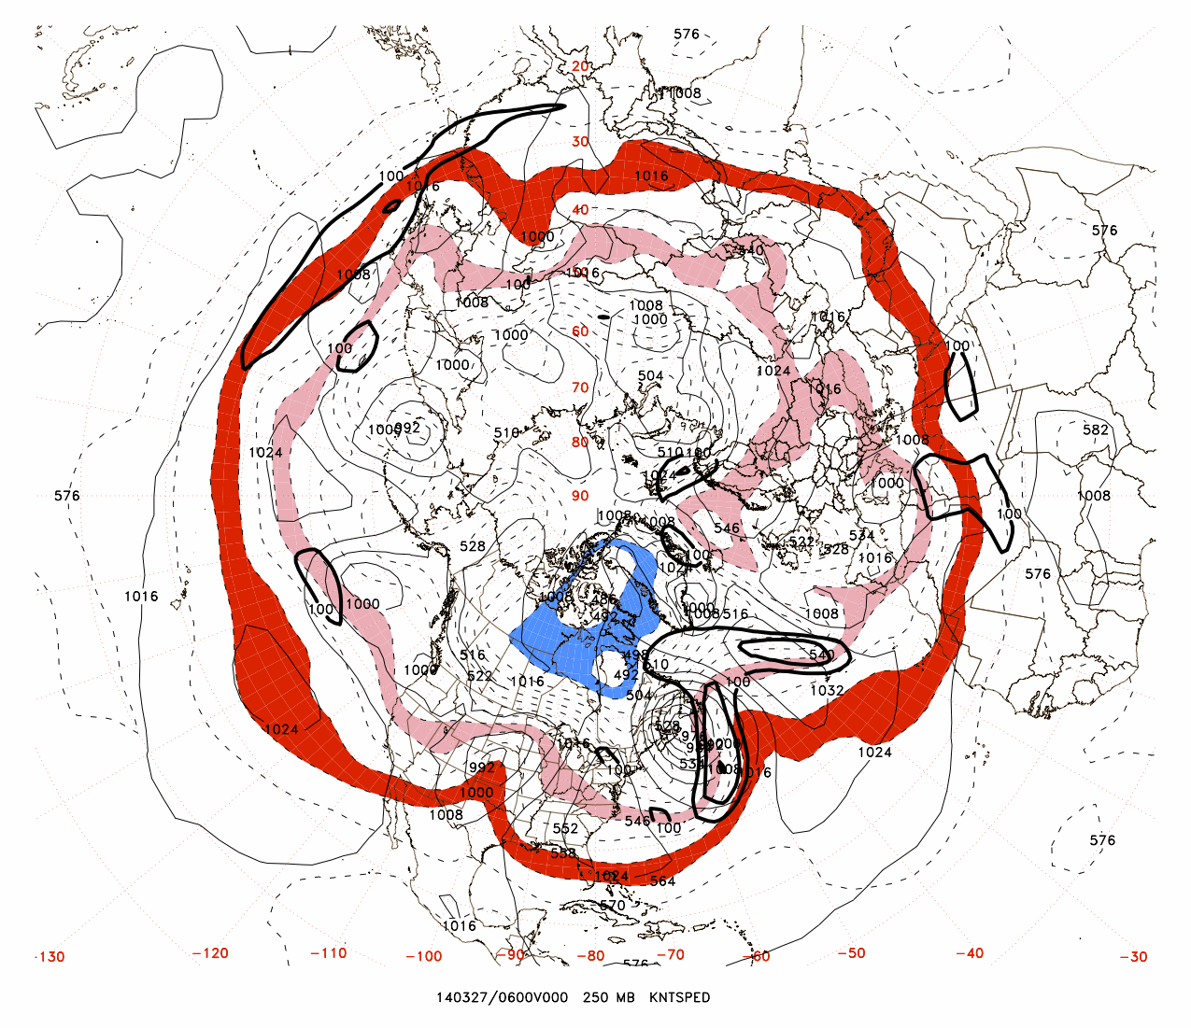
-0.51

Slide 59
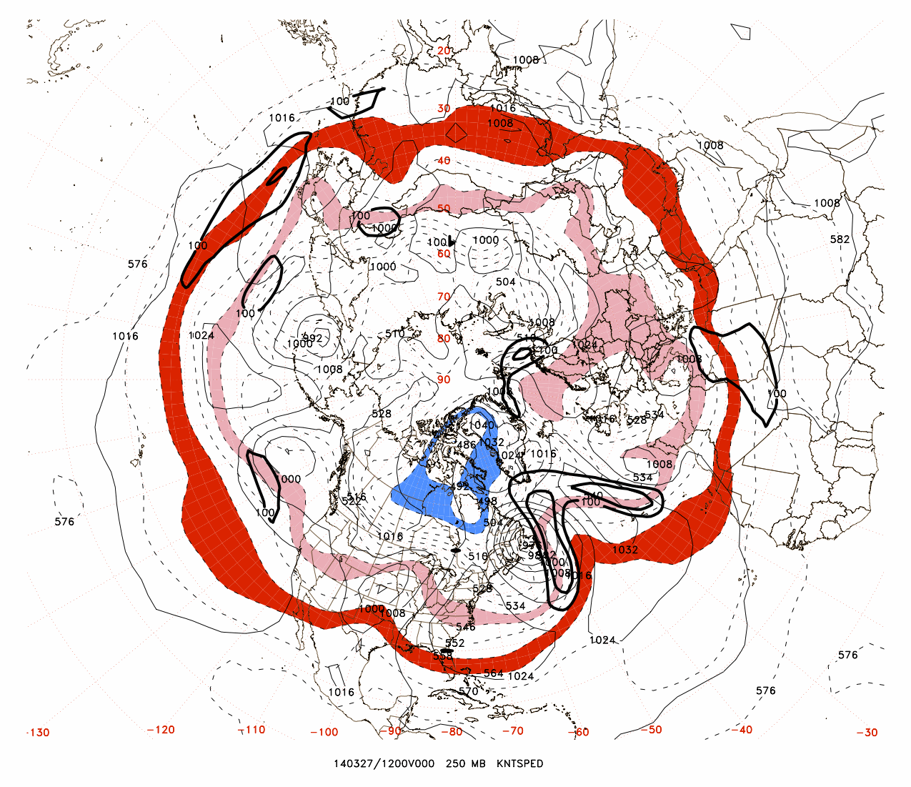
-0.90

Slide 60
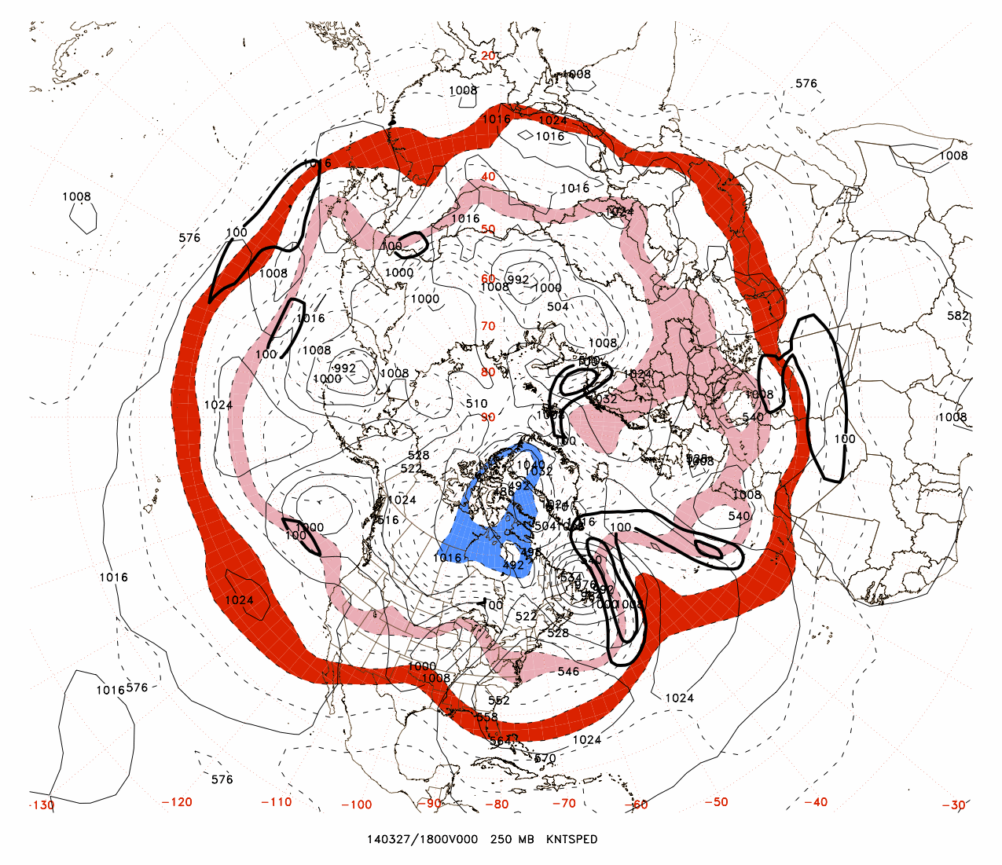
-1.36

Slide 61
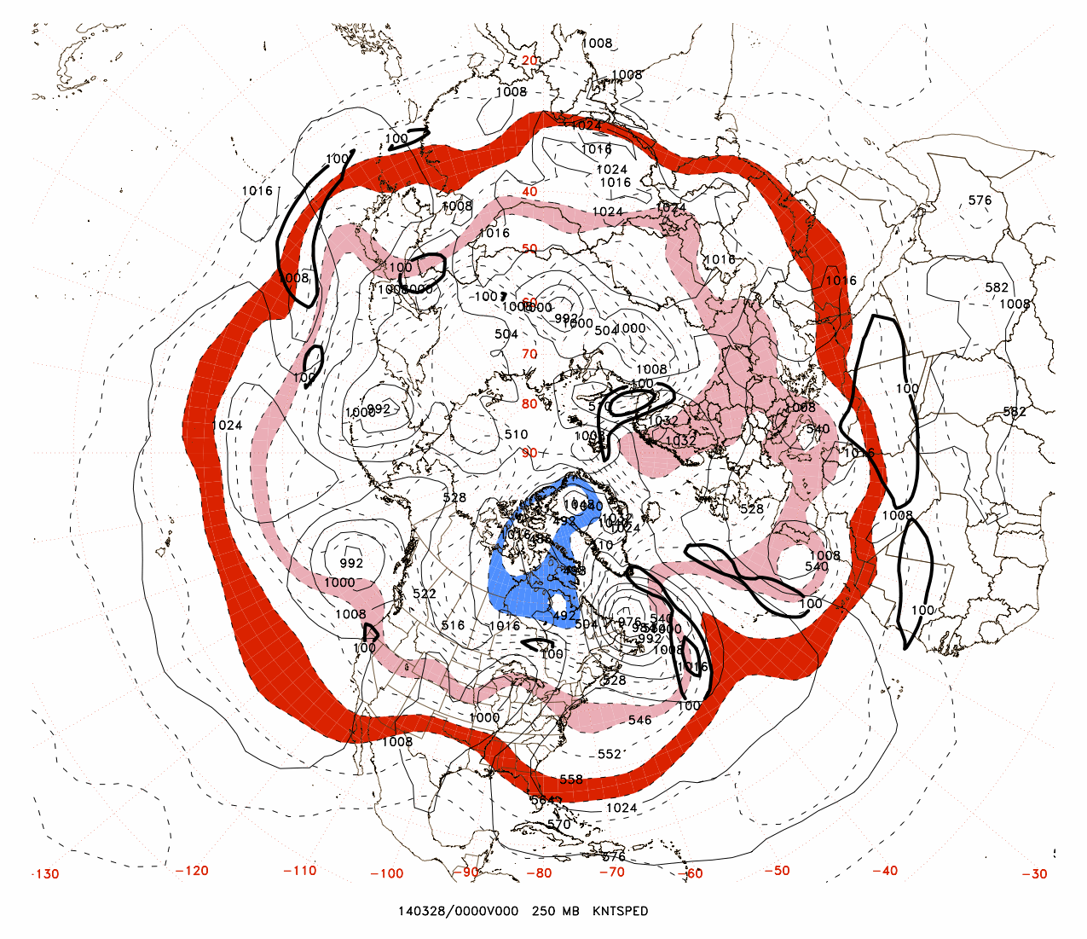
-1.48

Slide 62
The following two figures show the areal coverage of large moist baroclinic growth rates, along with 850-hPa frontogenesis for extreme values of NASTI

Slide 63
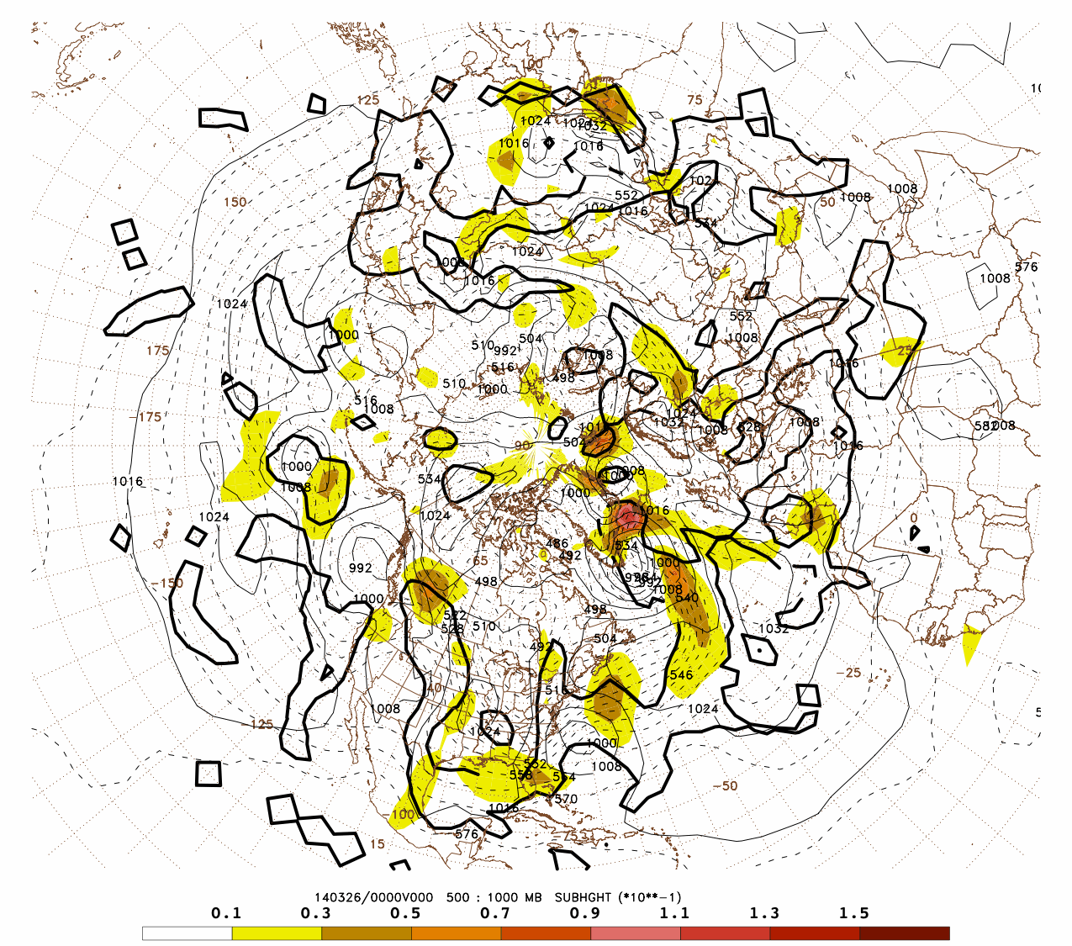
+2.50

Slide 64
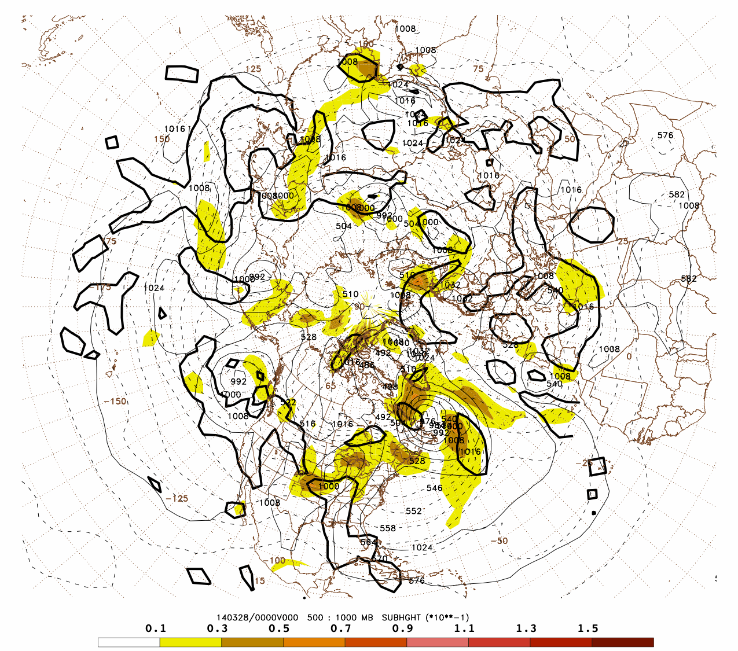
-1.48

Slide 65
Concluding discussion
Cyclogenesis is often a ‘regime changer’.
Moist baroclinic growth rate coverage is a useful metric for basin-wide weather regimes.
There is a suggestion that this metric (NASTI) has been increasing in recent decades.
Cyclogenesis forecasts have obviously improved. However, there are still crucial cases that are ‘missed’, which may have impact on medium-range forecasts.

Slide 66
References:
Bosart, L. F., 1981: The Presidents’ Day Snowstorm of 18-19 February 1979: A subsynoptic-scale event. Mon. Wea. Rev., 109, 1542-1566.
Durran, D. R., and J. B. Klemp, 1982: On the effects of moisture on the Brunt-Väisälä frequency. J. Atmos. Sci., 39, 2152-2158.
Gyakum, J. R., J. R. Anderson, R. Grumm and E. L. Gruner, 1989: North Pacific cold-season surface cyclone activity: 1975 through 1983. Mon. Wea. Rev., 117, 1141-1155.
Gyakum, J. R., P.J. Roebber and T.A. Bullock, 1992: The role of antecedent surface vorticity development as a conditioning process in explosive cyclone intensification. Mon. Wea. Rev., 120, 1465-1489.
Hoskins, B. J., and P. J. Valdes, 1990: On the existence of storm tracks. J. Atmos. Sci., 47, 1854-1864.
Roebber, P. J., 1984: Statistical Analysis and Updated Climatology of Explosive Cyclones. Mon. Wea. Rev., 112, 1577–1589.
Sanders, F., 1971: Analytic solutions of the nonlinear omega and vorticity equations for a structurally simple model of disturbances in the baroclinic westerlies. Mon. Wea. Rev., 99, 393–407.
Sanders, F. and J. R. Gyakum, 1980: Synoptic-dynamic climatology of the "bomb." Mon. Wea. Rev., 108, 1589-1606.
Stubbs, M. W., 1975: An unusually large fall of pressure. Weather, 30, 91-92.
Turner, J. K., J. R. Gyakum, and S. M. Milrad, 2013: A thermodynamic analysis of an intense North American arctic air mass. Mon. Wea. Rev., 141, 166-181.
Turner, J. K., and J. R. Gyakum, 2011: The development of Arctic air masses in Northwest Canada and their behavior in a warming climate. J. Climate, 24, 4618-4633.

