Slide 1

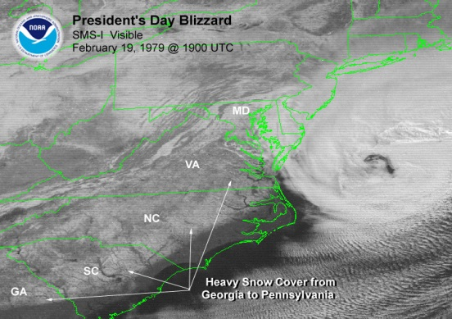
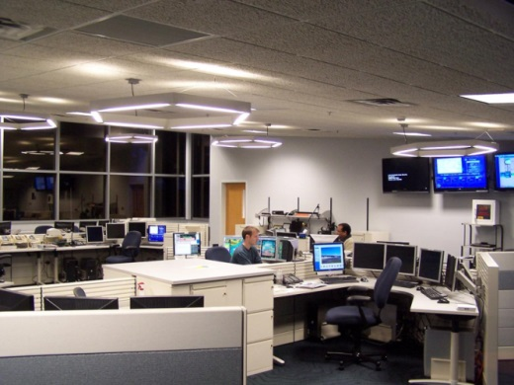
National Weather Service
WFO Operations
1979 vs 2014
Steve Zubrick
Science and Operations Officer (SOO)
Baltimore-Washington Weather Forecast Office
“Advances in Extratropical Cyclone Understanding and Prediction Since the 1979 Presidents' Day Storm” Colloquium
28 May 2014

Slide 2

WFO 1979 Operations
1979 NWS technology…
  Observations…
    GOES satellite imagery (paper copy)
      TIROS-N imaging system
        Advanced Very High Resolution Radiometer (AVHRR)
    Surface stations limited
    Radar network 1950/60s (WSR57/74C)

Slide 3
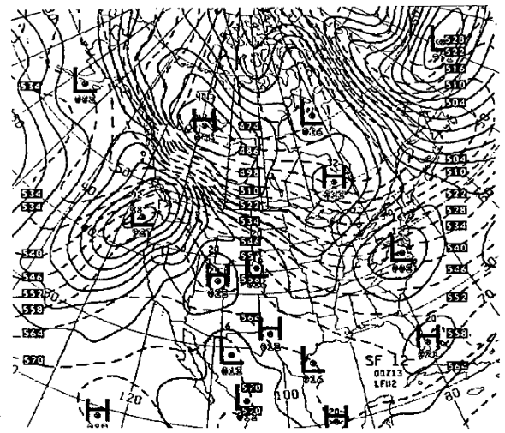
WFO 1979 Operations
1979 NWS technology…
  NWP Models…
    LFM-II (127 km)
    7-layer PE (190 km)
    Barotropic/Baroclinic

Slide 4
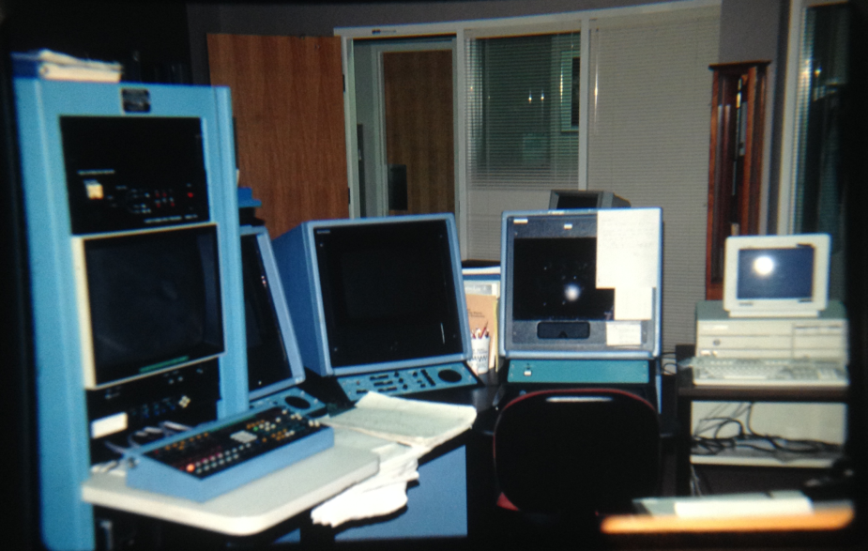
WFO 1979 Operations
1979 NWS technology…
  Workstations…
  AFOS: Automated Forecast Operations Sys.)
    Mono-chromatic
    Limited looping
    Up to 3 overlays
    Limited model data
    No model diag.
    Limited display of satellite/radar data
WFO/WBC-Sterling VA circa 1992

Slide 5

WFO 1979 Operations
1979 NWS technology…
  Communications…
    Telephone/Fax
    NAWAS (hotline)
    Mail (snail)
  Products…
    Text-based

Slide 6
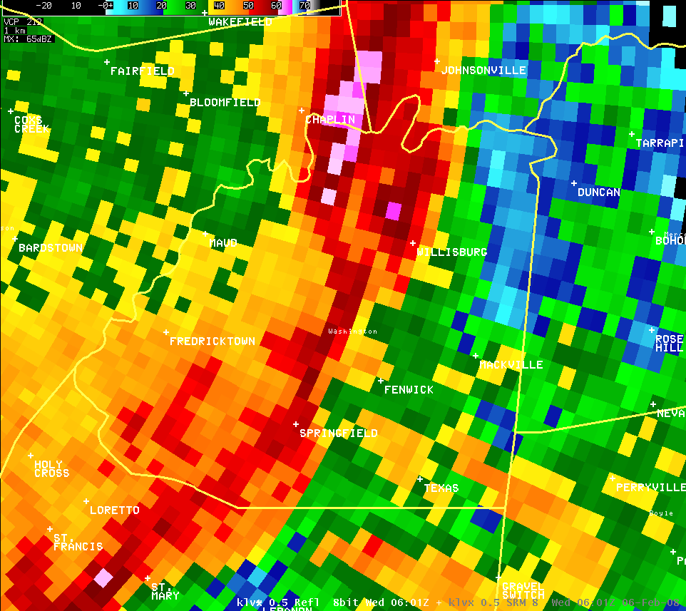
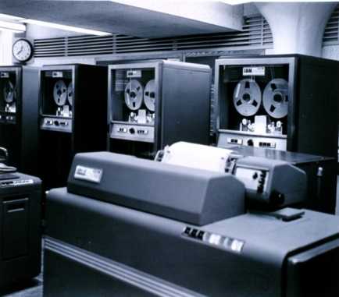
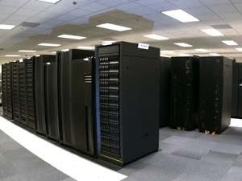
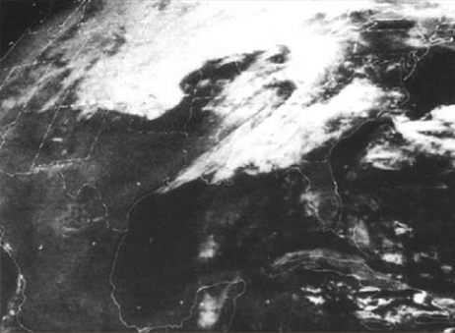
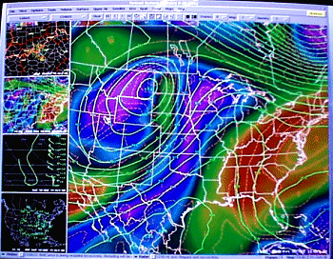
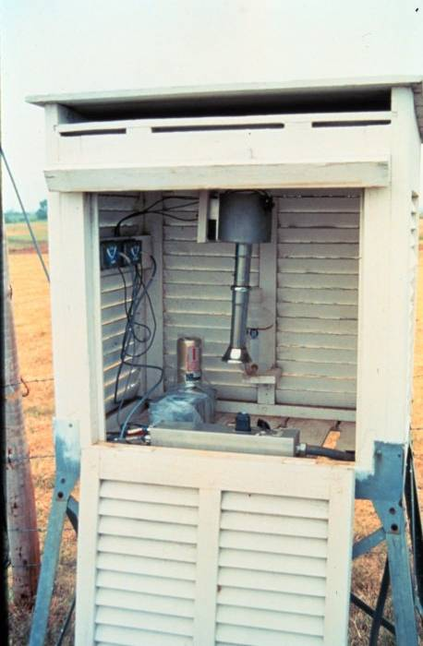
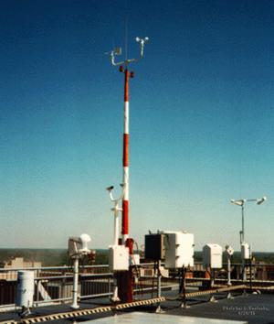
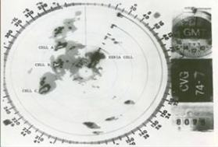
NWS 1979 to 2014
Then…
Now…

Slide 7
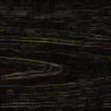
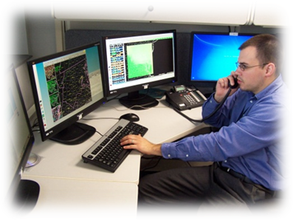

WFO 2014 Operations
2014 NWS technology…
  ADVANCED
  NWP: Ensembles, hi-res (3-4 km)
  Workstations: AWIPS (I/II)
  OBS: Radar/Sat/surface
  Comms: Internet/digital phones
  Products: NDFD/graphical (& text)

Slide 8
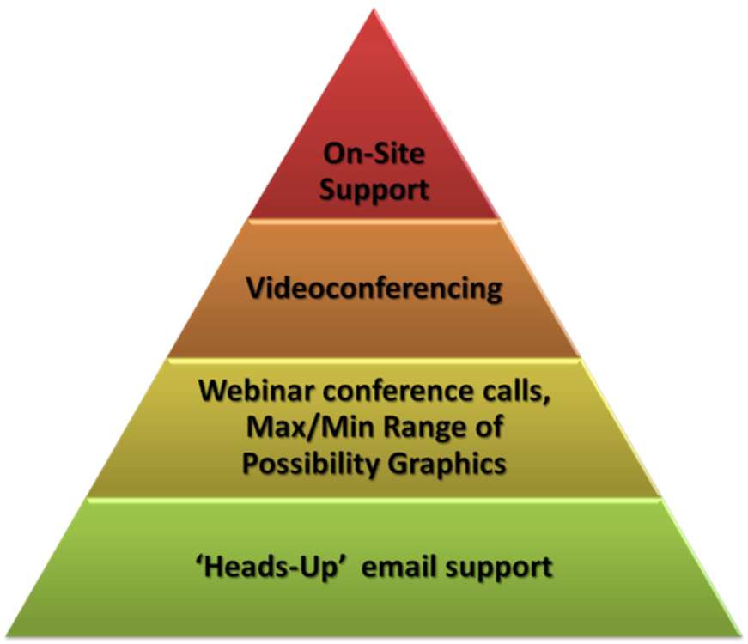
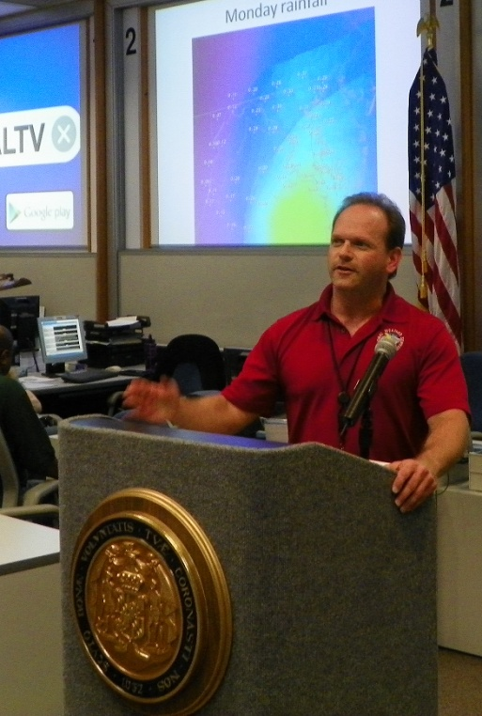
WFO 2014 Operations
Biggest change in WFO operations:
  IDSS:
  Integrated Decision Support Services
* Magnitude of Event
* Proximity in Time

Slide 9
WFO IDSS Operations
Based on personal interviews with WFO/WBC personnel who worked in the 1979 event…
  Very limited IDSS with external agencies (gov’t / media)
  No discussions on range of possibilities for event

Slide 10
WFO IDSS Operations
Now…
  Frequent communication of key IDSS information to key external agencies (gov’t / media)
  Provide guidance/discussions on range of possibilities for event

Slide 11
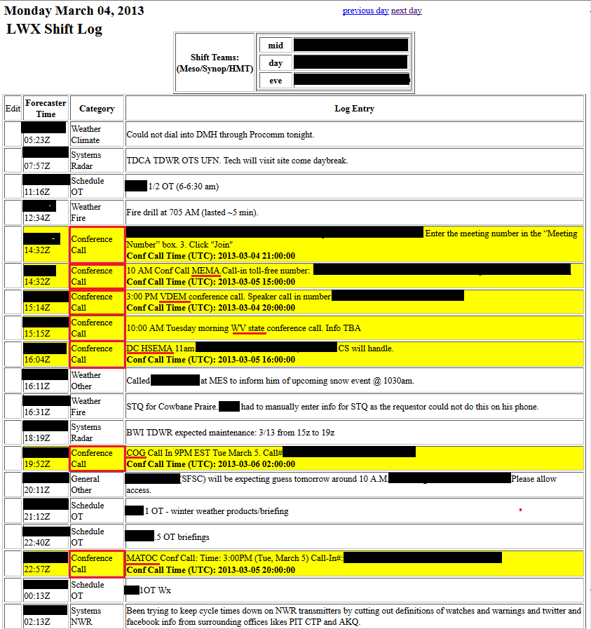
Examples IDSS in Action

Slide 12
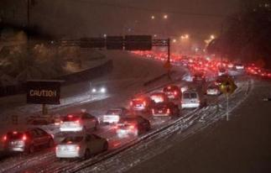
Example IDSS in Action
During winter 2013-14, WFO Sterling provided probability-based snowfall amount guidance to the public/media/gov’t
Following describes briefly this effort

Slide 13
LWX Operations 2014
Integration of IDSS into operations
Less emphasis on grid production, and more emphasis on IDSS, training, & program work
Developed a user interface which enables efficiencies in forecaster-led gridded data population
    GFE User Interface for Data Entry

Slide 14
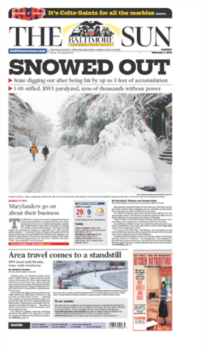
Pilot Project Objective 2: Winter Weather Probabilistic Products
Guidance for probabilistic products provided by AMS/NSF
Collaborated with WPC, MDL, & core customers
Allows forecaster to add value
Goal: Improved decision-making for core customers

Slide 15
Background
Accurate Forecasts Desired Days in Advance
But, as Lead Time ,Certainty
  And Vice-Versa
    Need to Better Communicate the Range of Possibilities
Lead Time
Certainty
Balance

Slide 16
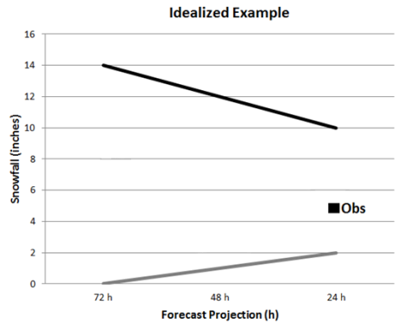
Idealized Situation
As Storm Nears…
  Range of Possibilities Shrinks
  Confidence Increases
NWS Forecast
Between Max/Min
Max
Max
Max
Snowfall (inches)
NWS Forecast; Most Likely
Actual
Snowfall
Min
Min
3 Days 2 Days 1.5 Days 24 Hrs 12 Hrs Snow +6 Hrs +9 Hrs Snow
Storm Timeline
Starts Ends

Slide 17
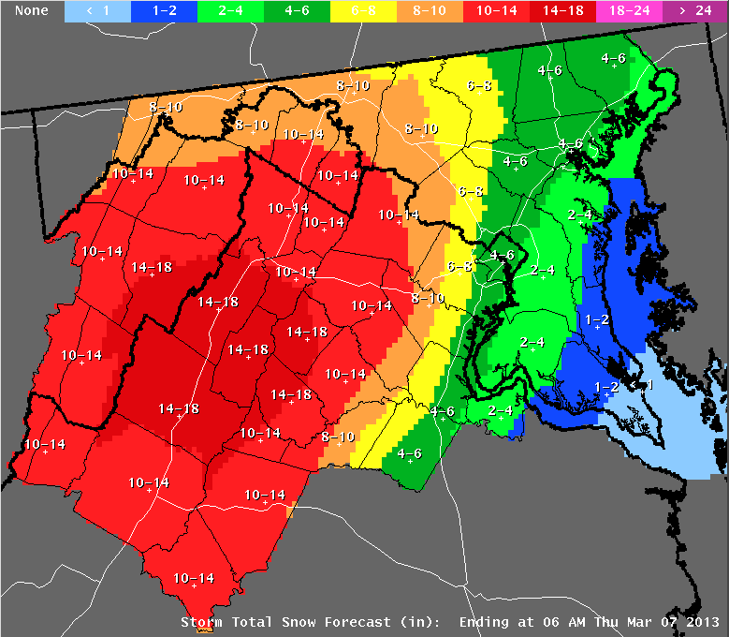
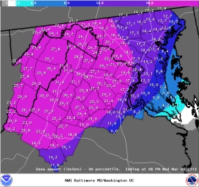
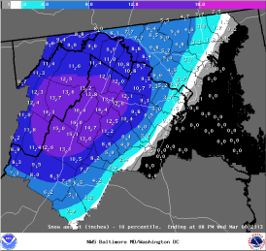
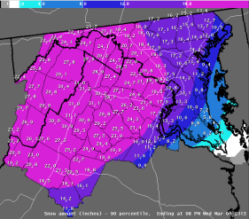
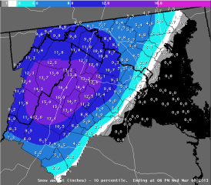
Min/Max/Most Likely Graphics
Minimum
Most Likely
Maximum
Expect at least this much
Official NWS Forecast
Potential for this much

Slide 18

Max/Min/Likely
Better Communication
of Range of Possibilities
  3 New Snow Products
    Explain the Uncertainty in the Snowfall Forecast
  When We Communicate Uncertainties…
    Provide the “Goal Posts” of Possibilities
    People Can Make Better Decisions
      Leads to Less Impact on the Economy & Society

Slide 19
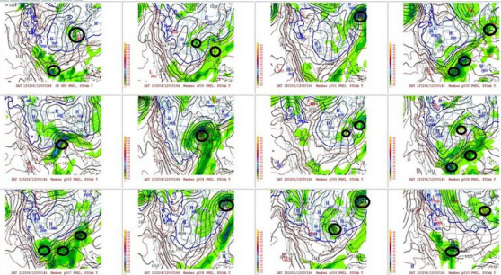
What Science is Behind This?
Provided from ensemble of atmospheric models
Ensemble: Many different models of the atmosphere that show possible differences in forecast weather
32 Pieces
21 SREF
6 GEFS
1 GFS
1 NAM
2 Euro
1 Canadian

Slide 20
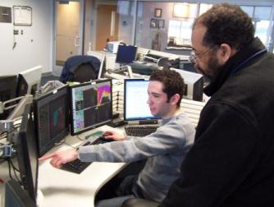
What Science is Behind This?
Forecasters at WFO Sterling:
  Evaluate computer guidance before being released
Final product combines:
  Forecaster Knowledge/Experience
  Computer Model Ensembles

Slide 21
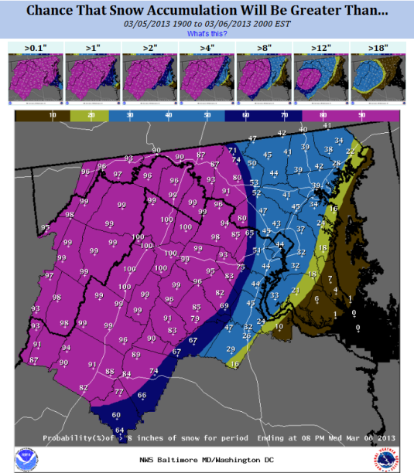
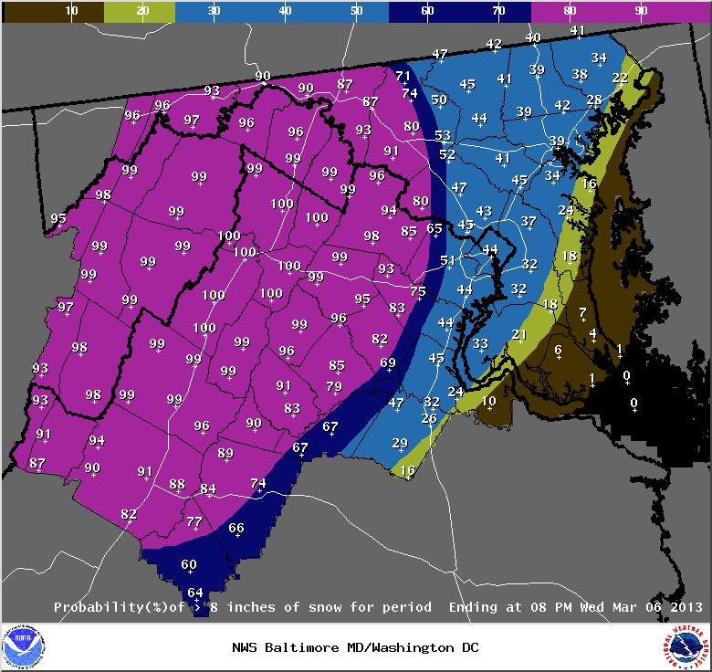

Exceedence Graphics
Allows user to evaluate threat for their thresholds
Mouse over desired amount and image appears on large screen
> 0.1”
> 1”
> 2”
> 4”
> 8”
> 12”
> 18”

Slide 22
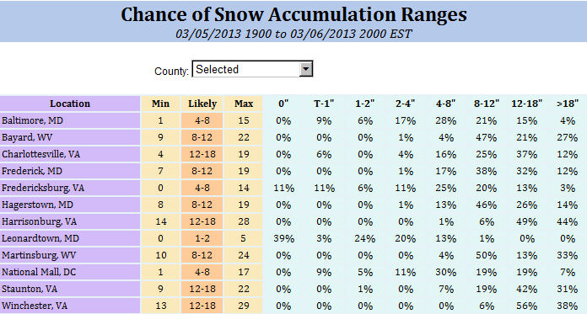
Table of Probabilistic
Snowfall Accumulations
User can see threat of all possible scenarios for their town

Slide 23
How Can This Help Me?
Better Communicating Uncertainty Leads To…
    Decision makers can weigh cost of taking action based on a range in forecasts vs. potential loss if no action is taken
    Some plan for worst case; others need most likely
    Ideally no surprises for anyone
    Less impact from winter storms through better planning & decision making

Slide 24

Summary
NWS WFO Baltimore/Washington DC issues snow forecasts for the range of possibilities in snow amount
3 new products (In addition to what was always issued)
  “Maximum / Most Likely / Minimum” maps
  “Chance of Exceeding” maps
  “Probability of Ranges” table
New winter weather webpage
  http://www.erh.noaa.gov/lwx/winter
Communicating uncertainty to decision-makers
  Minimize Winter’s Impact on the Region

Slide 25
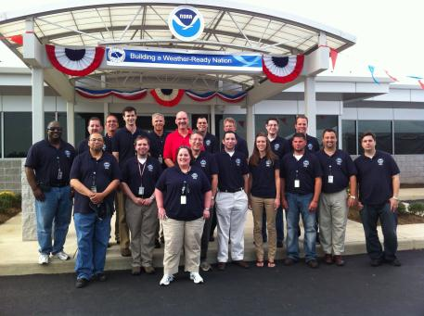

Summary
Events like 1979 storm have and will happen again
Advances in forecasting extreme cyclogenesis must be communicated to key core partners to get proper response
Heart of Weather-Ready Nation:
  “A Nation that is prepared for and responds to hazardous weather events”
WFO Sterling Staff
WRN Open House
October 2012

Slide 26


Questions?

