Slide 1
Evolution in identifying High Impact Weather Events since 18-19 February 1979
Richard H. Grumm
National Weather Service
State College, PA
Contributions:
Trevor Alcott WR/SSD
Randy Graham WR/Salt Lake City
Robert Hart FSU

Slide 2
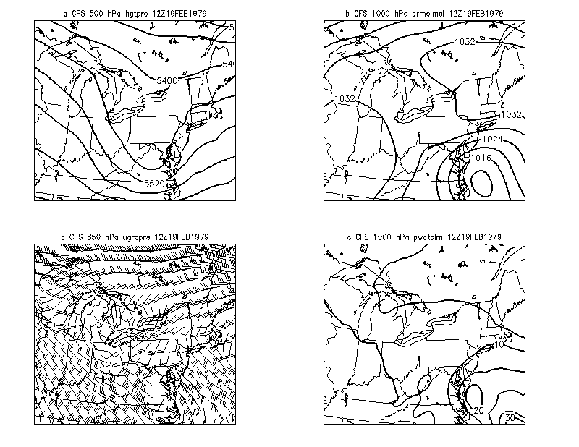
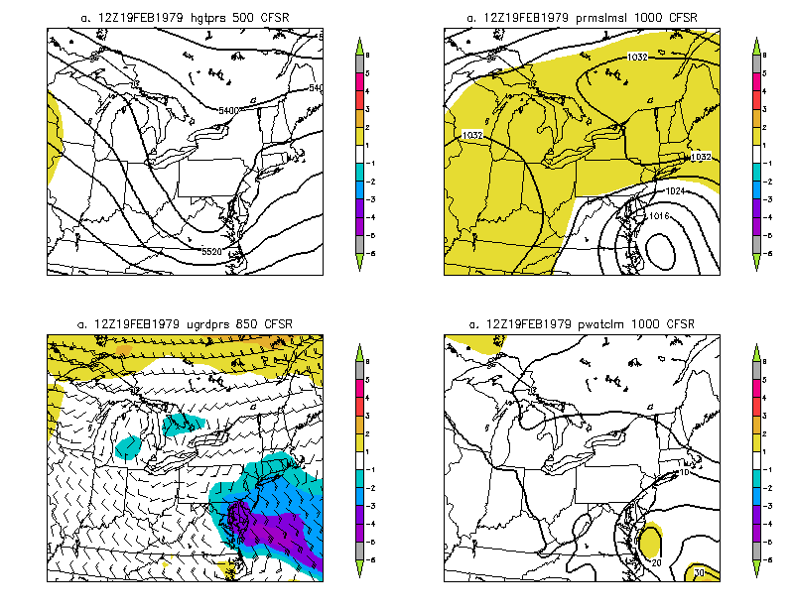
“The greatest snowstorm in more than half a century left the Washington area smothered under at most two feet of snow yesterday — a magnificent white menace that virtually imprisoned the city and sent road crews battling to reopen streets for this morning’s commuters.” Wash. Post 1979
1970s Traditional view
Using R-Analysis

Slide 3
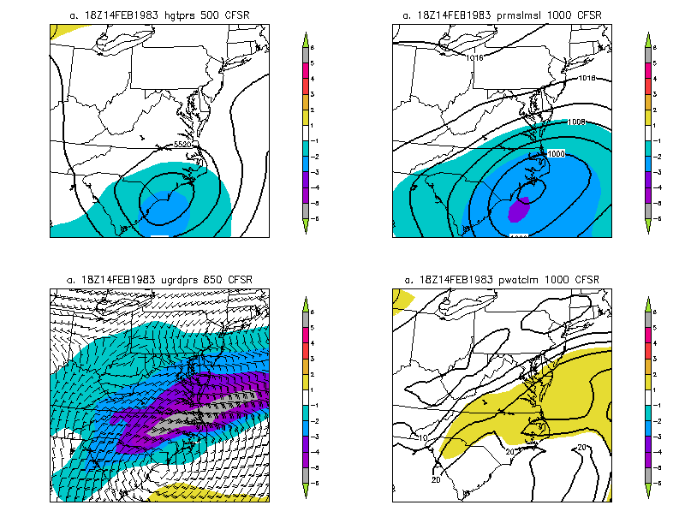
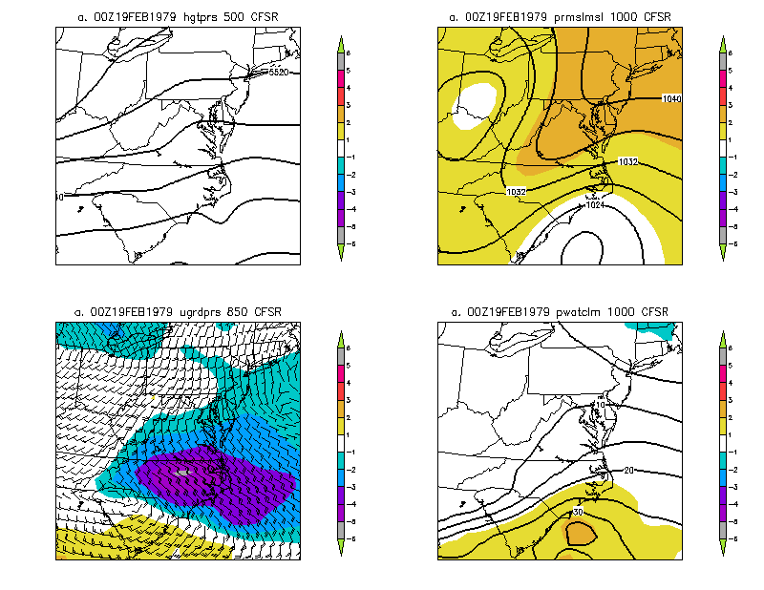
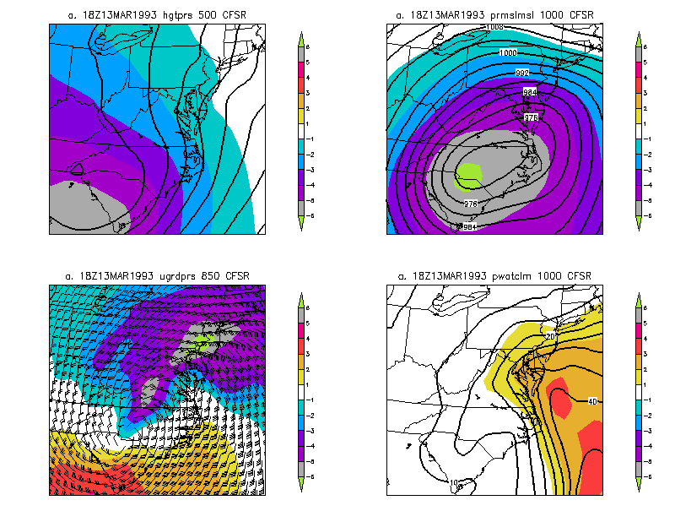
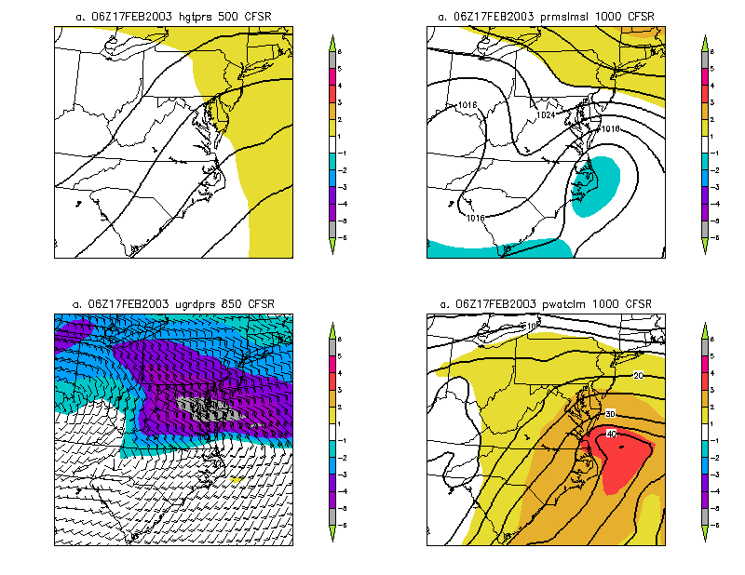
HIWE: Snow Storms over 30 years

Slide 4
R-Climate and HIWE
Traditional Standardized anomalies facilitate identifying features associated with significant high impact weather events
Remove the guessing improving identification of larger scale high impact weather events (HIWE)

Slide 5
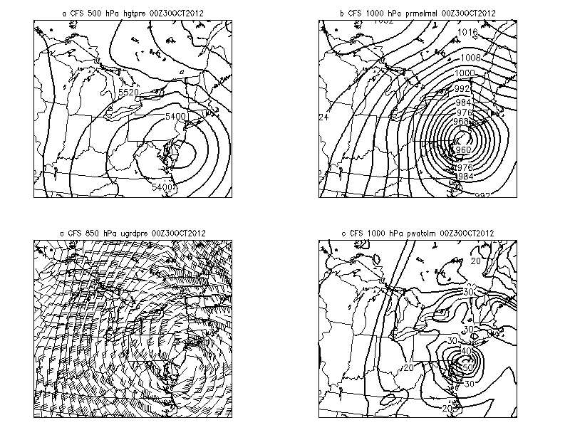
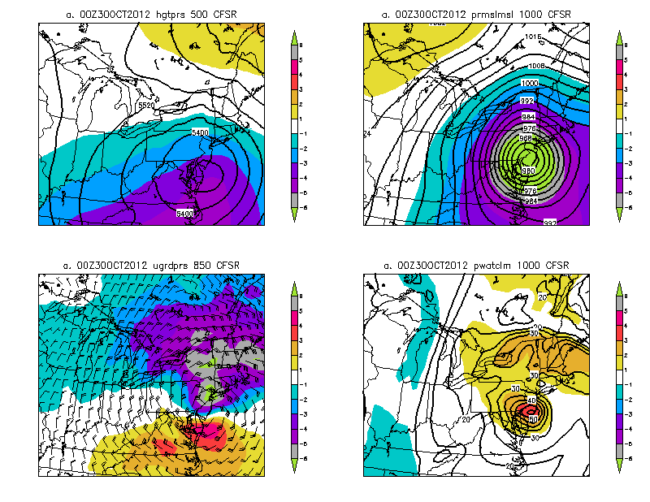
Sandy was a dandy

Slide 6
R-Climate and HIWE
Traditional Standardized anomalies facilitate identifying features associated with significant high impact weather events
Remove the guessing improving identification of larger scale high impact weather events (HIWE)
Now we can leverage the full PDF→ find extreme outliers

Slide 7
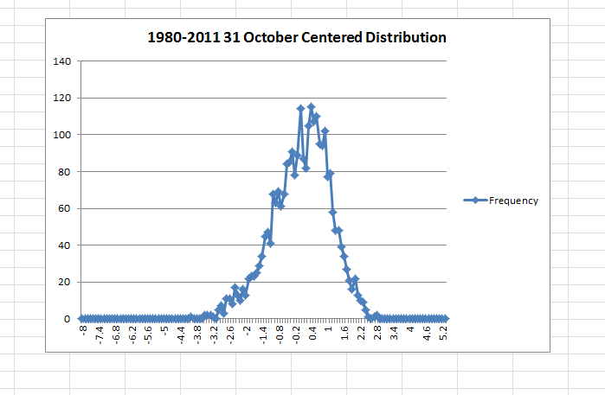
The Mean Sea-level Sandy if we know the PDF and the forecast automation can provide alerts to extreme events in tails of any distribution

Slide 8
R-Climate and Forecasts Simulation 0000 UTC 17 February 1979
Use 3-4 images from WRF-EMS runs for brevity (runs completed in grib2)
Traditional MSLP and QPF
MSLP with Standardized anomalies
Surface cyclone was not so impressive→ anticyclone was!
Show GEFS traditional “Superstorm” images

Slide 9
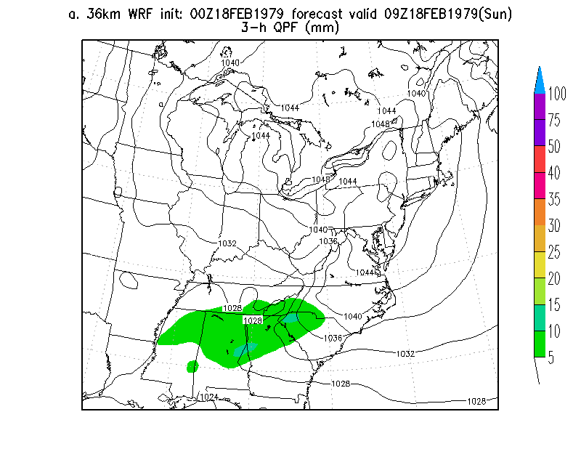
Traditional MSLP/3-hour QPF

Slide 10
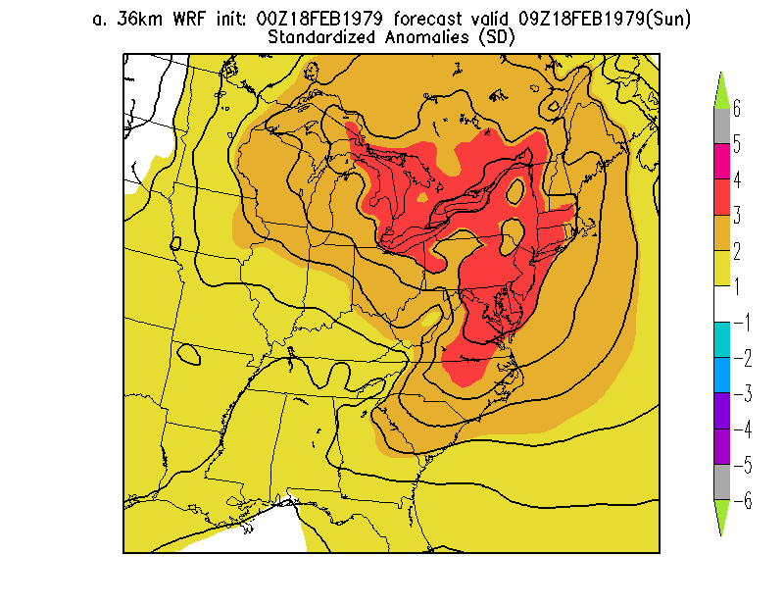
MSLP and Standardized Anomalies

Slide 11
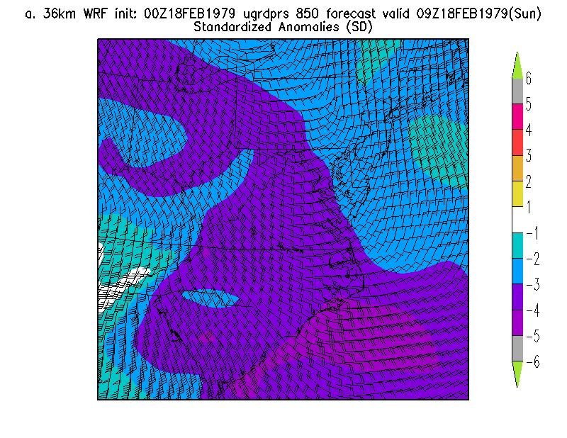
Magnificent 850 hPa wind anomalies

Slide 12
R-Climate
The WRF simulations nailed the -6σ LLJ
Critical feature with historic East Coast winter storms
WRF nailed the massive anticyclone
Nailed snow too but not enough time to show
Standardized anomalies analysis had proven to be of great use in identifying high impact weather events in recent years. They would have been of Great Value in 1979 too!

Slide 13
GEFS-R
For another case
No good data available for this event
But have a proxy event→ 13-14 March 1993

Slide 14
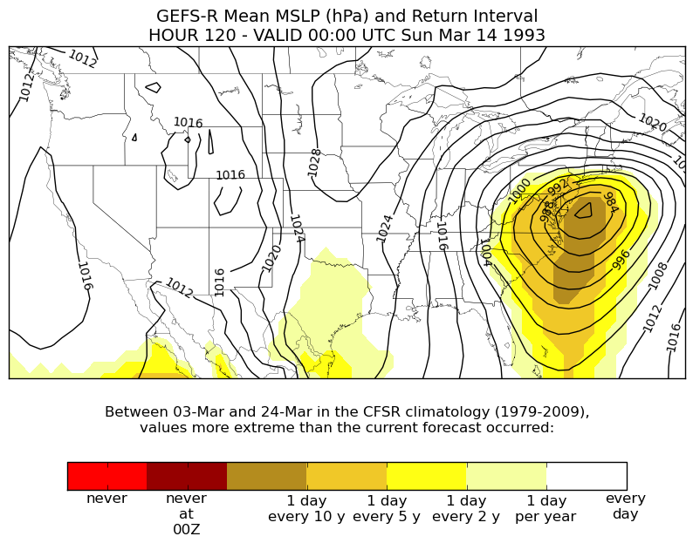
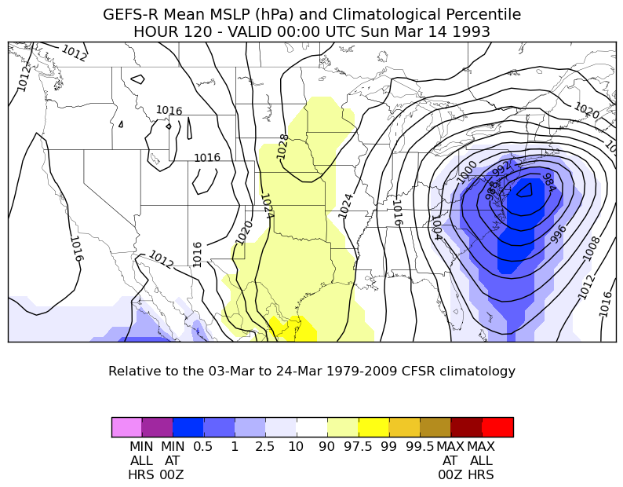
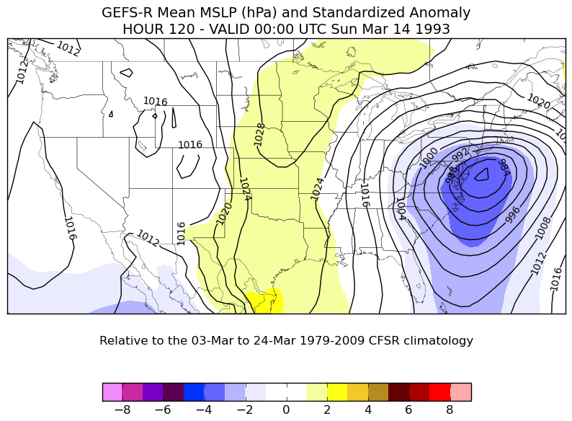
R-Climate Anomalies

Slide 15
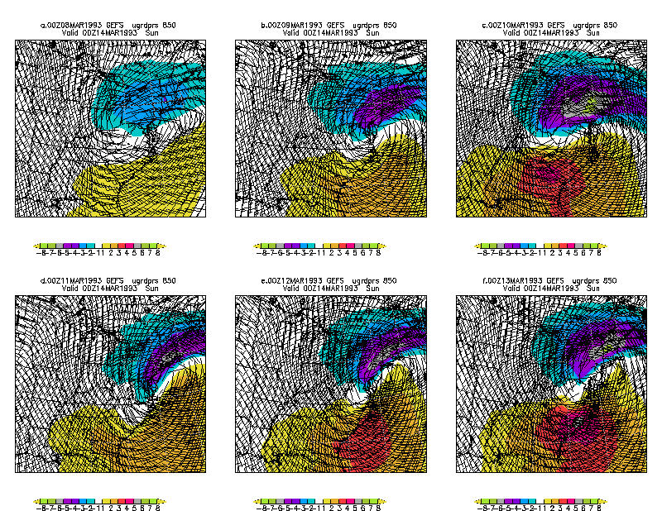
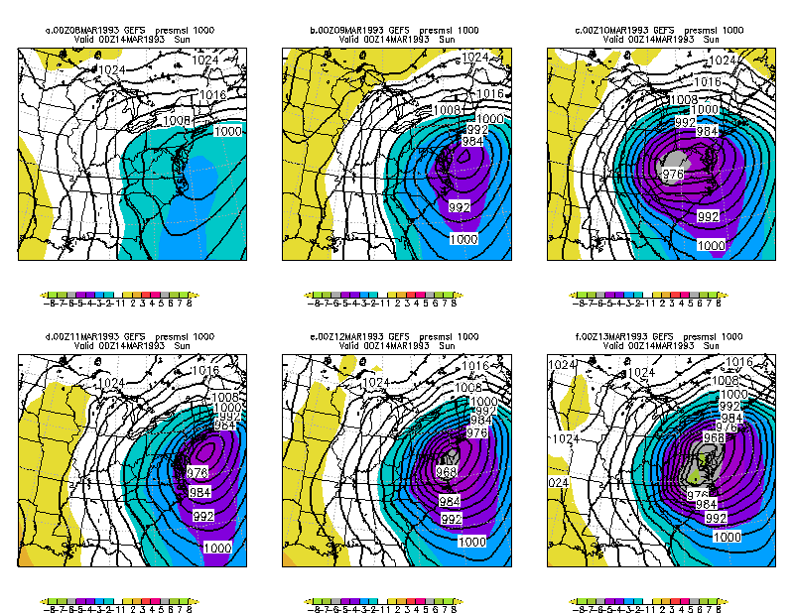
GEFS-R Proxy case March 1993 superstorm

Slide 16
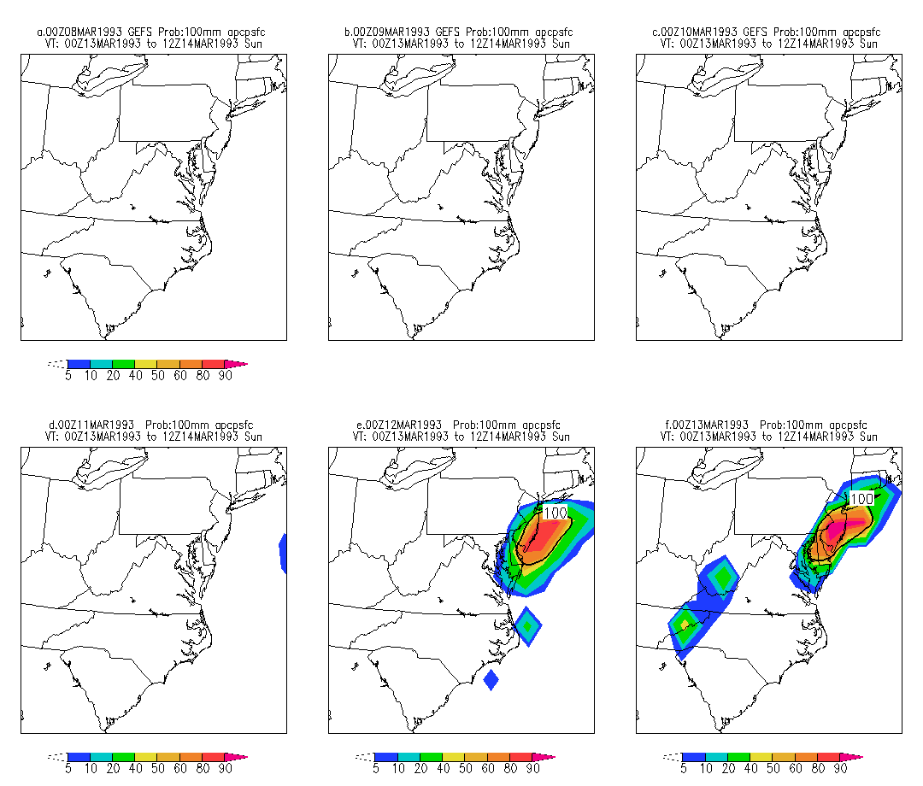
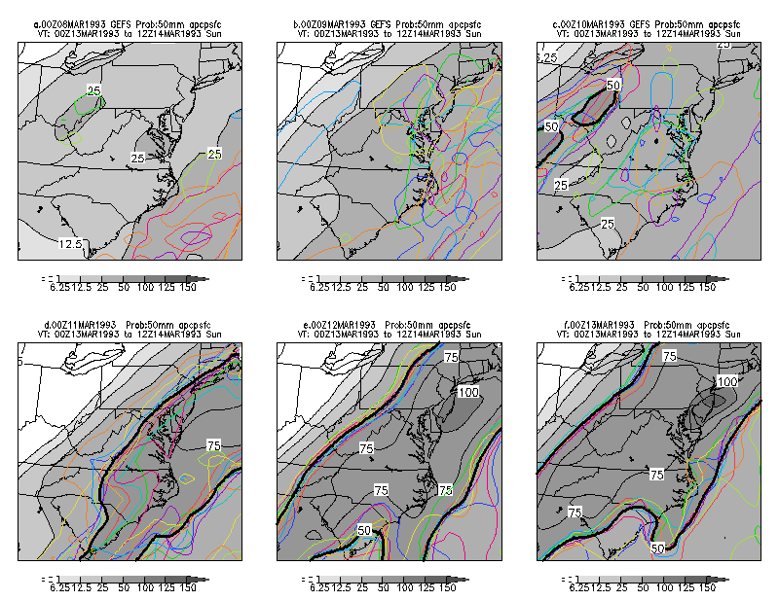
Big QPF amounts shorter lead-times

Slide 17
Leveraging the full R-Climate PDF works with automation/bots
Current NWS has WR-Situational Awareness
Identifies strongly forced high impact events
IDSS for significant large scale events
Could provide inputs for Algorithms
Extreme forecast indices→ R-Climate based
Extreme weather alerts regional and locally
Exploitable PDF EFS and EFS PDF verse R-Climate

Slide 18
Zonal Wind Anomalies
120 hour Forecast – Valid 00Z Mar 14 1993
700 hPa
850 hPa
120 hour forecast
700 hPa: -3 to -4 σ
850 hPa: -4 to -5 σ
Significant values at 120 hours
72 hour forecast
-4 to -5 σ at both 700 & 850 hPa
24 hour forecast
700 hPa: -4 to -5 σ
850 hPa: 5 to -6 σ
Displaced to the northwest
72 hour Forecast – Valid 00Z Mar 14 1993
700 hPa
850 hPa
24 hour Forecast – Valid 00Z Mar 14 1993
700 hPa
850 hPa

Slide 20
Model Climate (M-Climate)
Probability distribution functions from EFS or single model
EFS and M-Climate based EFI
When is model predicting a record or near record event
Another means to add value to the forecast
Another HIWE alert opportunity
QPF is the best starting point for this activity

Slide 21
As we move foreword
Leveraging seemingly disparate datasets
We can improve identification of high impact weather events and thus decision support activities
Tools but the forecaster over the process
Lends well to automation and automated alerts
Where to focus activities and resources
Few surprises

Slide 22
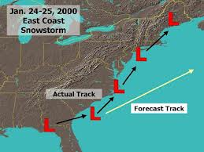
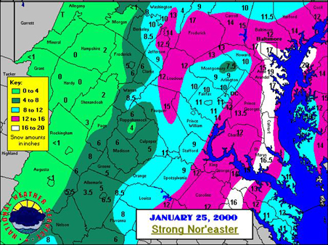
BOTS will be watching it like a hawk…

