Slide 1
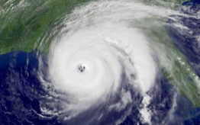
A First Look at Hurricane Sandy
Dr. Louis W. Uccellini
National Centers for Environmental Prediction
Director
Town Hall Meeting: Hurricane and Post-Tropical Cyclone Sandy: Predictions, Warnings, Societal Impacts and Response
AMS Annual Meeting
Austin, TX
January 7, 2013
“Where America’s Climate, Weather, Ocean and Space Weather Services Begin”

Slide 2
Outline
Surface Characteristics of Sandy
Forecasts for Sandy (from the forecaster perspective)
Communication Strategy
Initial Look at Models used by Forecasters
Verifications
Issues/Challenges – Ongoing Experiments
Summary

Slide 3
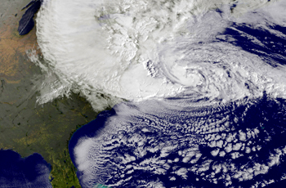
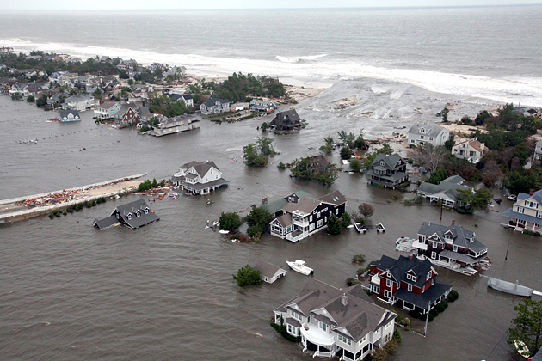
Surface Analysis: Friday October 26 – Tuesday October 30, 2012
Oct 26
Oct 27
Oct 28
Oct 29
Oct 30

Slide 4
Hurricane Sandy: Extra Data
Extra radiosonde deployment over an 8 day period
received over 600 additional soundings across continental US (CONUS)
First time this was done across CONUS for any storm in a real-time mode
Aircraft data
NOAA P3, G4, USAF C130J
NOAA G4 tasked earlier than usual to obtain info on steering current
4

Slide 5
Forecasts for Sandy (from the Forecaster Perspective)

Slide 6
Jet Stream 10/29/12 12Z (Blue) Uncertainty in Sandy’s track
Jet Stream forms a pattern like a Greek Ω (Omega)
Jet Stream
H
L
Jet Stream
L
Sandy
10/29/12 12Z
Jet Stream
Possible tracks as Sandy interacted with Omega Block

Slide 7
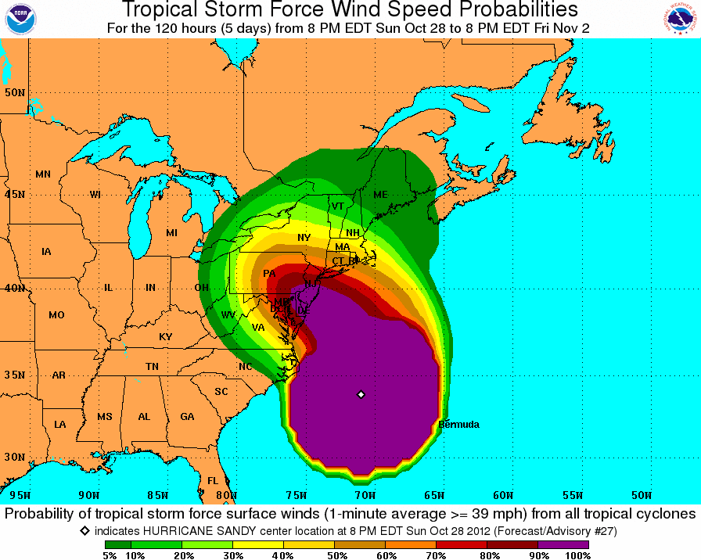
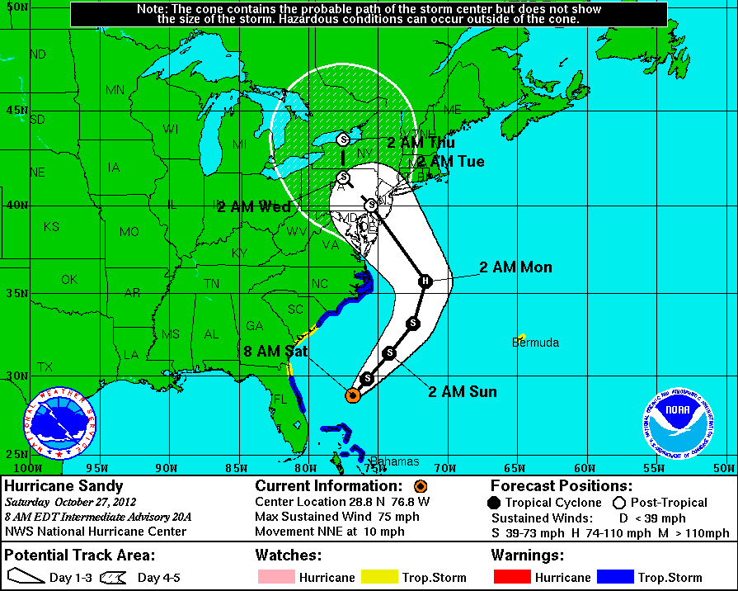
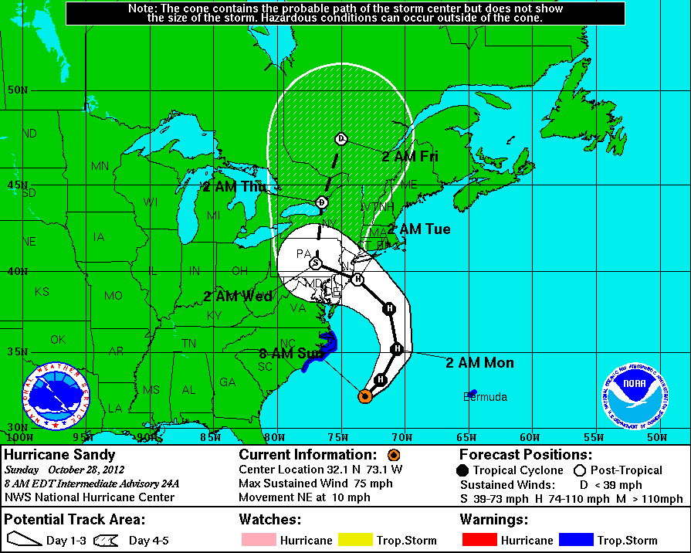
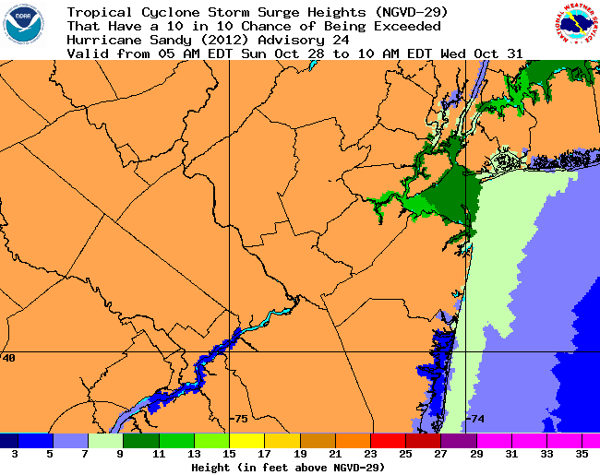
Hurricane Sandy: Collaborative Forecast Process
Outlook Issued Oct 23
8PM Oct 28 – 8PM Nov 2
Heavy Rain
Oct 27
High Winds
NHC - Wind Speed and Surge Height Probabilities
Oct 28
CPC – Outlooks, Hazards Chart, 5 days in advance
10% exceedence
5AM Oct 28 – 10AM Oct 31
National Hurricane Center
– Hurricane Track/Intensity
7

Slide 8
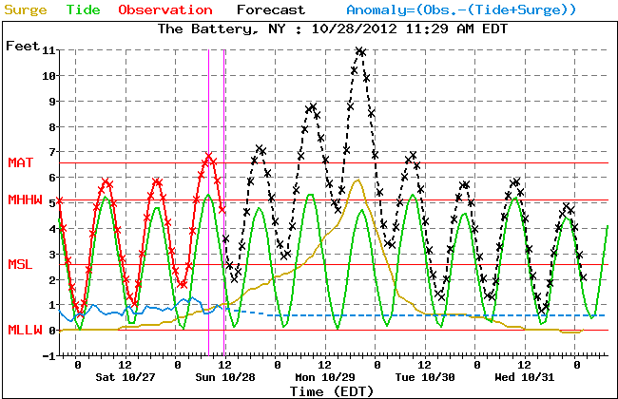
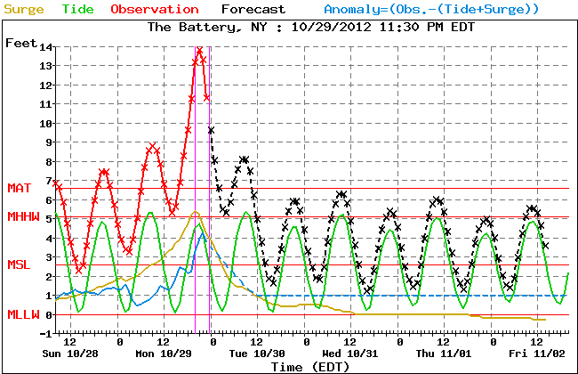
Hurricane Sandy: Collaborative Forecast Process
MDL NWS Surge Guidance and Verification:
Forecasts were coordinated among NHC, OPC, local WFOs
“Life Threatening” statements issued Sunday morning by NHC and called into NYC Emergency Operations Center;
NYC initiates evacuations and shut down of public transportation shortly thereafter
8

Slide 9
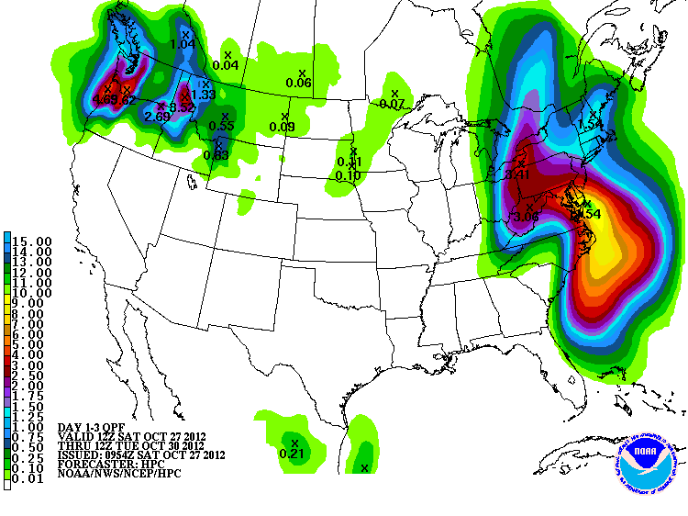
Hurricane Sandy: Collaborative Forecast Process
HPC – QPF and Winter Weather Desk Snow forecasts
72 hour Precipitation Forecast: Oct 27 –Oct 30
3 day Snow Total: valid Oct 28-Oct 30
9

Slide 10
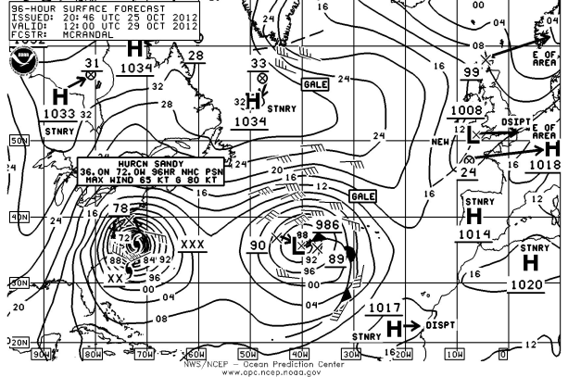
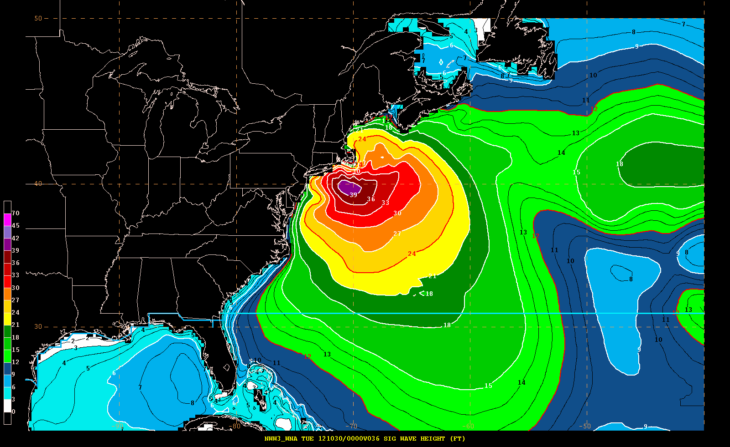
Hurricane Sandy: Collaborative Forecast Process
OPC – 96 hour surface chart
EMC – Wave Model forecasts
36 hour wave height forecast (ft)
10

Slide 11
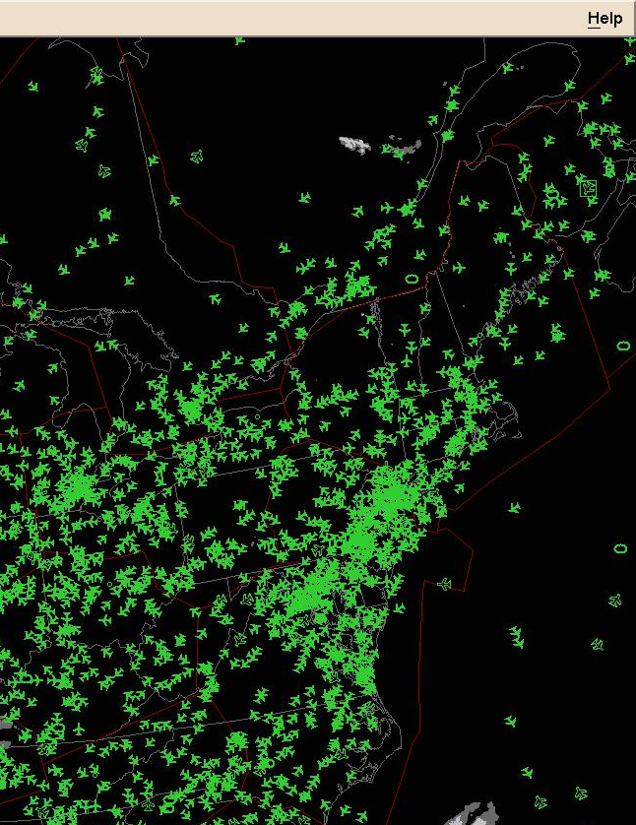
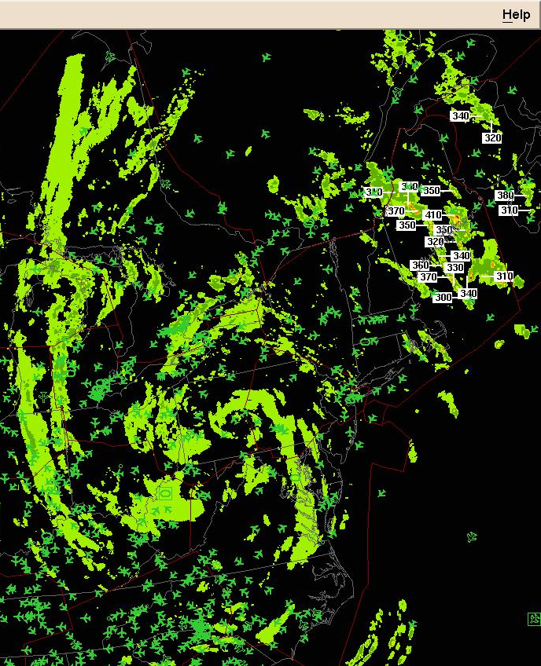
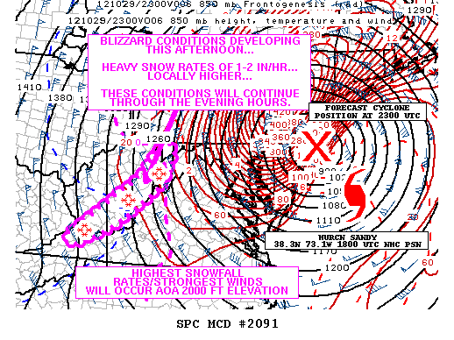
Hurricane Sandy: Collaborative Forecast Process
AWC – briefings for FAA staff: current weather, timing of impacts at facilities and airports, outlooks for recovery, coordinated with WFOs and CWSUs
Normal air traffic
Air traffic during Hurricane Sandy
SPC – Mesoscale Discussion highlighting blizzard conditions in the Appalachians
11

Slide 12
Hurricane Sandy: Communication Strategy
Forecaster collaboration across All NCEP Centers, WFOs and Other NOAA LOs (NESDIS, NOS, OMAO); Specific local forecasts issued by WFOs
All special messages and linkages to local emergency centers through WFOs
Focused outreach from Friday to Monday resulted in consistent message delivered to insure decision makers and the general public understood the dangerous impacts associated with Sandy
12
12
Notes:
12

Slide 13
Hurricane Sandy: Communication Strategy
Messaging Focused on Impact-Based Decision Support Services
Unique nature of storm (tropical to extratropical transition
Large area affected by strong winds
East to west track toward NJ
Record surge/inundation in NJ→ NYC→ SE New England
Record blizzard in Appalachian Mountains & WV
Threats emphasized particularly dangerous storm – “worst case scenario” compared to the Perfect Storm
13
13
Notes:
13

Slide 14
Initial Look at Models Used by the Forecaster

Slide 15
Hurricane Sandy: All Charts Valid 12Z October 29, 2012
Surface Analysis
7 day forecast
6 day forecast
5 day forecast
4 day forecast
3 day forecast
2 day forecast
1 day forecast

Slide 16
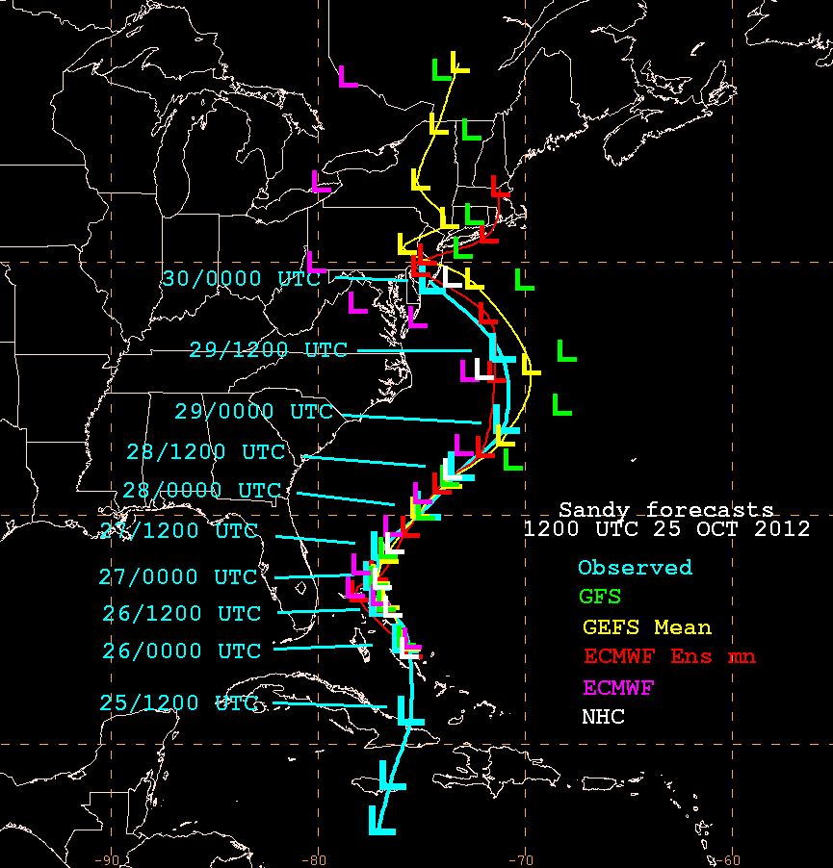
Forecasters Use Ensemble Means for Official Track Forecasts

Slide 17
Low Track Forecast – 1.5 days prior to landfall
* Note the ensemble spread at each forecast time.
SREF predicted acceleration of storm 36 hours of before landfall
Storm acceleration still underforecasted
Is acceleration a function of the interaction of Sandy with the extratropical trough? The blocking ridge? Both?
Storm accelerated towards New Jersey coast

Slide 18
Verification

Slide 19
Hurricane Sandy
October 21, 2012 0345Z through October 31, 2012 1315Z
National Hurricane Center's 5 day forecast track issued at 11 a.m. EDT on Thursday, October 25

Slide 20
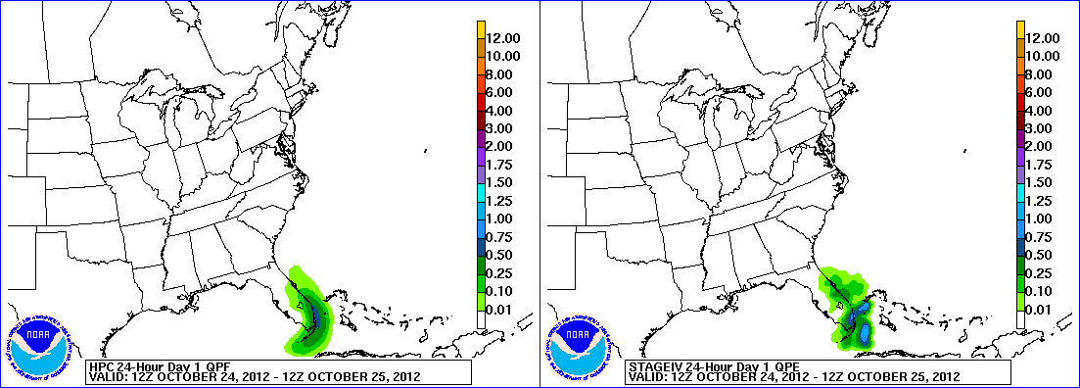
Hurricane Sandy Precipitation
HPC Forecast
Verification
October 24 – November 1, 2012

Slide 21
3 day Snow Total: valid Oct 28-Oct 30
Snow Totals (Inches)
...WEST VIRGINIA...
CLAYTON 2 NNW 33.0
QUINWOOD 29.0
DAVIS 28.0
FLAT TOP 28.0
HUTTONSVILLE 5 WSW 28.0
CRAIGSVILLE 26.0
ALEXANDER 24.0
ALPINE LAKE 24.0
KITZMILLER 24.0
MINGO 2 SSE 24.0
NETTIE 24.0
TERRA ALTA 24.0
BAYARD 22.3
BEVERLY 21.0

Slide 22
Issues/Challenges – Ongoing Experiments

Slide 23
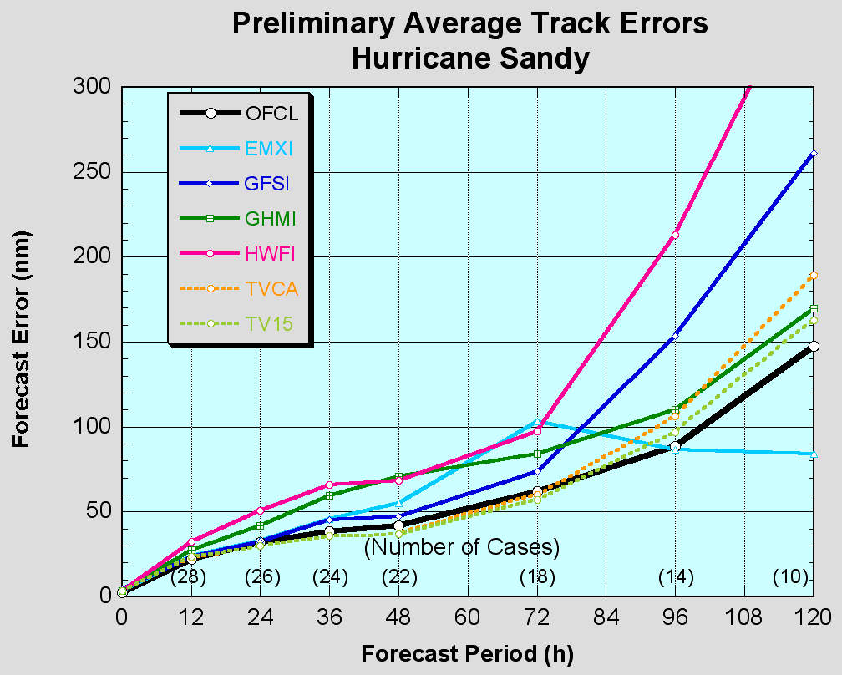
NHC Review of model performance for the entire 2012 Atlantic Hurricane Season by NHC lead hurricane forecaster Richard Pasch
“Busy season for the NHC;445 TC forecasts issued for Atlantic Basin (long term mean is ~340)”
“GFS (slightly) better than ECMWF at most forecast intervals in the Atlantic for track and was generally the best individual model; kudos to EMC”
ECMWF outperformed all models at four days and beyond

Slide 24
Some Ongoing Experiments
Higher Resolution Ensemble Forecasts
Data Denial Experiments

Slide 25
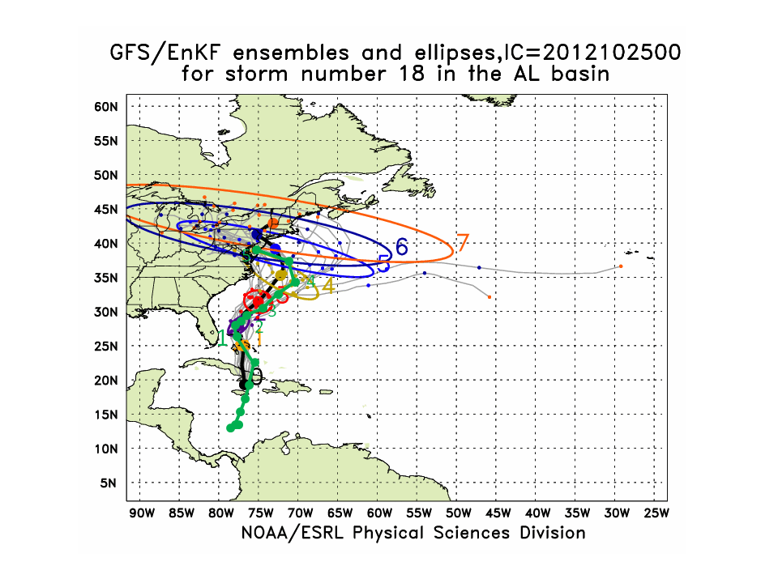
Higher Resolution HFIP Global Ensemble Forecast for Hurricane Sandy
from
00Z Thursday 10/25/12 (8pm EDT Wednesday 10/24/12)
Numbers indicate time in days from beginning of forecast
Ensemble Mean
5 day forecast before landfall
OBS
Sandy Named 10/22/12 06Z
Provided by Jeff Whitaker (ESRL)

Slide 26
Sensitivity Experiments
Special raobs launched at 06 and 18Z (615 over 8 days)
The supplemental radiosondes were assimilated in the operational GDAS/GFS 06 and 18Z cycles
A data denial experiment with and without the special soundings was carried out using the operational configuration of the NCEP GDAS/GFS to review impact on track, speed and run-to-run consistency
Excluding the 06 and 18Z CONUS radiosonde data
Initialized using the operational GFS initial conditions at 18Z 25 Oct 2012
Last cycle executed was 12Z 30Oct2012
Fully cycled with data assimilation

Slide 27
2012102600 cycle
2012102606 cycle
Track Forecasts

Slide 28
2012102700 cycle
2012102712 cycle
Track Forecasts

Slide 29
Surge Issues
Surge forecast heavily dependent on track/fetch
Model forecasts for NYC and surrounding areas were record setting but still under-forecasted
Model calibration needed for extratropical systems affecting NYC: still ongoing

Slide 30
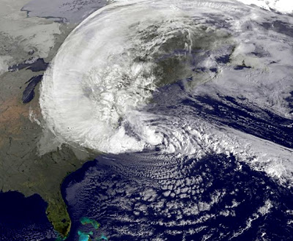
Summary
Forecasts were generally based on ensemble model approach (from U.S., Europe and Canada). ECMWF higher resolution deterministic and ensemble models provided first alert (7+ days in advance) with remarkable accuracy
Be careful with overgeneralizations, GFS had best track forecasts for 2012 season
Beginning Thursday – Friday: NOAA/NWS communicated/coordinated all forecasts with FEMA/emergency management community; NHC provided briefings to the White House
Media coordination started on Friday and continued through the event
Conveyed consistent forecast message on the historic nature, unique characteristics and destructive potential for this storm
Westward track
Large size
Destructive surge (historic levels)
Tropical – extra tropical transition
Heavy precipitation
Record setting blizzard conditions
Evacuations initiated 60-72 hours in advance
The forecasts saved lives!
Primary model issue: ongoing HFIP research points to enhanced resolution for deterministic and ensemble systems

Slide 31
Appendix

Slide 32
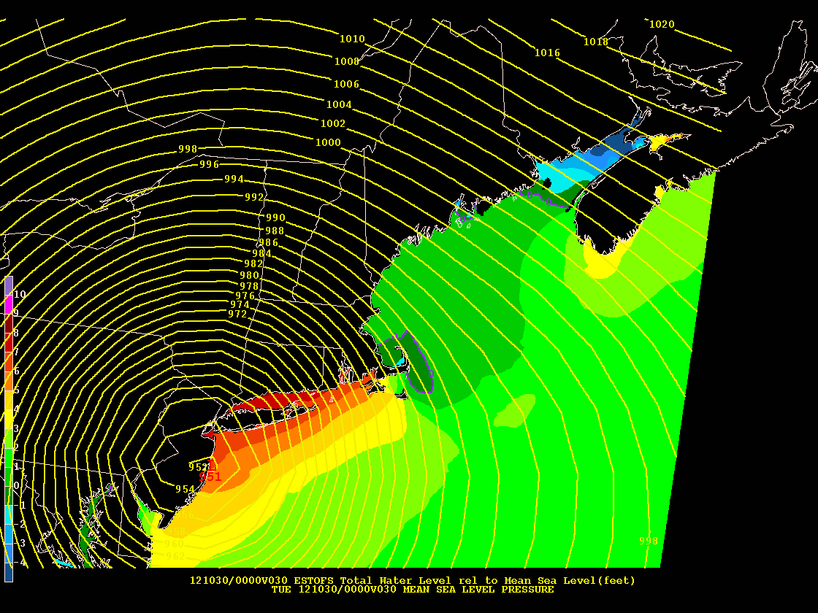
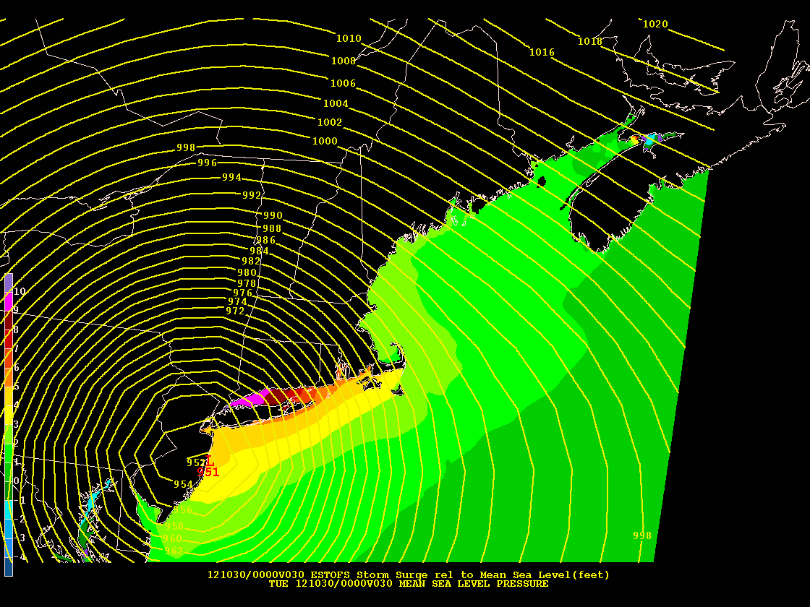
Extratropical Storm Surge
Extratropical Surge and Tide Operational Forecast System (ESTOFS)
Storm Surge relative to MSL(feet)
30 hour forecast
Initial time: 2PM Sunday, Oct 28
Extratropical Surge and Tide Operational Forecast System (ESTOFS)
Total Water Level (feet)
30 hour forecast
Initial time: 2PM Sunday, Oct 28
A collaboration between the NOAA/NOS/Coast Survey Development Lab and NOAA/NCEP

Slide 33
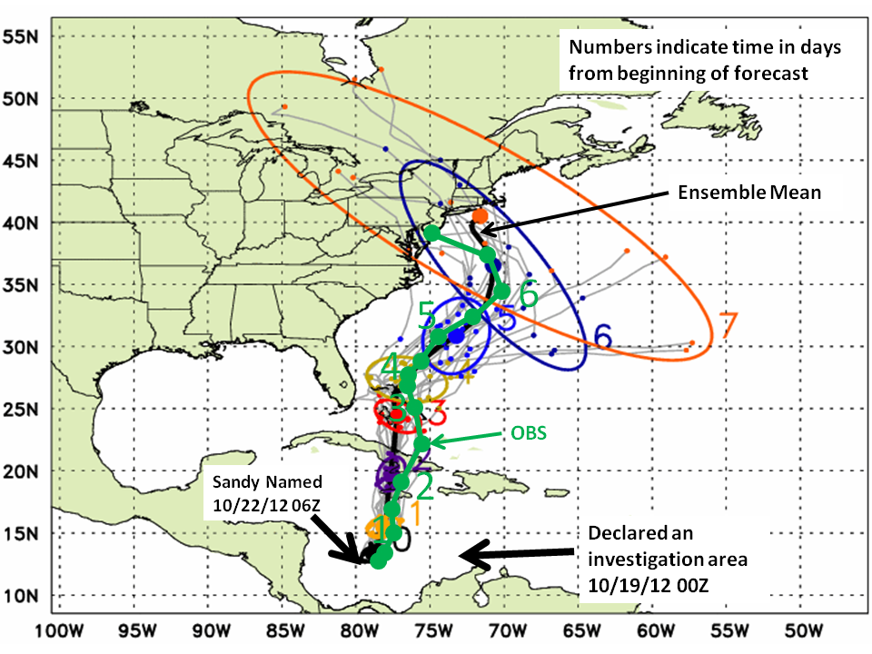
Higher Resolution HFIP Global Ensemble Forecast for Hurricane Sandy
from
00Z Tuesday 10/23/12 (8pm EDT Monday 10/22/12)
7 day forecast before landfall
Provided by Jeff Whitaker (ESRL)

